Slide 1
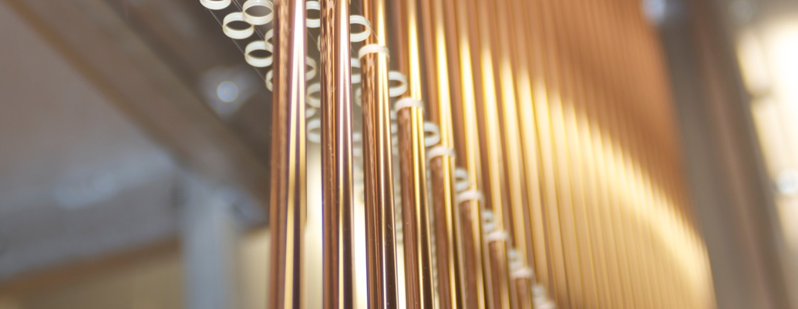
Straw tracker
Notes:
First of all I wish to thank for the invitation and the good reception the Conference organizer. I want to took about straw tracker in the different experiment.
Добрый день. Прежде чем начать доклад о строу трекере СПД расскажу немного о принципах детектирирования при помощи строу трекера.

Slide 2
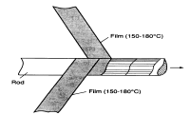
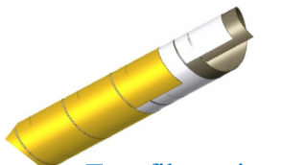
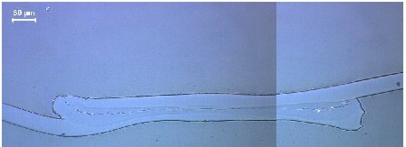
Two design of the straw-tube production
Microscope pictures of a straw cross- section for quality control of the weld
Straw winding. Two films revolve and stick together among themselves.
Ultrasonic welding of straws
Notes:
The most popular two ways to manufacture straw. Wilding and ultrasonic welding. Two films revolve and stick together among themselves. This method has several drawbaks. One of which is elongation straw and falling tension. The advantage is a large overpressure limit. It is possible manufacture small radius straw-2mm. Some detector prepared in the straw group in LHEP may be used in the NA64.
Another method are ultrasonic welding and produced about 15km straw tubes in the NA62.

Slide 3
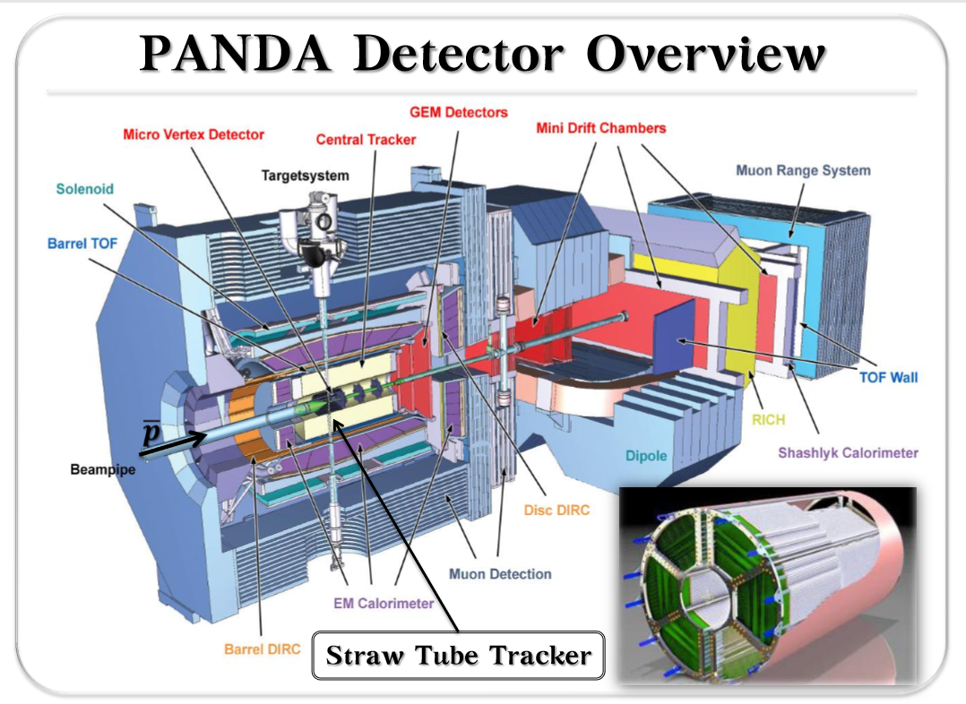
Notes:
The panda experience can be very useful for use in a barrel detector.

Slide 4
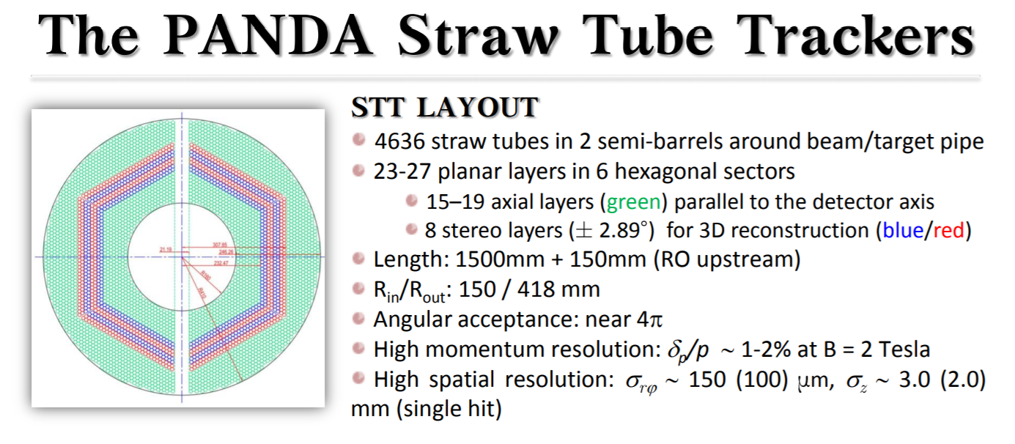

Slide 5
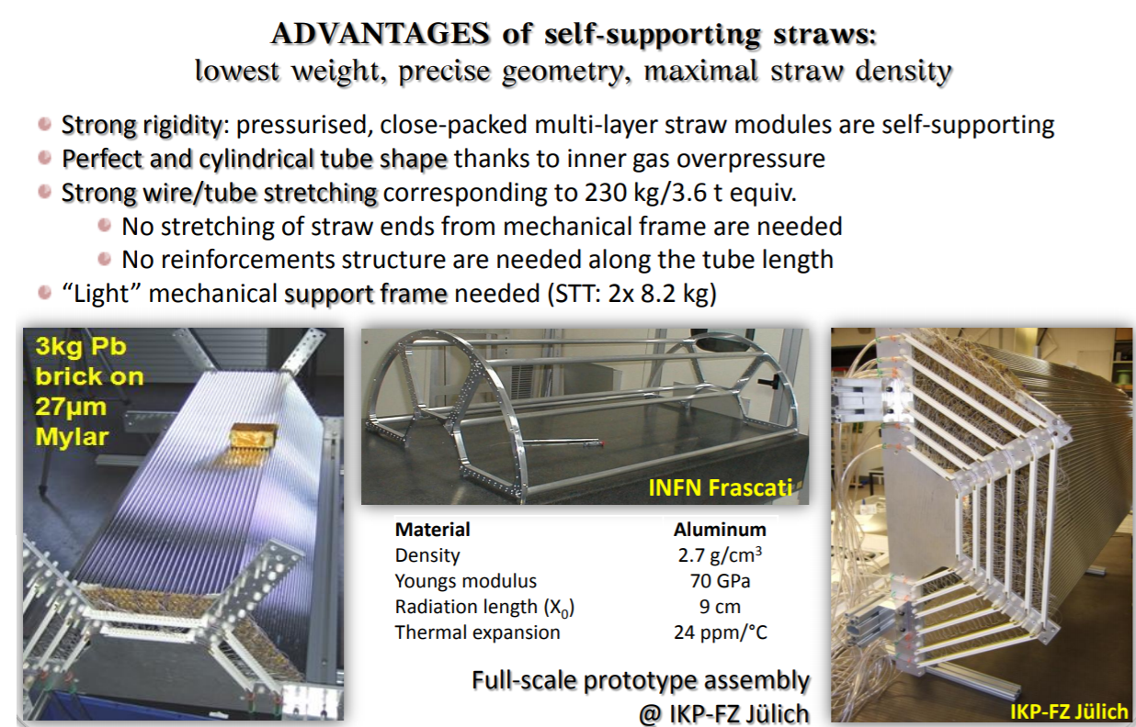

Slide 6
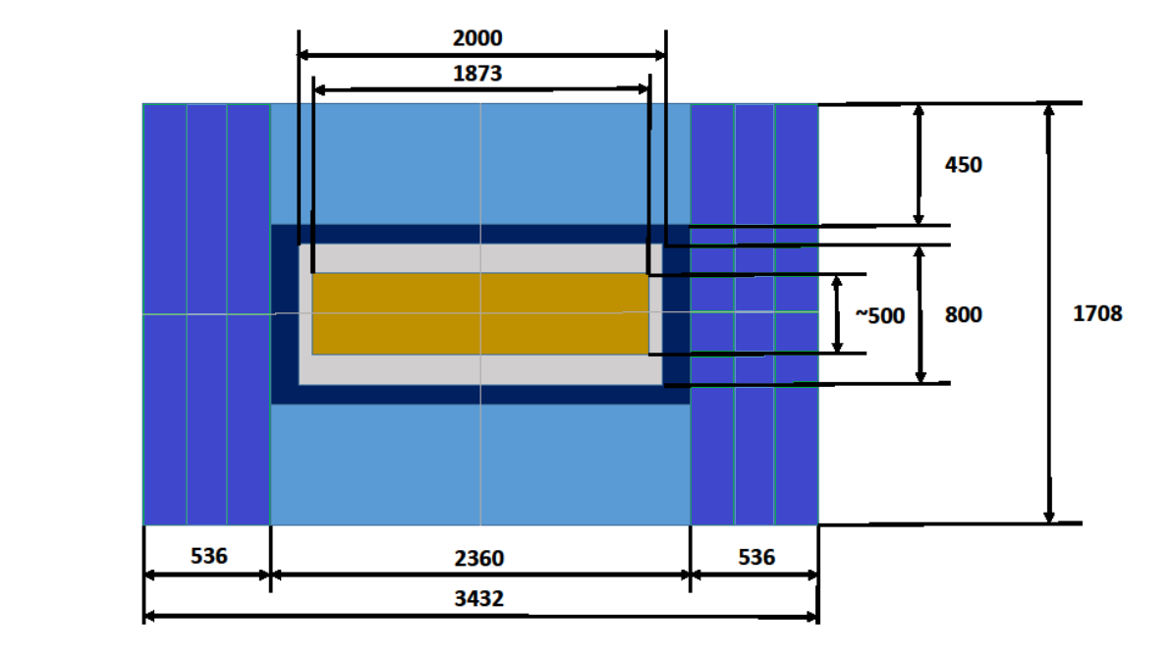
barrel
endcap

Slide 7
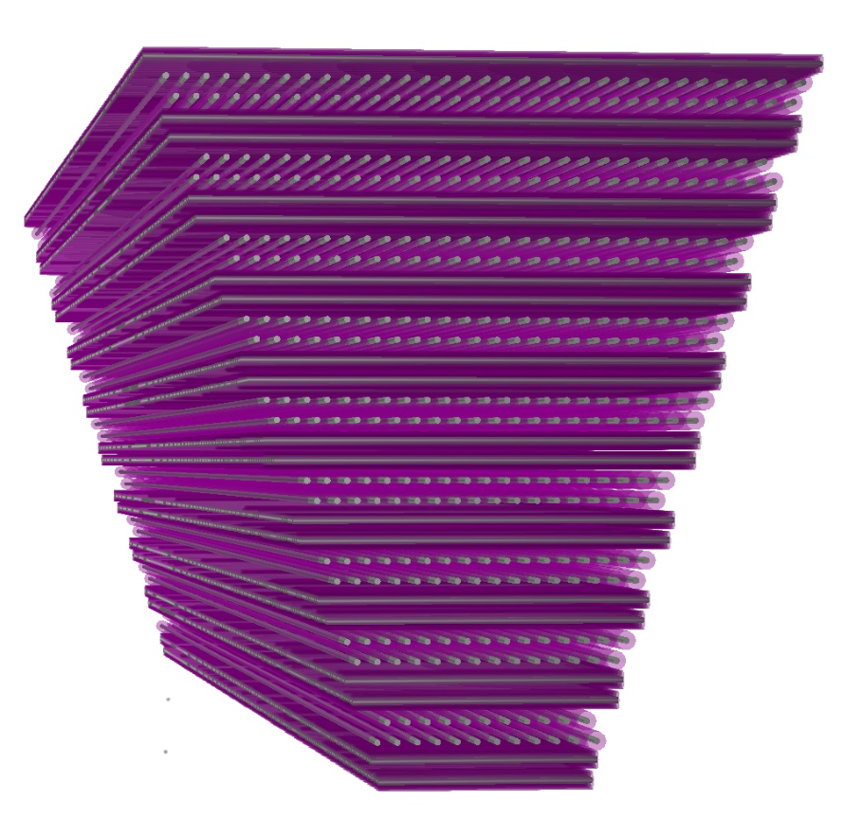
BARREL STRAW TRACKER
600
450
2300
300
8 XY(optional UV) wedge-shaped straws stations
Straw tube with 10mm diameter, in the center a 30mkm diameter gold-plated tungsten wire
Precision measurement ~150 mkm
The number of layers and the number of straws are discussed. About 45 layers are now assumed

Slide 8
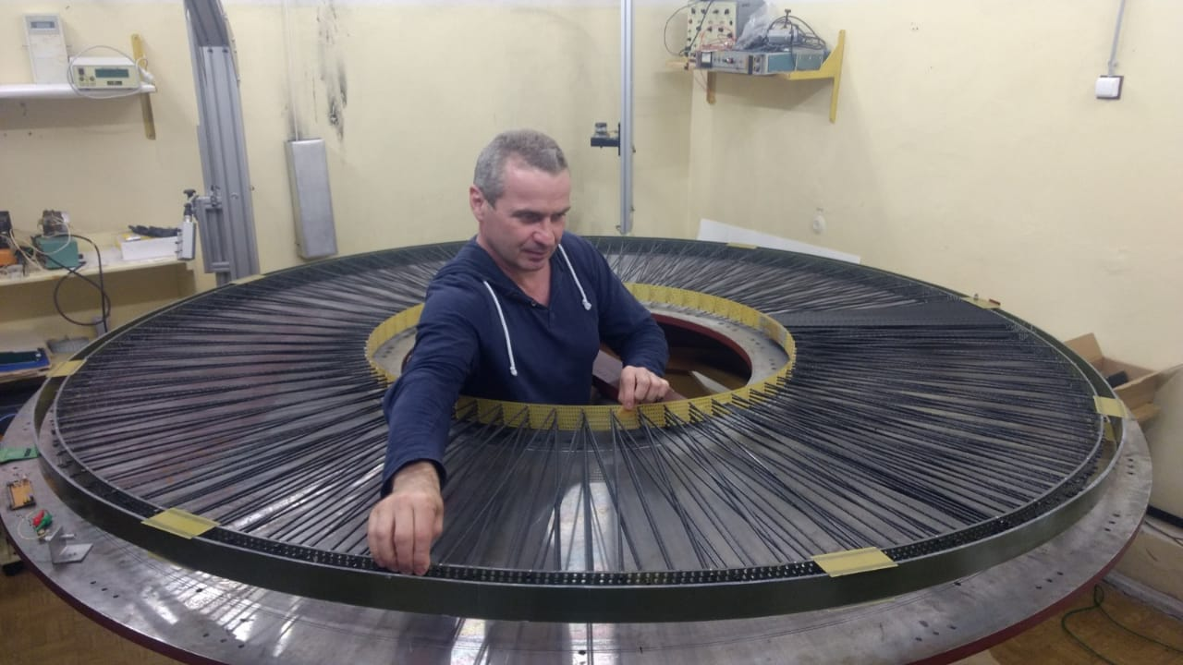
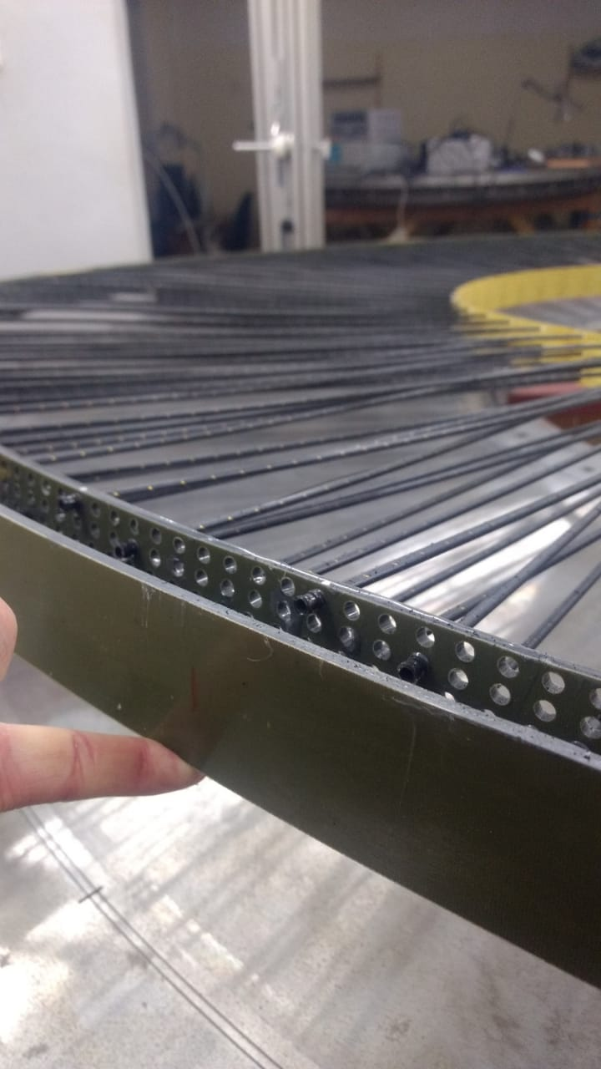
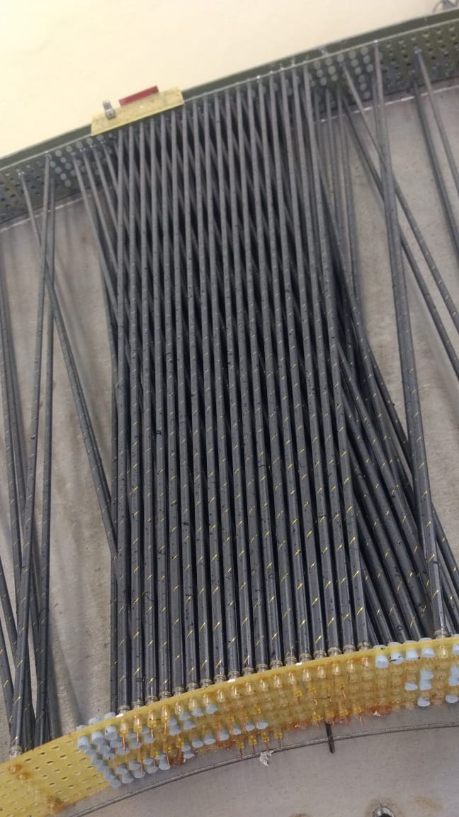

Slide 9
а) Размеры и вес-не более100кг
б) Сегментирование- 3 основные секции(баррель-8 частей, 2ендкапа-по 8(опционально-2)
в) Способ размещения относительно других систем –крепление к колориметру
г) Точность размещения подсистемы относительно других элементов установки-?
д) Выделяемая мощность (+/-30%)- 0,1W на канал (примерно 1,0-1,5 кW на 10000-15000 каналов)
е) Особенности материалов, которые могут быть важны при проектировании (магнитные свойства, горючесть и т. д.)-на следующем слайде подробно описано
ж) Необходимость возможности доступа-желательно
з) Необходимость диагностики-обязательно
и) Требования по электромагнитной совместимости-?
к) Другие особенности подсистемы, которые, по-вашему мнению, могут оказаться важными- автоматический климат- контроль (~2 град)

Slide 10
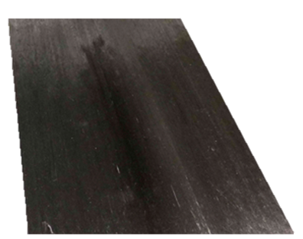
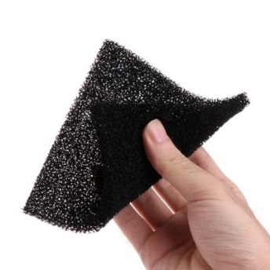
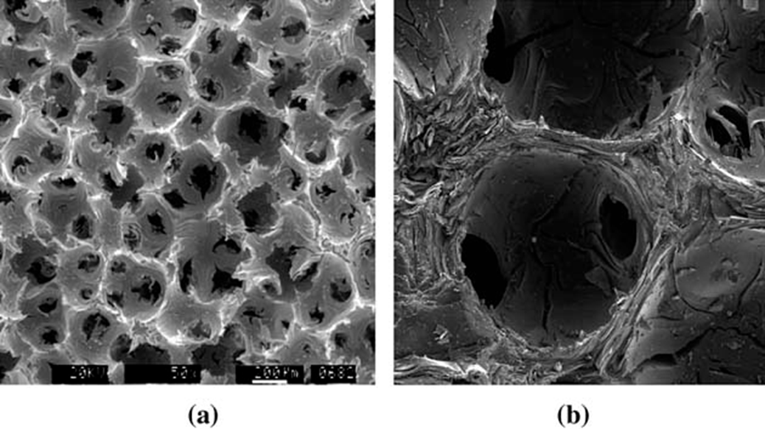

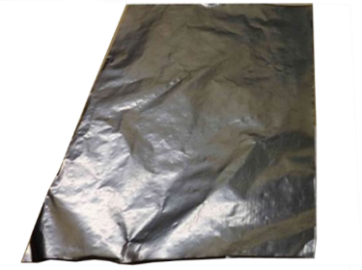




TRACKER MECHNICS
Requirements:
  support the tracker in position, with minimum mass, low X/X0
  provide cooling and thermal stability
  provide high dimensional and dynamic stability
Consolidated use of Carbon as structural…
Boundary conditions:
  high radiation levels
  Inelastic deformation
  temperature and humidity variations
5-11 µm
Carbon Unidirectional Prepreg: Ready to mold or cure material in sheet form which contains fiber all aligned in one direction. Filament diameter=11 µm
~ 45 µm
Carbon Fibre Reinforced Plastics
… and thermal management materials
 | Filaments [K=1000] | E1 [GPa] | X_{t} /X_{c} [MPa] | E2 [GPa] | Y_{t} [MPa] | K [W/mK] | CTE [10⁻⁶K⁻¹]
K13D2U [0] fibre | 2K | 935 | 3688 |  |  | 800 | -1,1
K13D2U [0] prepreg | 2K | 563 | 1800/340 | 6 | 25 | ~450 | -1,2 / 61
80 (g/m²) FAW
Carbon foam: high thermal performance, properties are porosity dependent
 | Density [g/cm3] | K In plane [W/mK] | K Out of plane [W/mK]
POCO HTC | 0.9 | 70-245 | 245
Thermal Pyrolytic Graphite: Thermal management material with very high thermal conductivity and flexibility
… and more
Aluminium Graphite Composites, Thermal phase change material
 | Thick. [µm] | Density [g/cm3] | K In plane [W/mK] | K Out of plane [W/mK]
Amec FGS_003 | 30 | 1.6 | 1500 | 15
TPG @ Tile | 250 | 2.25 | 1500-1700 | 6-10
 | Density [g/cm3] | K In plane [W/mK] | K Out of plane [W/mK]
ALG2208 | 2.2 | 220 | 140
 | Thick. [µm] | Trans. T [°C] | K [W/mK]
Tpcm 580 | 76-400 | 50 | 3.8

Slide 11
TRACKER ELECTRONICS TIGER
In Turin the electronics based on the TIGER chip (Turin Integrated Gem Electronics for Readout)
is developed for trigger-less readout of the GEM detectors.
Charge and time measurements provided.
TIGER parameters
5 x 5 mm² 110nm CMOS technology
64 channels: preAmp, shapers, TDC/ADC, local controller
Digital backend inherited from TOFPET2 ASIC (SEU protected)
On-chip bias and power management
On-chip calibration circuitry
Fully digital output
4 TX SDR/DDR LVDS links, 8B/10B encoding
Nominal 160 MHz system clock
10 MHz SPI configuration link
Sustained event rate > 100 kHz/ch

Slide 12
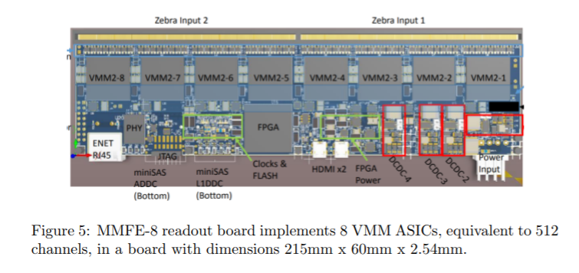
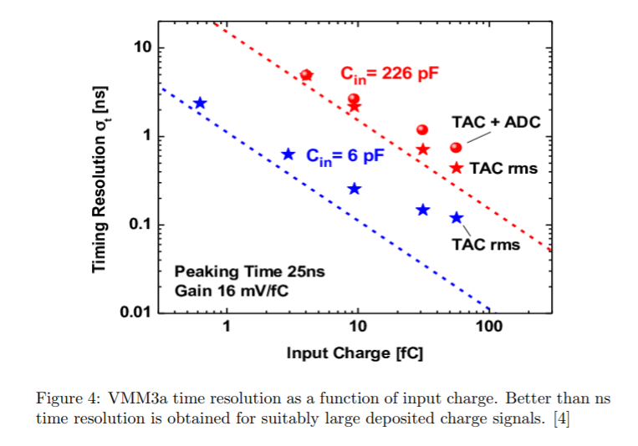
TRACKER ELECTRONICS DUNA

Slide 13
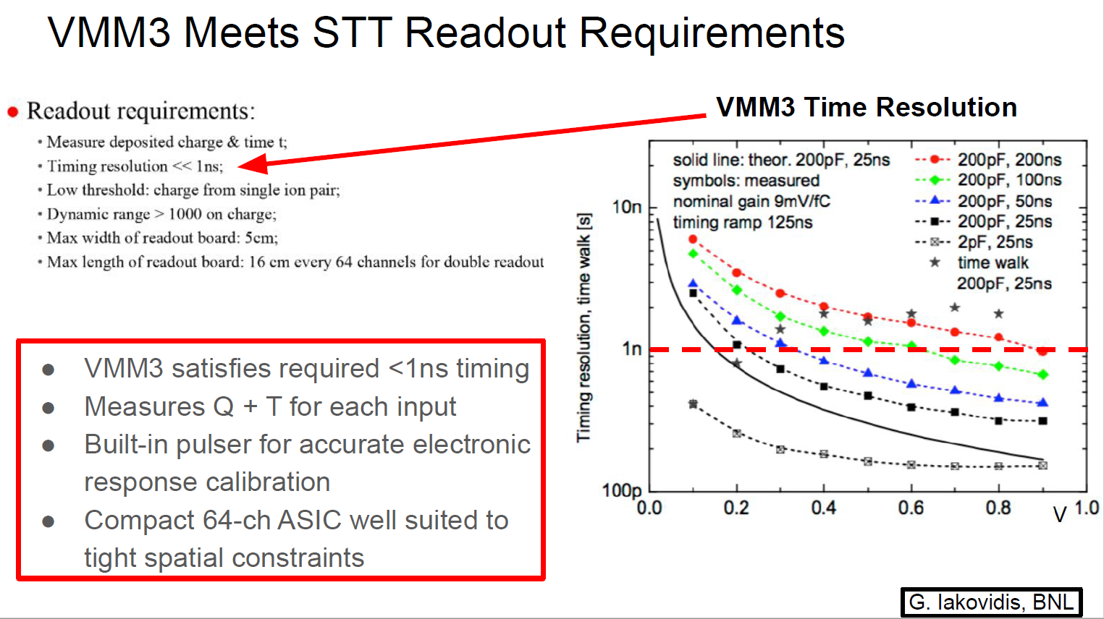

Slide 14

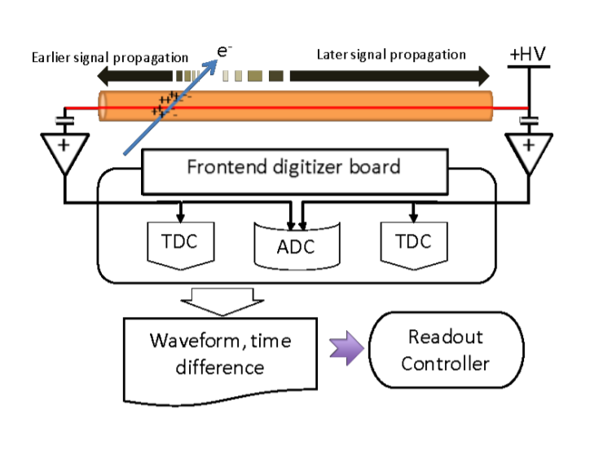

Slide 15
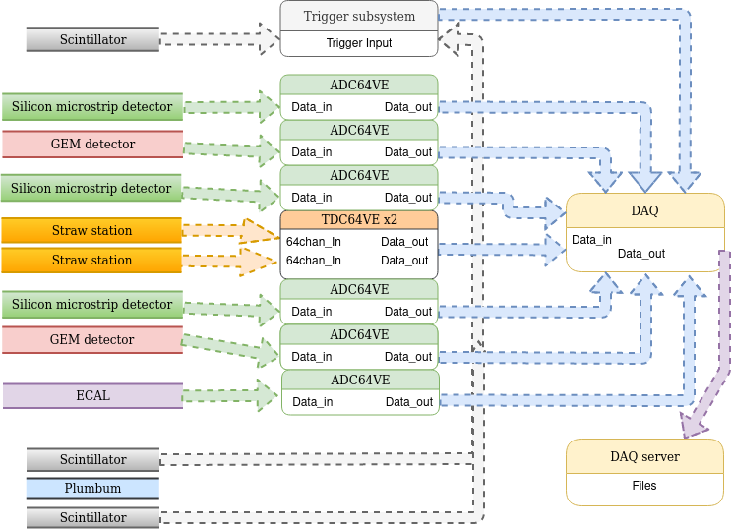
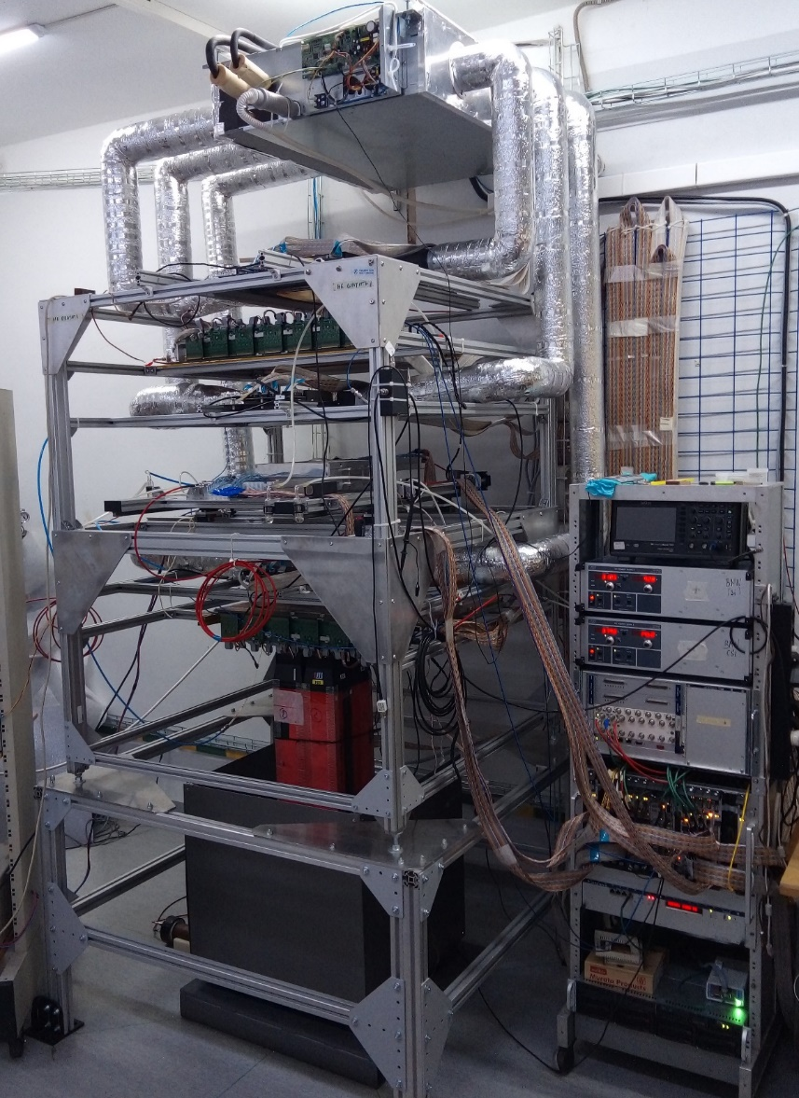
Блок-схема стенда miniSPD

Slide 16
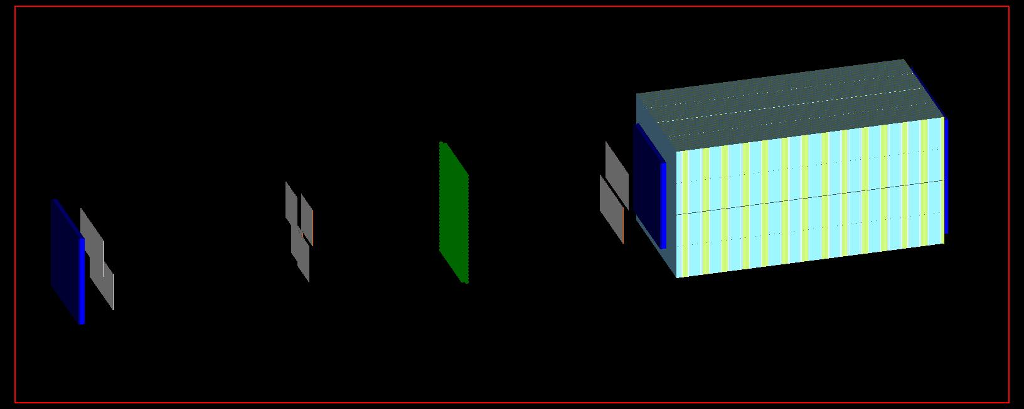
MiniSPD+Lead
Scintillator N3
Scintillator N2
Straw
SI N2
SI N1
SI N3
Calorimeter 44 cm
Scintillator N1
Generation condition:
100 000 events
PV (10, 10, -80) mm

