Slide 1

SPD STRUCTURE AND ASSEMBLING
SPD Collaboration
Moshkovsky I.V.
DUBNA 2019
Notes:
1

Slide 2
CONTENTS
1. EXPERIMENTAL HALL
1.1. Examination of the basic decisions
1.2. Movement system
2. COLLIDER DESIGN FOR SPD
2.1. Design of beam pipe for IT
2.2. Collider structure near SPD
3. EXPERIMENTAL SET-UP
3.1. Possible redesign with results of examination
3.2. Assembling
4. PRELIMINARY PLAN
2
Notes:
2

Slide 3
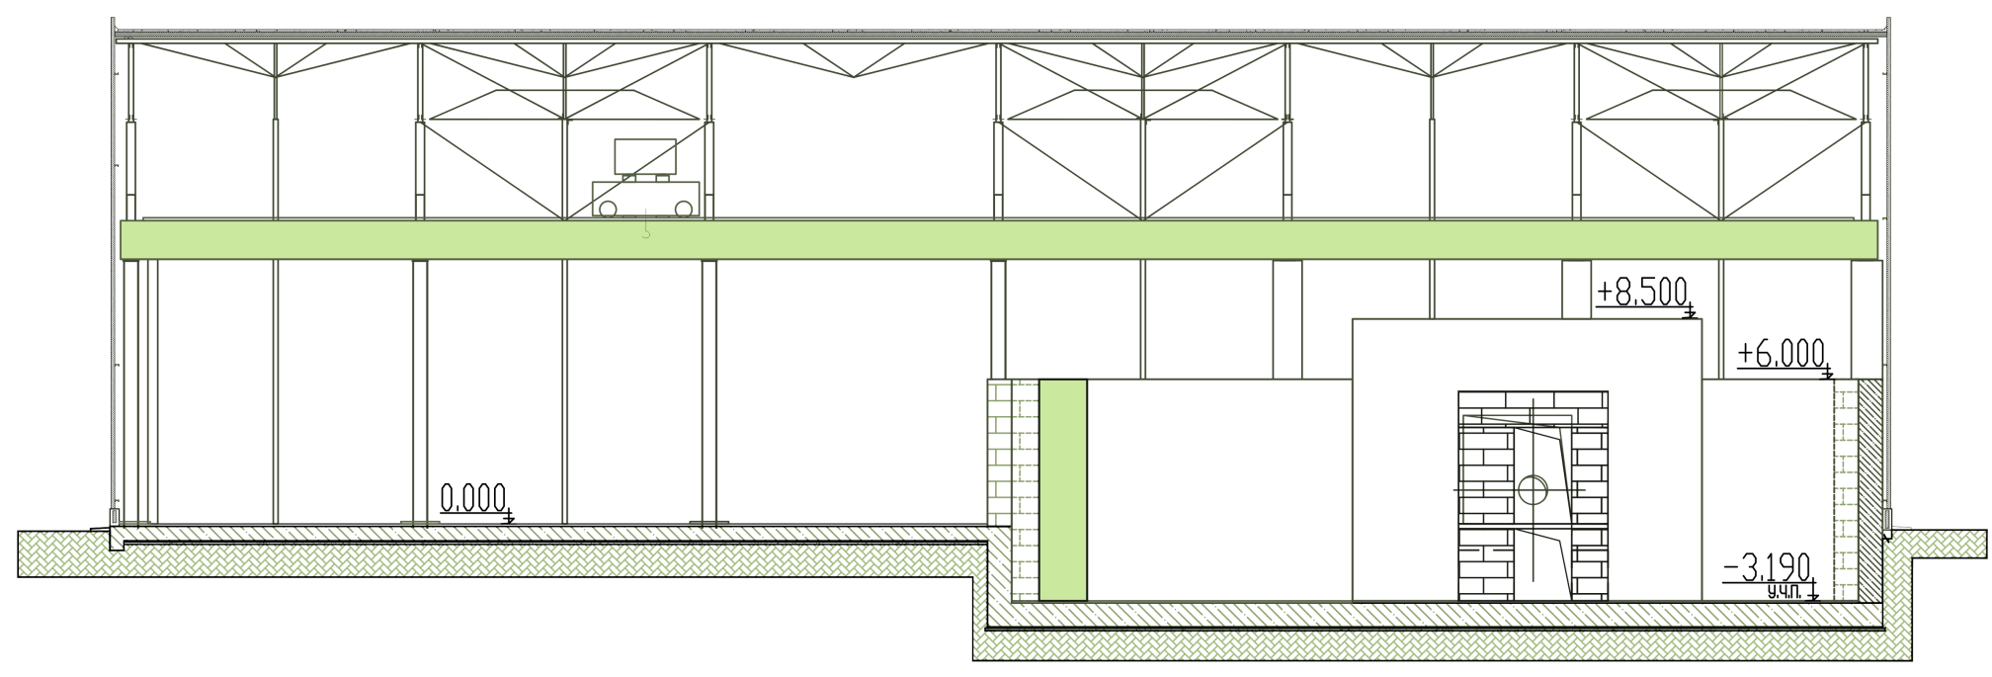
EXPERIMENTAL HALL
SPD facilities consist of Production area and Experimental hall.
Total area is more than – 2000m².
Main gate for trucks - 4000mm x 4000mm.
Dismantle part of wall for widest equipment - 8000mm x 8000mm.
Bridge crane specifications: High range – 12 m;
MAX load main hook – 80 t, auxiliary hook – 20 t.
Longitudinal section
Production area
Experimental hall
3
Notes:
3

Slide 4
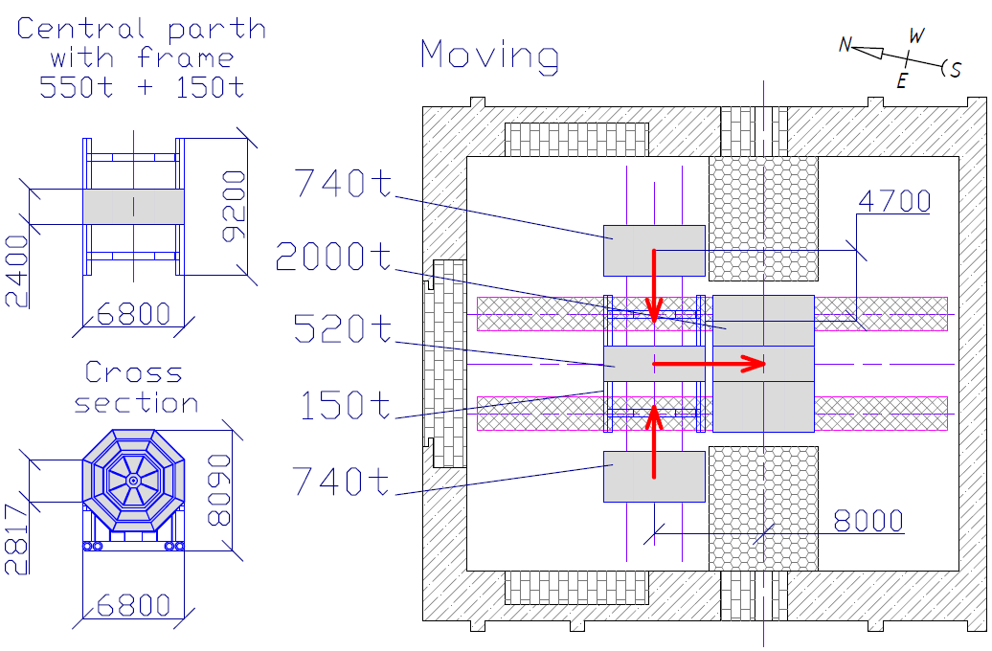
EXPERIMENTAL HALL
4
Notes:
4

Slide 5
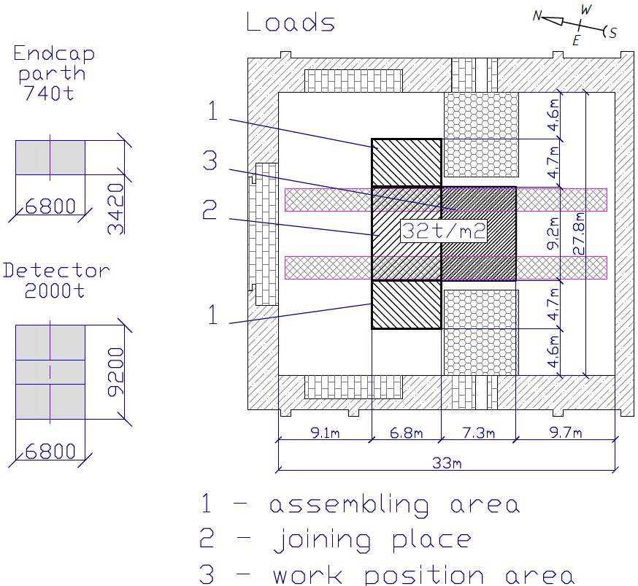
EXPERIMENTAL HALL
5
Notes:
5

Slide 6
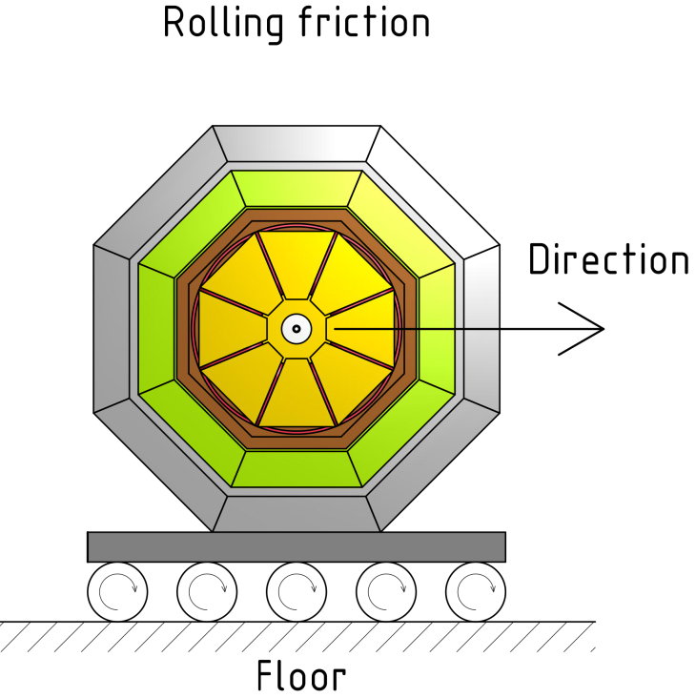
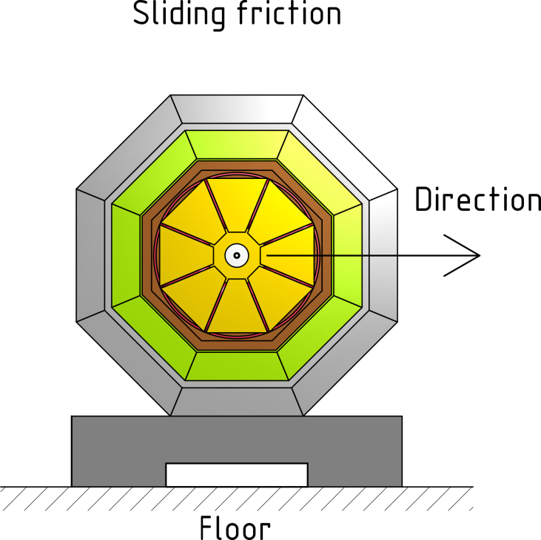
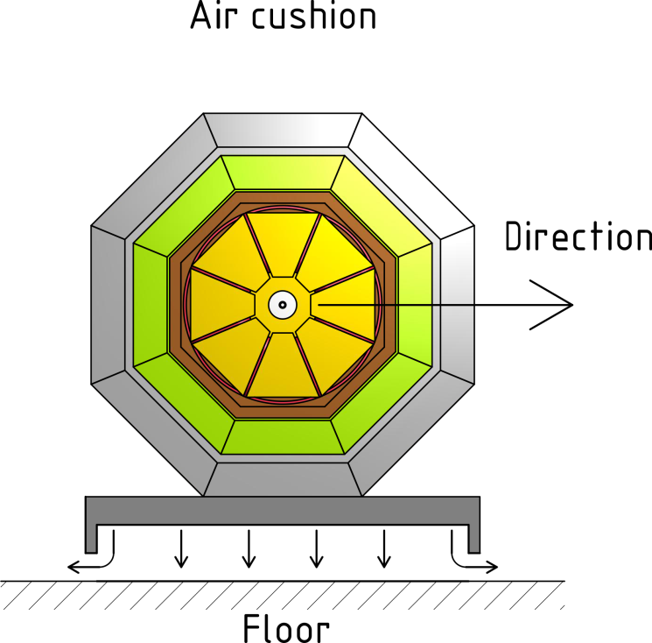

EXPERIMENTAL HALL
Moving system variants
We have specialists with experience with movement systems:
Rolling friction – NICA MPD experience
Sliding friction – JINR experience
Air cushion (air pad) – CERN ATLAS experience
Preliminary concept of the movement system - August-September 2019.
6
Notes:
6

Slide 7
EXPERIMENTAL HALL
The request letter has been sent (signed by LHEP Director) in November 2018.
Examination of Hall foundation is in progress.
The conclusion is expected after April 10.
The work with the floor SPD Hall were stopped in November 2018.
Currently SPD Hall is considered as last point to be build for NICA collider.
7
Notes:
7

Slide 8
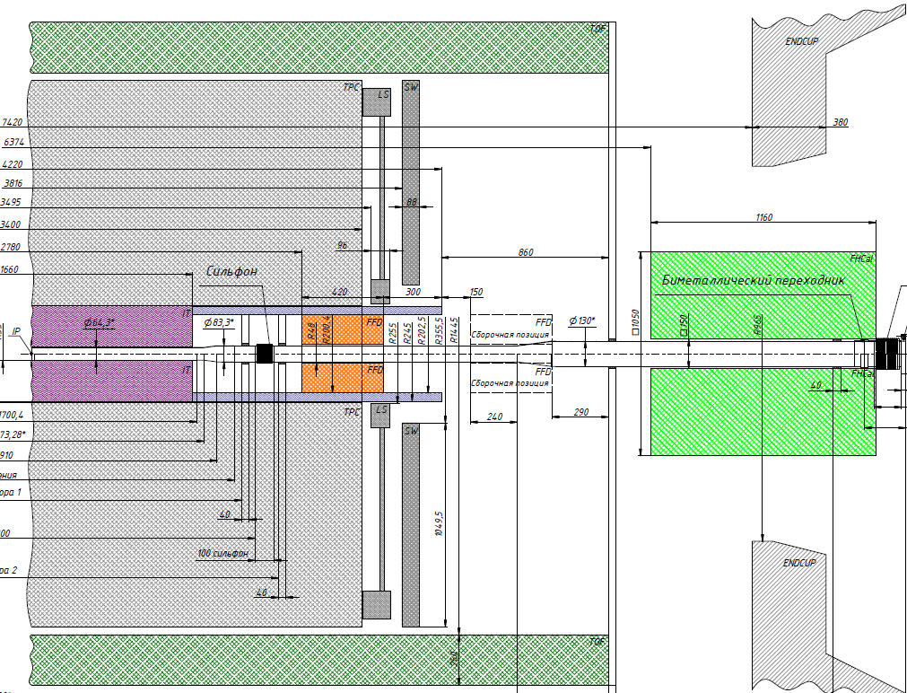

COLLIDER DESIGN FOR SPD
Envelop drawing beam pipe example
8
Notes:
8

Slide 9
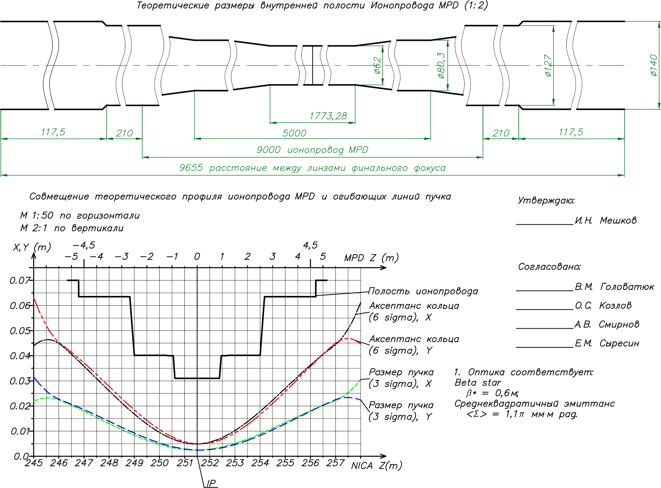
COLLIDER DESIGN FOR SPD
Theoretical drawing - Acceptance example
9
Notes:
9

Slide 10
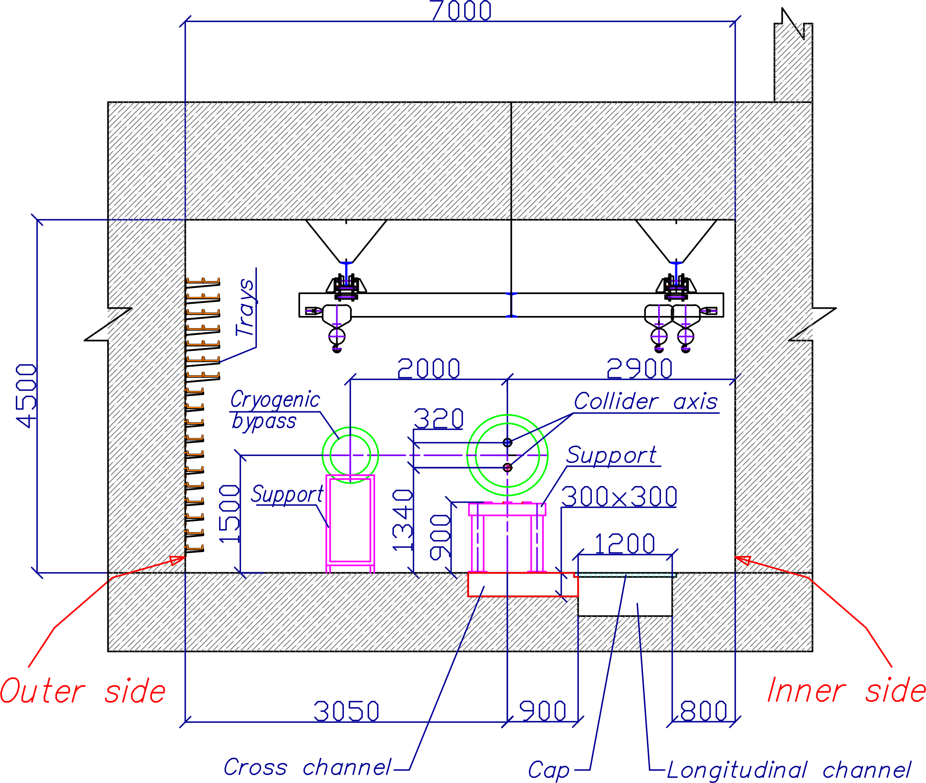

COLLIDER DESIGN FOR SPD
Collider tunnel cross section scheme
10
Notes:
10

Slide 11
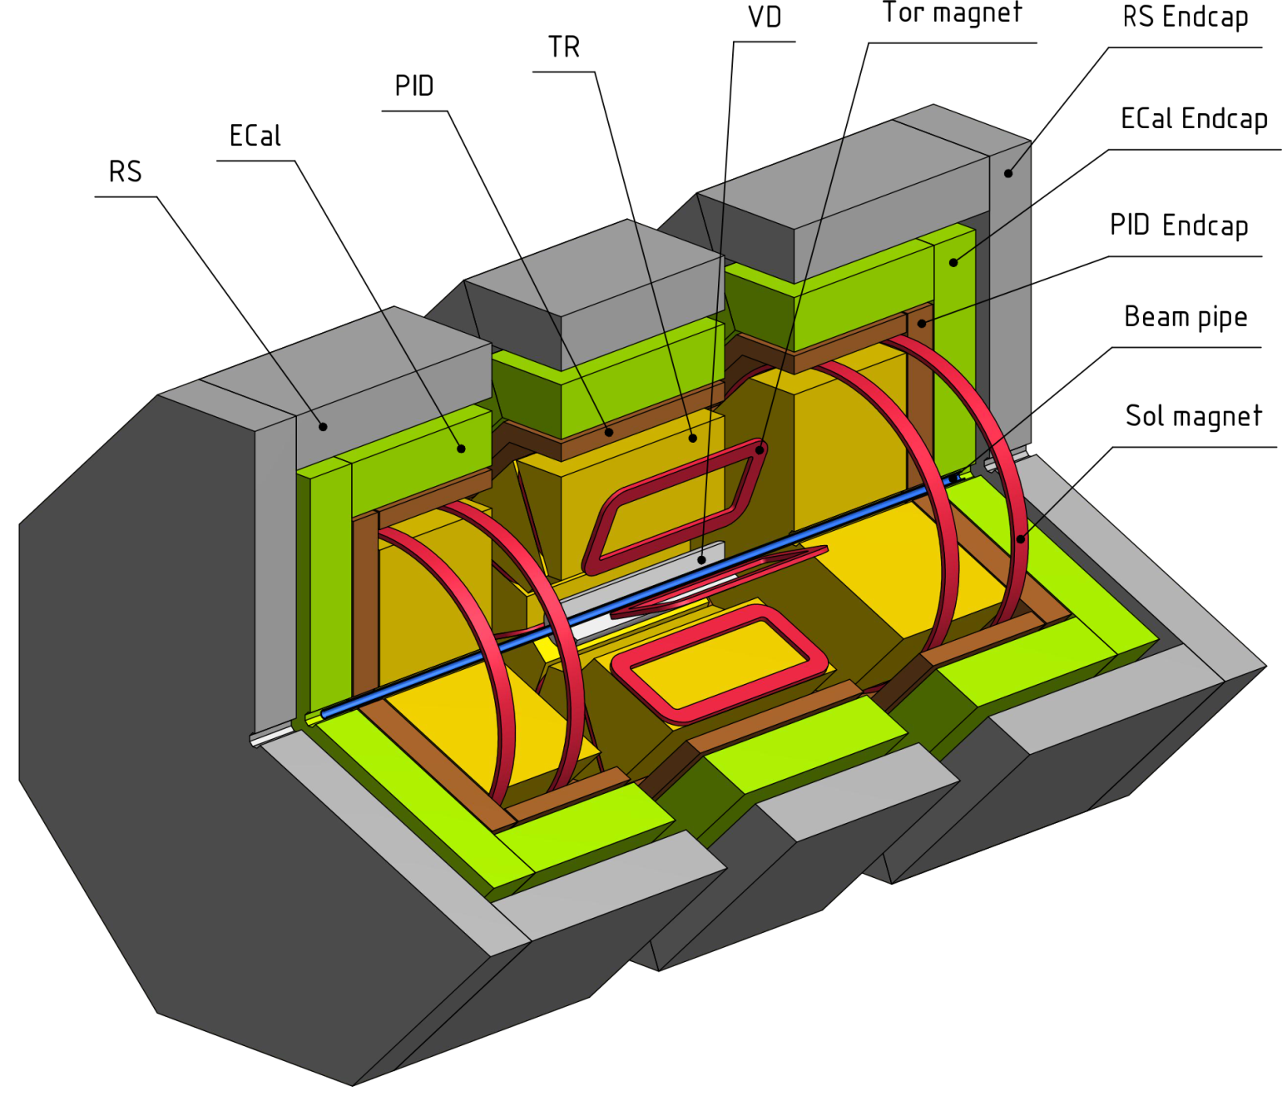

EXPERIMENTAL SET-UP
Scheme of SPD
11
Notes:
11

Slide 12
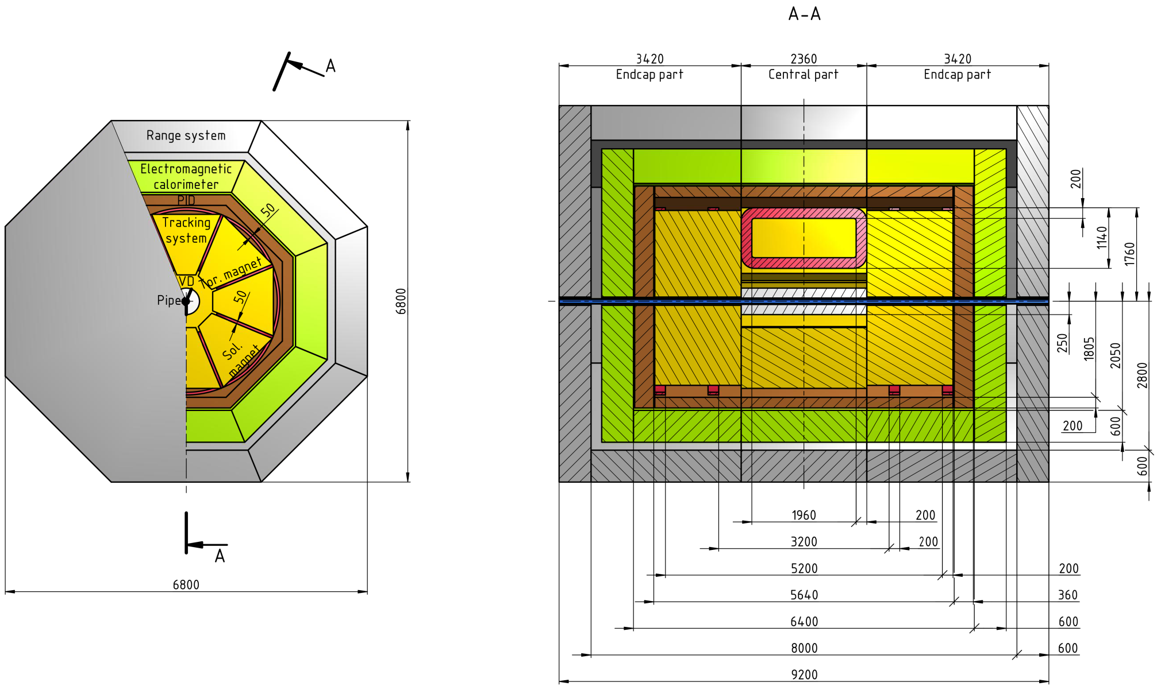
EXPERIMENTAL SET-UP
General drawing of SPD
12
Notes:
12

Slide 13
PRELIMINARY PLAN
.
Data from detector experts are needed to do new design of SPD.
Detailed data on requirements for collider design near SPD are necessary.
Design IP pipe has to be done with vertex experts.
New SPD design (according results of basic examinations).
13
Notes:
13

Slide 14
PRELIMINARY PLAN
 | 2019
 | March | April | May | June | July | August | September
Examination of hall foundation. Valuation.
Beam pipe for IT. Concept design.
Movement system. Concept design.
Redesign of set-up. Concept design.
Assembling. Concept design.
14
Notes:
14

Slide 15

CONTENTS
Vica – Virtual collider assistant
Skills:
Visual determination of dimensions
by comparing an object with a human one.
Goal:
Helps NICA.
Strengths:
Works hard.
15
Notes:
15

Slide 16
THANK YOU!
16
Notes:
16

