Slide 1
NICA accelerator complex at LHEP and proposal to study polarization phenomena with its beams
(the SPD project)
Roumen Tsenov,
for the SPD project team

Slide 2
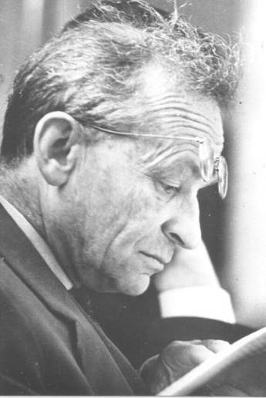

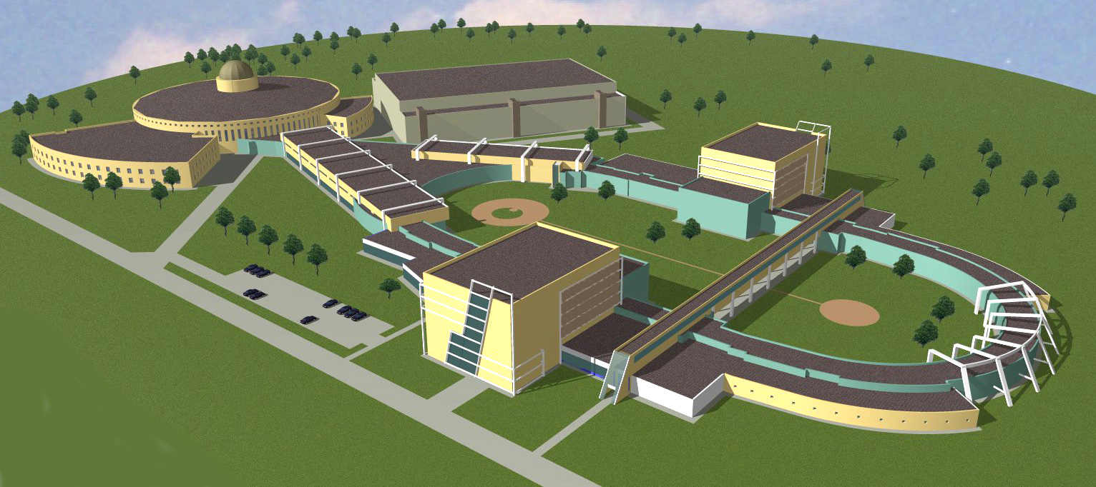
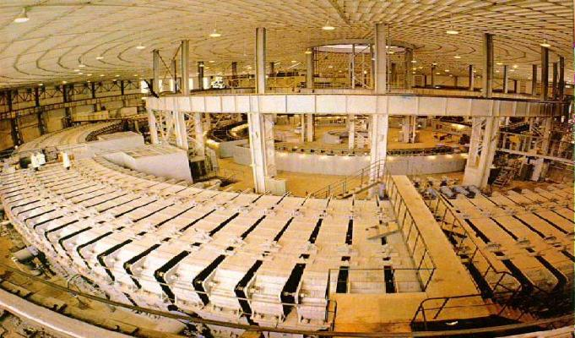
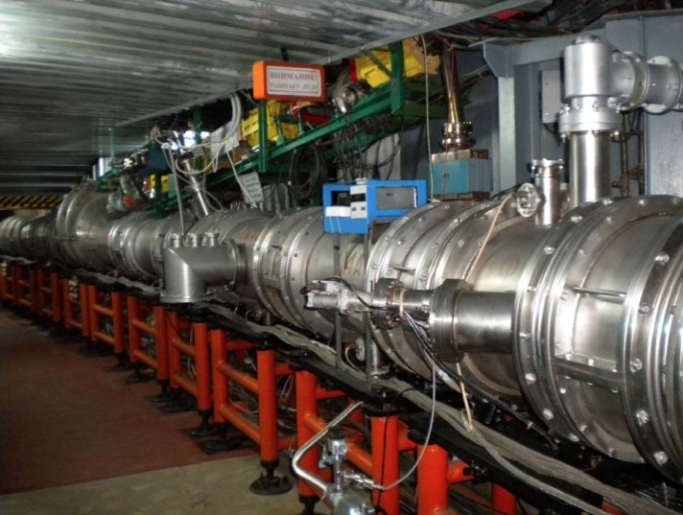
From the Synchrophasotron to the NICA collider
1957
Synchrophasotron
1993
Nuclotron
2019
NICA
10 GeV proton synchrotron – then the world leader in energy
Start up of the
high energy era
the first superconducting
accelerator of heavy ions
based on
Dubna type
SC magnets
Superconducting
collider of heavy ions
A.M. Baldin
– pioneer
of relativistic
nuclear physics
V.I.Veksler – discovery of
the Phase Stability Principle
(1944)
Study of nuclear matter under extreme conditions
and spin physics

Slide 3
NICA (Nuclotron based Ion Colider fAcility)
is the flagship project in high energy physics
of the Joint Institute for Nuclear Research
Main targets of the NICA project:
- study of hot and dense baryonic matter
- investigation of nucleon spin structure,
polarization phenomena
Ring circumference, m | 503.04
heavy ions
energy range for Au⁷⁹⁺: √S_{NN}, GeV | 4 - 11
r.m.s. Δp/p, 10⁻³ | 1.6
Luminosity for Au⁷⁹⁺, cm⁻² s⁻¹ | 1x10²⁷
polarized particles
max. √S for polarized p, GeV | 27
Luminosity for p, cm⁻² s⁻¹ | 1x10³²

Slide 4
Structure and Operation Regimes
Linac HILac
KRION
Booster (25 Tm)
storage of
(2 ÷ 4)×10⁹ ions,
acceleration
up to 600 MeV/u
Ion sources
Linac LU-20
Fixed Target Area
Stripping (80%) ¹⁹⁷Au³¹⁺ => ¹⁹⁷Au⁷⁹⁺
Nuclotron (45 Tm)
injection bunch
~ 2×10⁹ ions
acceleration up to
1 - 4.5 GeV/u
IP-2
Two SC collider rings
~ 2 x 22 injection cycles
22 bunches per ring
IP-1

Slide 5
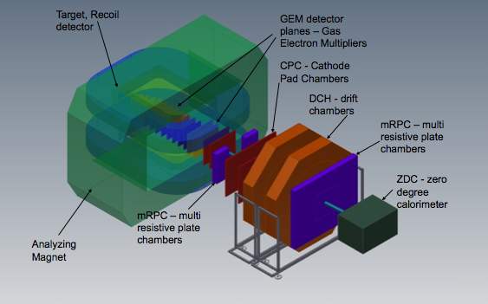
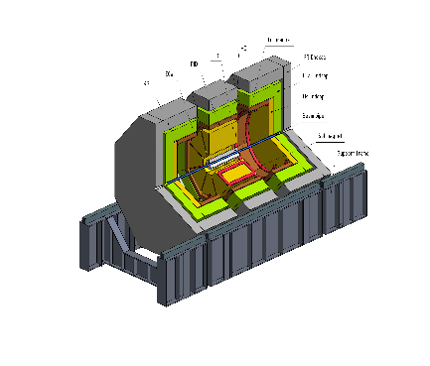
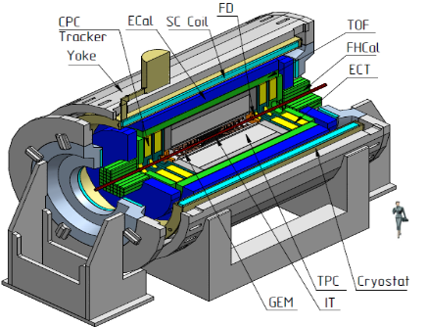
The NICA complex
existing facilities
to be constructed
KRION-6T+ HILac (3MeV/u)
BM@N
SPD
PS & LU-20 (5MeV/u)
hall for fixed target
experiments
Booster
(600 MeV/u)
SPD hall
MPD hall
NUCLOTRON 0.6-4.5 GeV/u
MPD
Collider

Slide 6

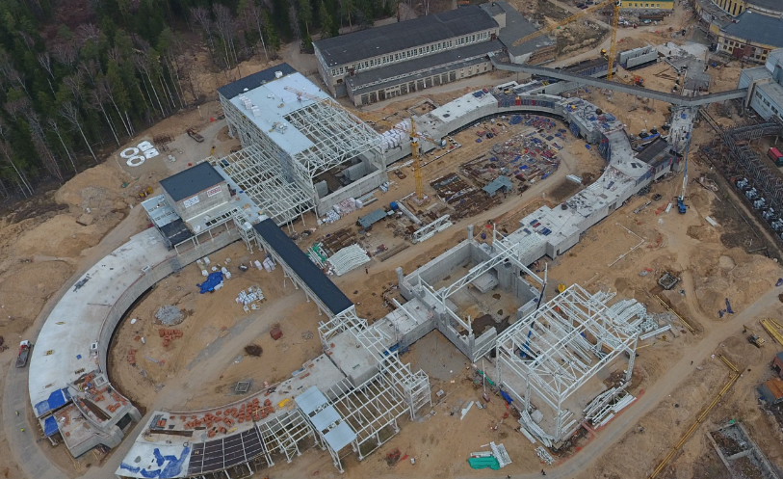
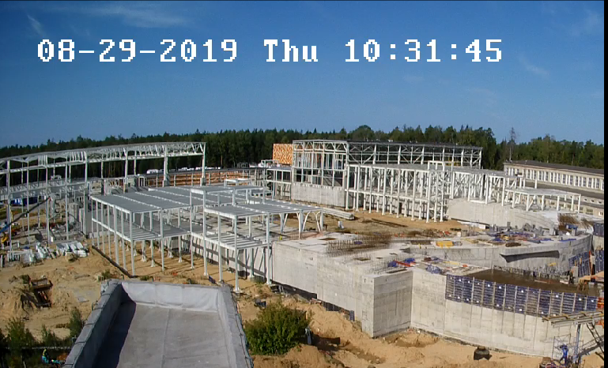
Civil construction, bld.17
April 2019
MPD Hall
SPD Hall
http://nucloweb.jinr.ru/nucloserv/205corp.htm

Slide 7
Major milestones
2018 – start of BM@N experiment (min. configuration)
2018 –2019 – Booster commissioning
2019 – readiness of MPD Hall
2019 – MPD magnet commissioning
2020 – completion of civil construction (build. 17)
2020 – MPD commissioning (Stage I)
2020 –2021 – Collider commissioning
2020 – completion of “NICA Center” construction
2021 – commissioning of Computer center
2023 – MPD commissioning (Stage II)
2025 – SPD commissioning (Stage I)

Slide 8
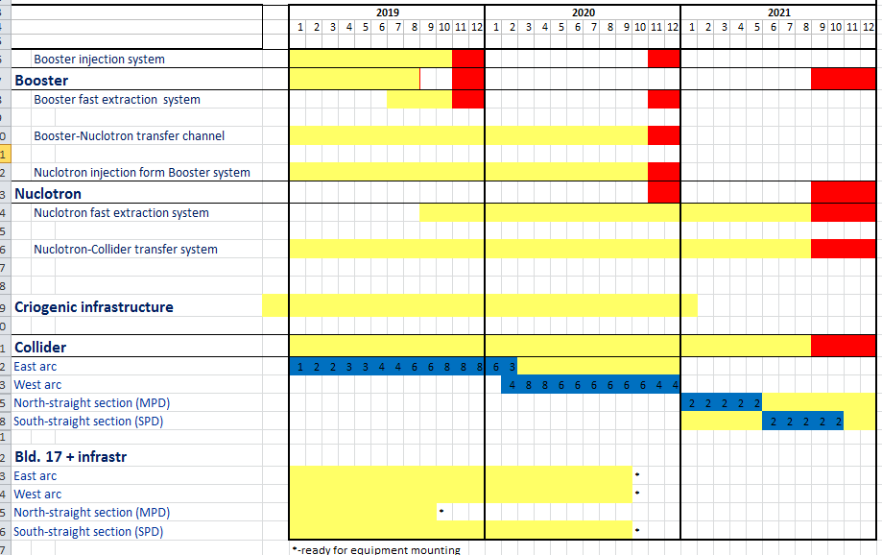
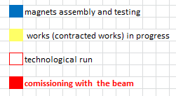
Time-schedule
S. Kostromin, PAC June 2019
Jan
2022

Slide 9
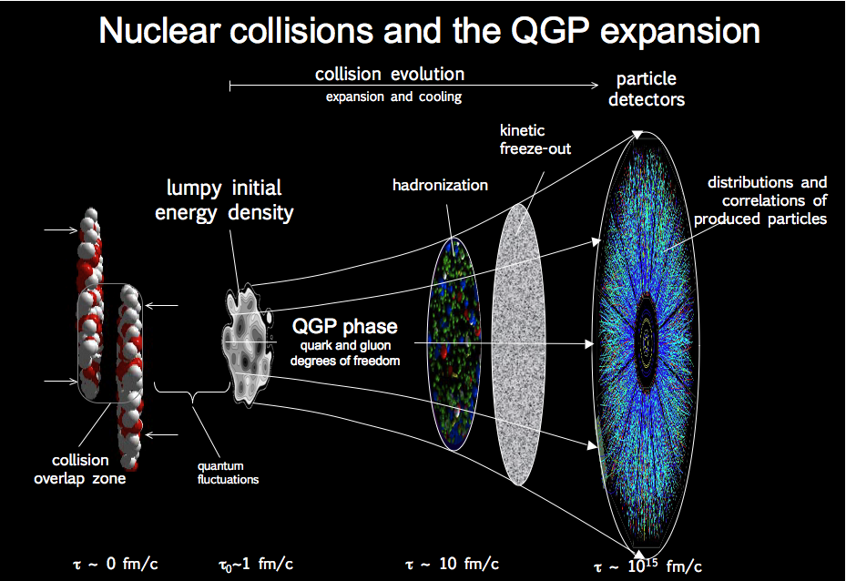
Development in time, 1 fm / c = 3.3 x10⁻²⁴ sec

Slide 10
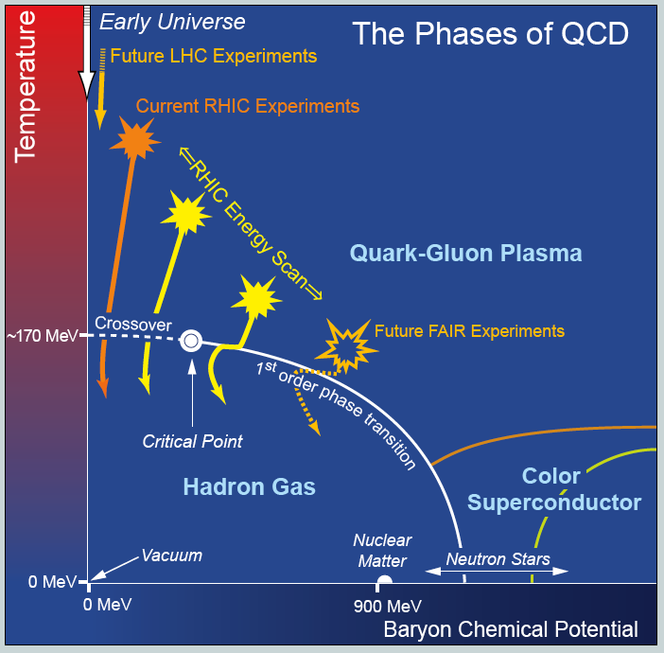
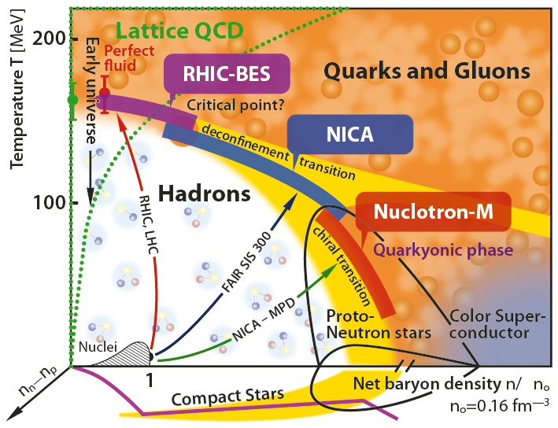
QCD phase diagram
FAIR & NICA
NICA

Slide 11
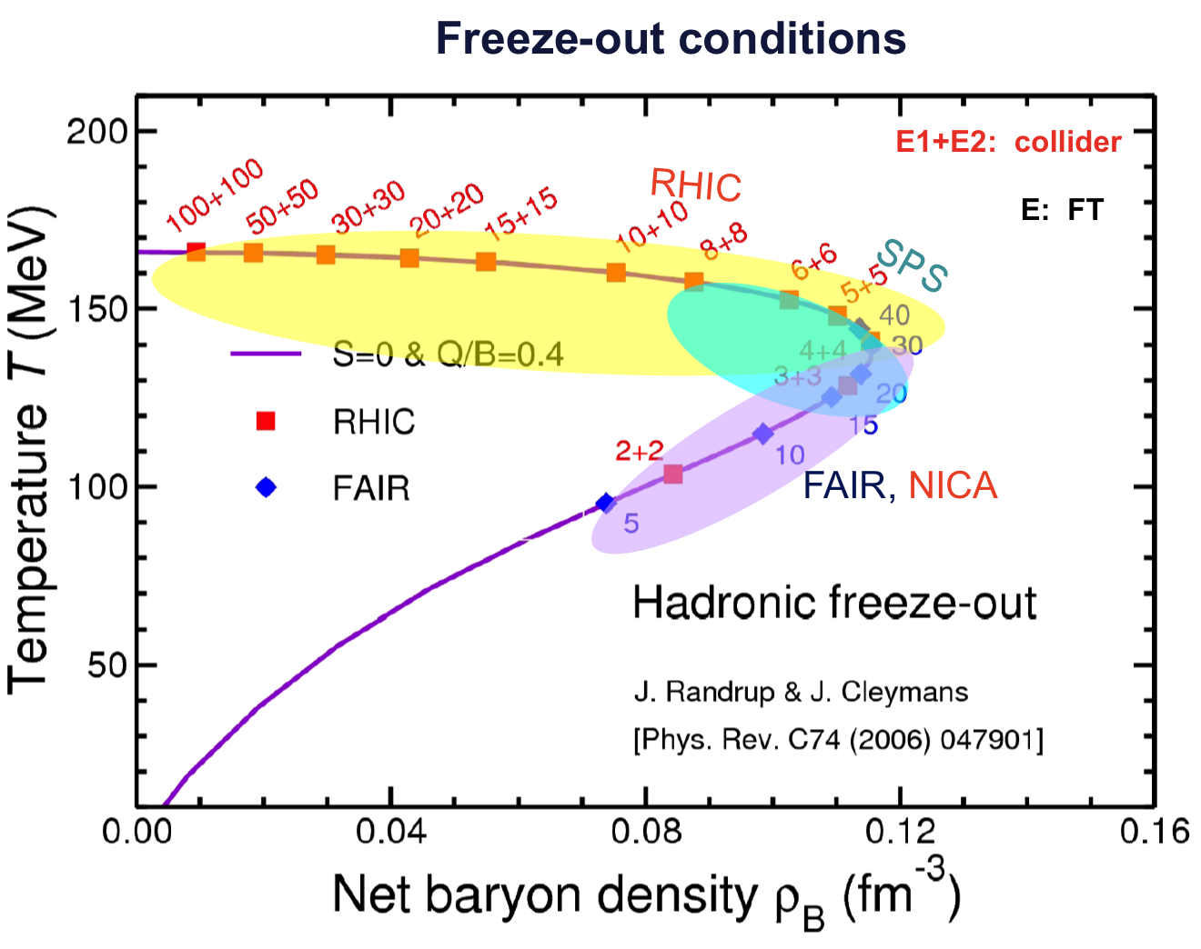
Physics at NICA
Quark-gluon matter at NICA :
Highest net baryon density
Energy range covers onset of deconfinement
Complementary to the RHIC/BES, FAIR and CERN experimental programs
Bulk properties, EOS - particle yields
& spectra, ratios, femtoscopy, flow
In-Medium modification of hadron properties
Deconfinement (chiral), phase transition at high ρ_{B} - enhanced strangeness production
QCD Critical Point - event-by-event fluctuations & correlations
Strangeness in nuclear matter - hypernuclei

Slide 12
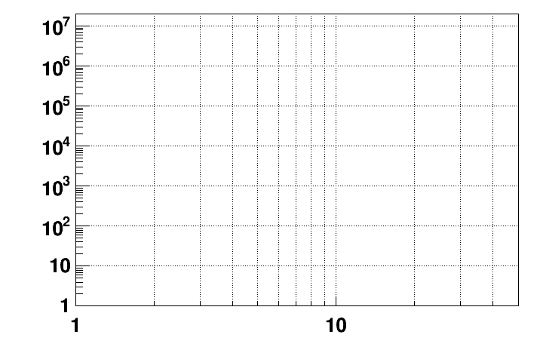
Present and future HI experiments
energy region of
max. baryonic density
CBM
2022 – 2025: SIS-100 FAIR
NICA/BM@N II
HADES
NICA/MPD
Interaction rate [Hz]
STAR F.T.
STAR BES II
NA-61/SHINE
Collision energy √S [GeV]
NN

Slide 13
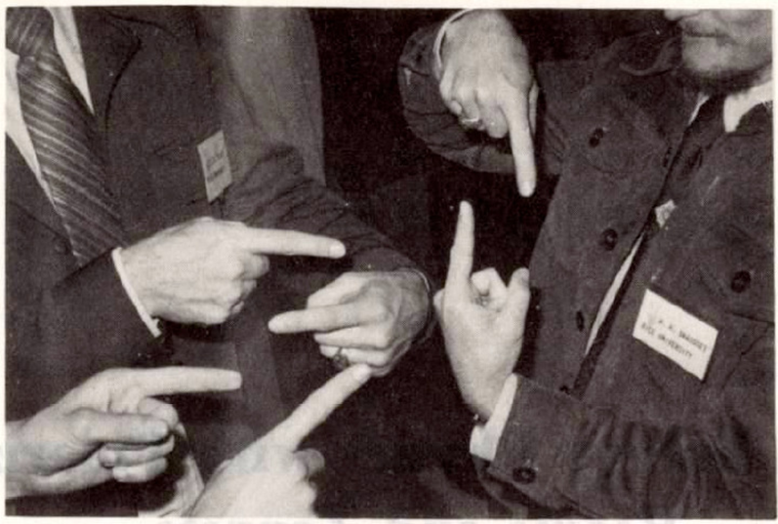
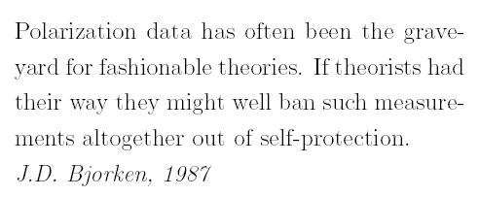
Collisions of polarized particles
Long tradition at the Synchrophasotron and Nuclotron

Slide 14
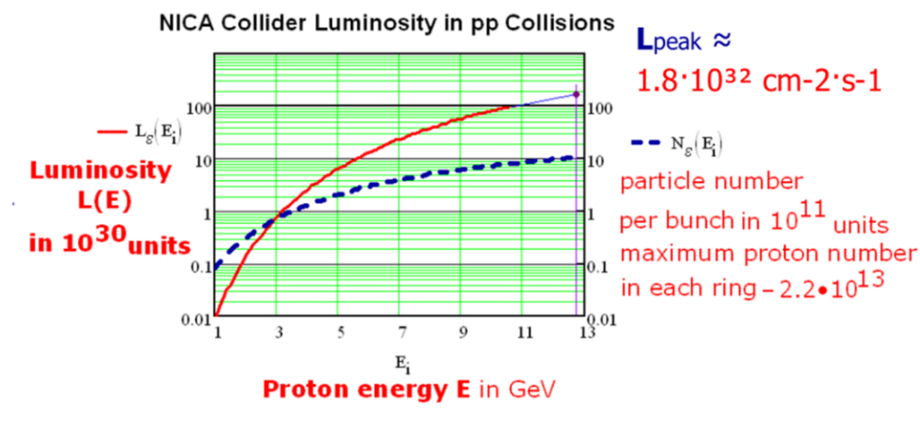
Polarized beams
A bunch crossing each 80 ns;
crossing rate 12.5 MHz .
Polarized beams
p↑p↑ at √s_{pp} = 12 - 27 GeV, L_{av} ≈ 10³² cm⁻²s⁻¹
d↑d↑ at √s_{NN} = 4 - 13 GeV
longitudinal and transverse polarization at SPD and MPD

Slide 15
Physics tasks
Nucleon spin structure studies
Spin-dependent effects in elastic pp, pd and dd scattering;
Spin effects in exclusive hadron production;
Spin effects in production of hadrons with high p_{T} in interaction of vector and tensor (d) polarized beams;
Multiquark states and correlations
Notes:
15
15
15
15

Slide 16
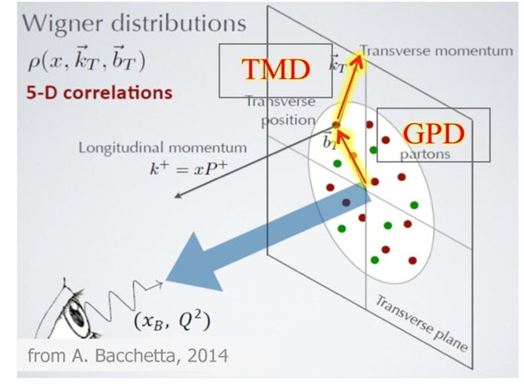
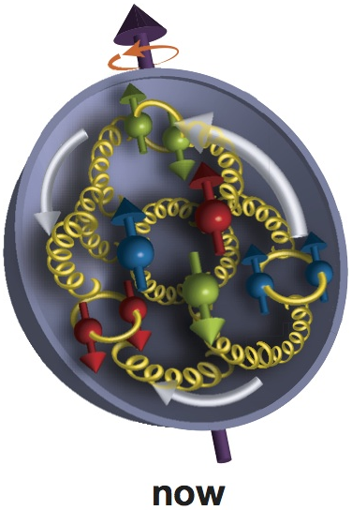
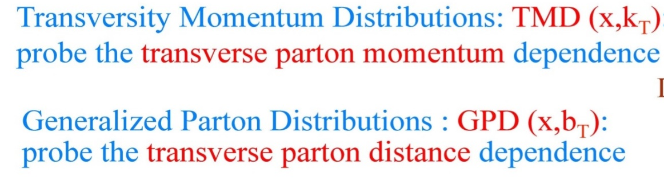
Spin dependent PDFs

Slide 17

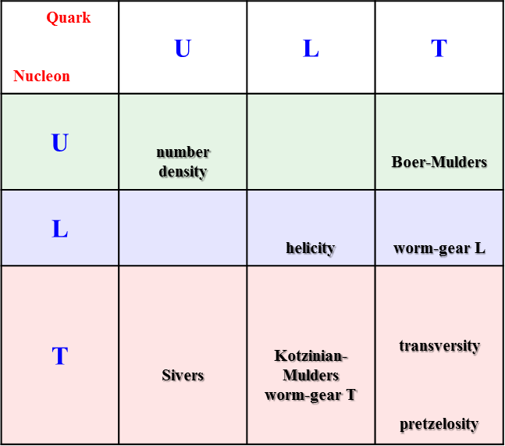
Nucleon structure and PDFs
Quark Nucleon | U | L | T
U | number density
L |  |  | worm-gear L
T | Sivers | Kotzinian-Mulders worm-gear T | transversity pretzelosity
PDFs describe different properties:
3 PDFs are needed to describe nucleon structure in collinear approximation
8 PDFs are needed if we want to take into account intrinsic transverse momentum k_{T} of quarks
spin of the nucleon spin of the quark k_{T}
f₁ -- density of partons in non-polarized nucleon;
g₁ -- helicity, longitudinal polarization of quarks in longitudinally polarized nucleon;
h┴ -- Boer-Mulders, transversely polarized quarks in non-polarized nucleon;
f┴_{1T} - Sivers, correlation between the transverse polarization of the nucleon (transverse spin) and the transverse momentum of non-polarized quarks; etc…

Slide 18
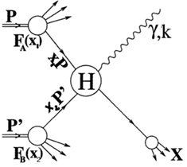
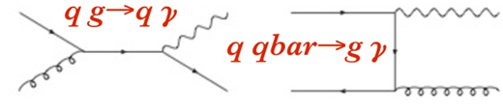
Physical probes
  Inclusive and exclusive Drell-Yan pair production;
  Direct photons;
  Nucleon PDFs by J/ψ production;
Notes:
18
18
18
18

Slide 19
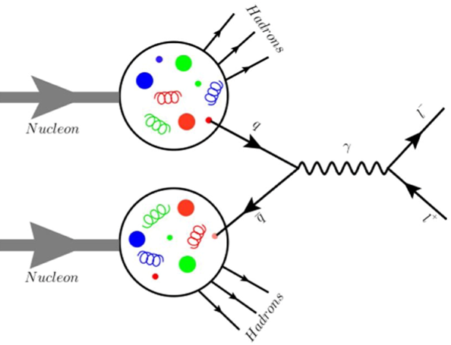

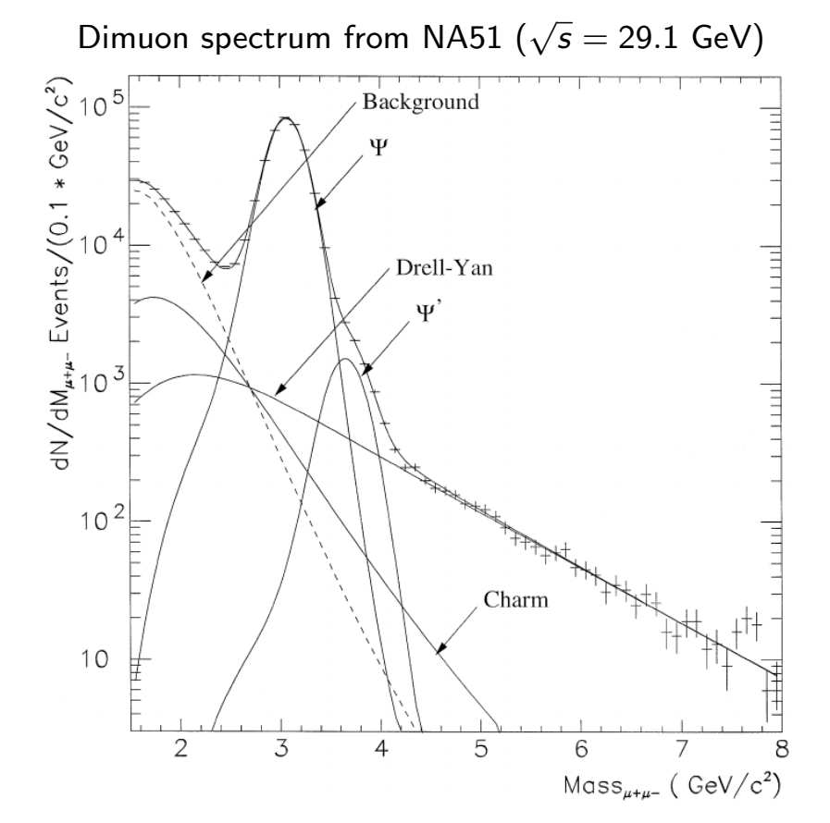
Drell-Yan process
A quark-antiquark pair creates a lepton (e/μ) pair trough a virtual photon
We can use this “virtual photon microscope” to look into nucleons and obtain access to PDFs.

Slide 20
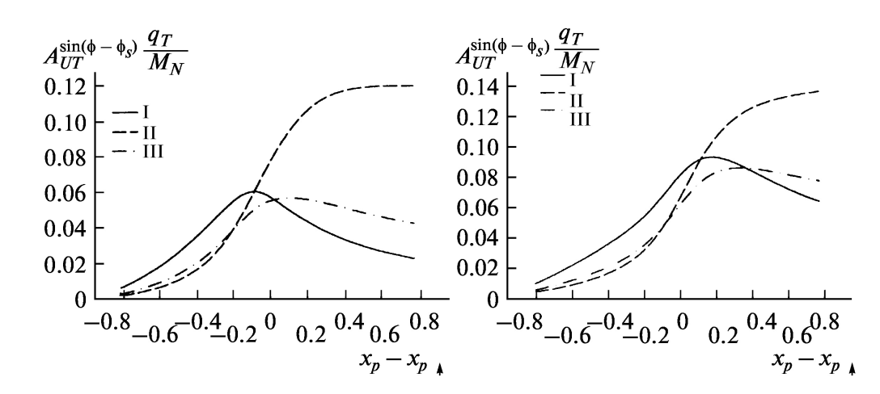
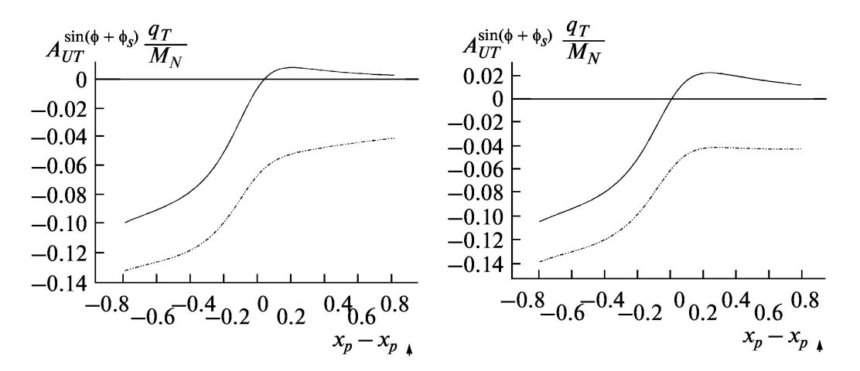
Asymmetries in DY pair production
Q² = 4 GeV²
Q² = 15 GeV²
Sivers
J.C.Collins et al., PRD73
(2006)014021
Boer-Mulders
s= 400 GeV²

Slide 21

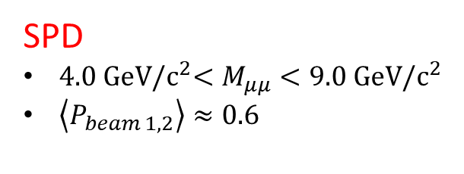

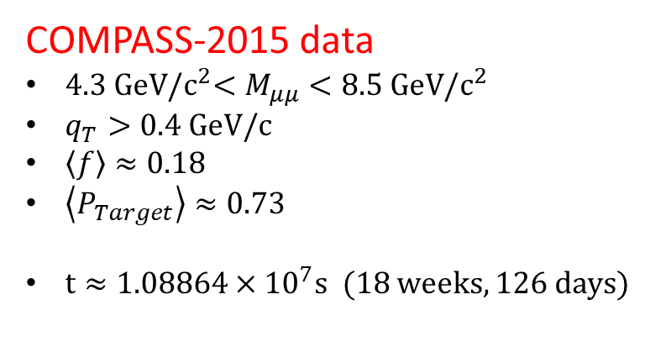

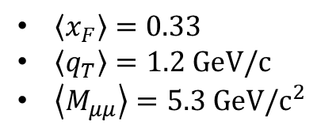

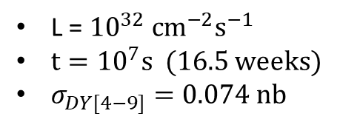
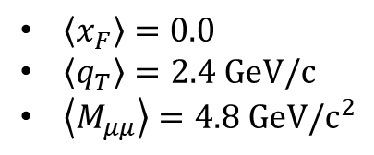
Kinematical ranges and statistics
PRL 119 (2017) 112002
COMPASS-2015 data
$4.3 GeV{/c}^{2}<M_{μμ}<8.5 GeV/c^{2}$
$q_{T}>0.4 GeV/c$
$\left\langle f\right\rangle ≈0.18$
$\left\langle P_{Target}\right\rangle ≈0.73$
${t≈1.08864×10}^{7}s$ (18 weeks, 126 days)
$\left\langle x_{F}\right\rangle =0.33$
$\left\langle q_{T}\right\rangle =1.2 GeV/c$
$\left\langle M_{μμ}\right\rangle =5.3$ $GeV/c^{2}$
$N_{DY}$= 35 $×$ ${10}^{3}$
SPD
$4.0 GeV{/c}^{2}<M_{μμ}<9.0 GeV/c^{2}$
$\left\langle P_{beam 1,2}\right\rangle ≈0.6$
$\left\langle x_{F}\right\rangle =0.0$
$\left\langle q_{T}\right\rangle =2.4 GeV/c$
$\left\langle M_{μμ}\right\rangle =4.8$ $GeV/c^{2}$
L = ${10}^{32} {cm}^{−2}s^{−1}$
${t=10}^{7}s$ (16.5 weeks)
$σ_{DY[4−9]}=0.074 nb$
$N_{DY}$ = $σ_{DY}×L×t$
$N_{DY}$= 88.8 $×$ ${10}^{3}$
$$dA=\frac{1}{P_{b1}P_{b2}}×\frac{1}{\sqrt{N}}$$

Slide 22
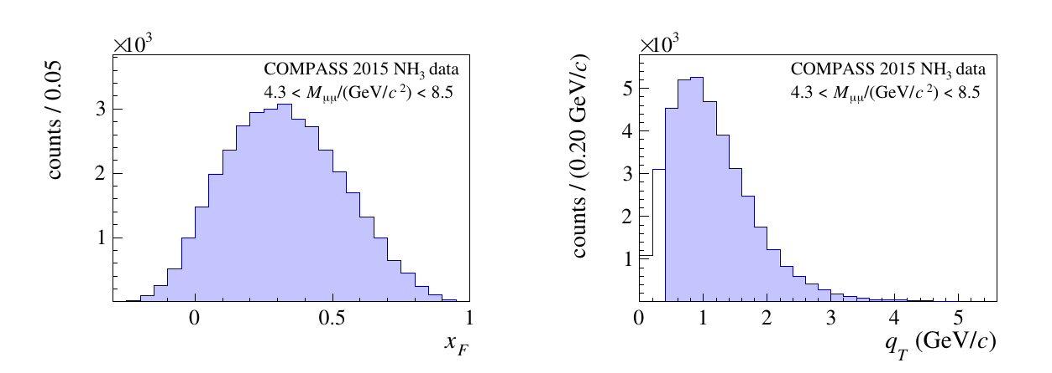
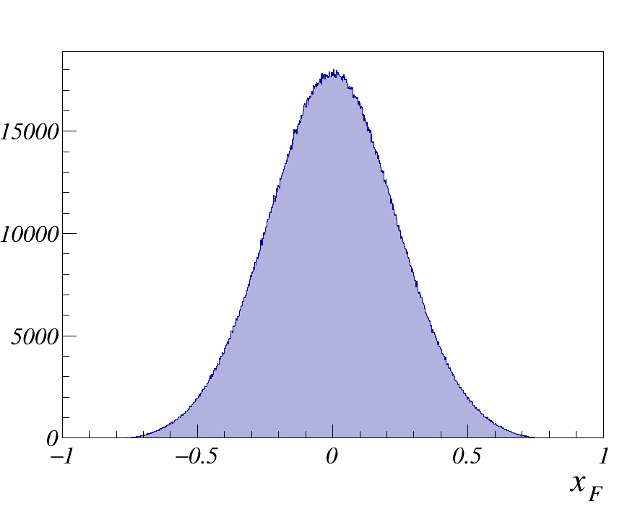
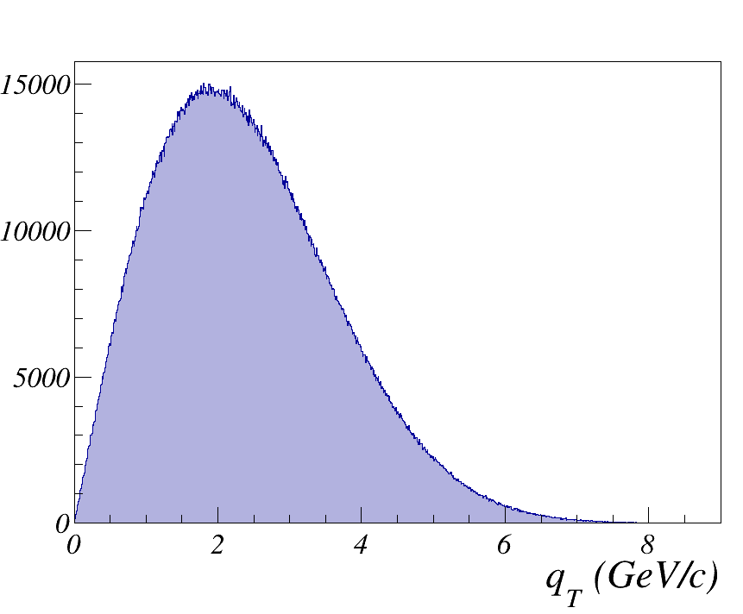
Kinematics
COMPASS
SPD

Slide 23
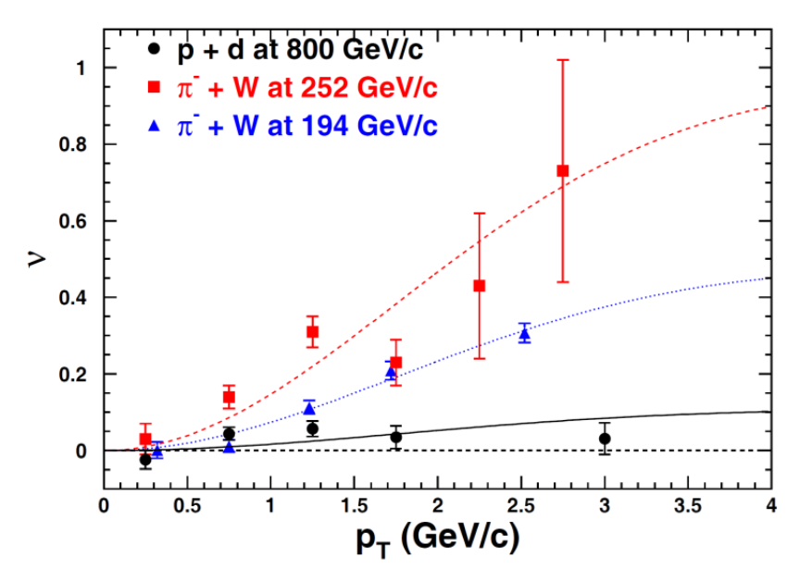
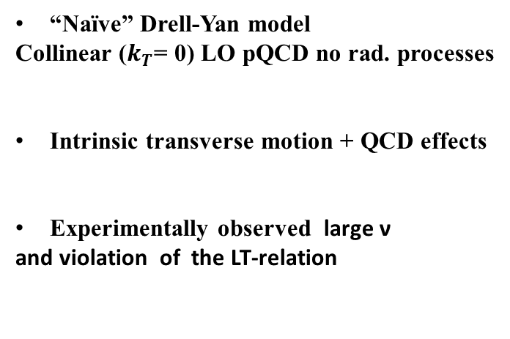
Unpolarised Drell-Yan
Boer-Mulder
Boer-Mulder
“Naïve” Drell-Yan model
Collinear ($k_{T}$= 0) LO pQCD no rad. processes
Intrinsic transverse motion + QCD effects
Experimentally observed large ν
and violation of the LT-relation

Slide 24
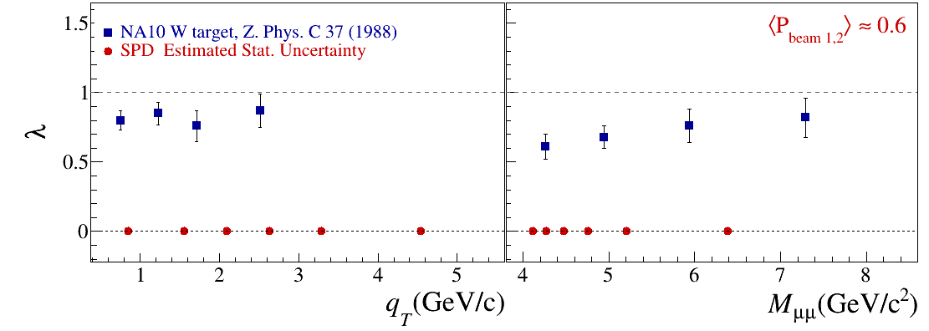
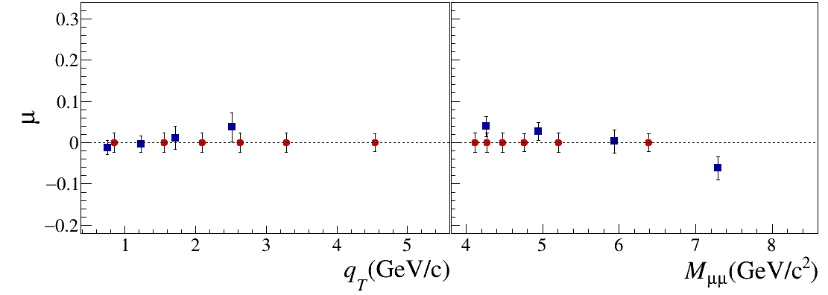
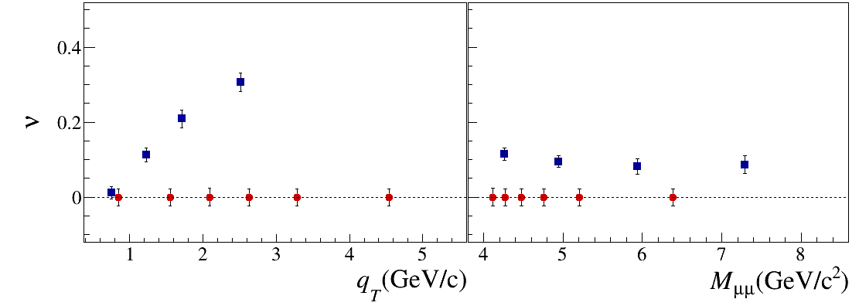


NA10 vs SPD
In 6 bins
SPD dA $≈$ 0.02
with $\left\langle P_{beam 1,2}\right\rangle =1.0$ SPD dA $≈$ 0.008

Slide 25
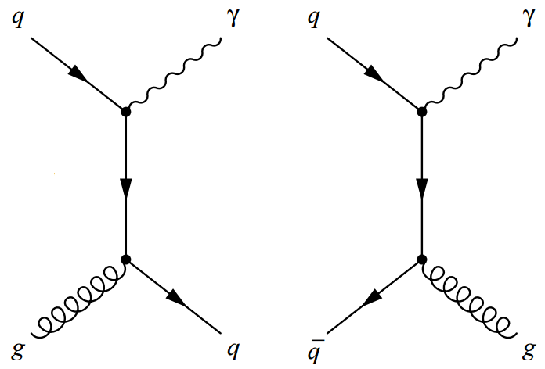
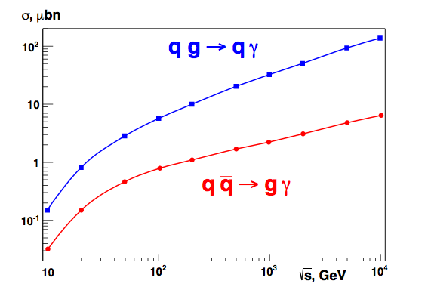
Prompt (direct) photon production
Gluon Compton
scattering
Quark-antiquark
annihilation
The gluon Compton scattering mechanism dominates…
q g→q γ 85%
q qbar→g γ 15%
NICA
…so we can obtain access to the contribution of gluon to spin of the nucleon.
RHIC

Slide 26
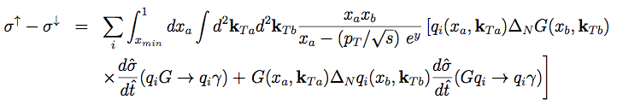
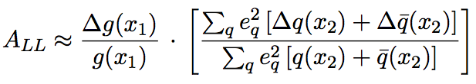

Prompt photons
The gluon Compton scattering gives access to the gluon content of proton:
Transverse beam polarization: access to the Sivers function for gluons
Longitudinal beam polarization: access to gluon polarization ∆g/g

Slide 27
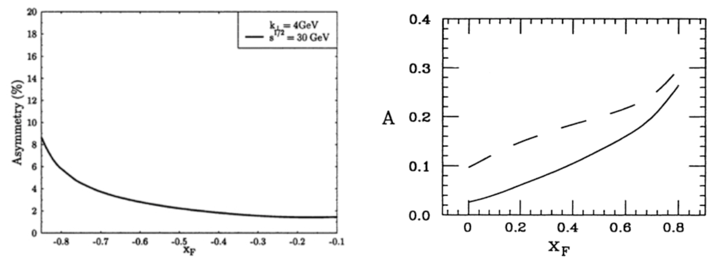
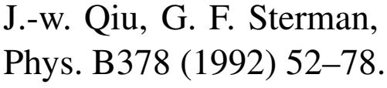
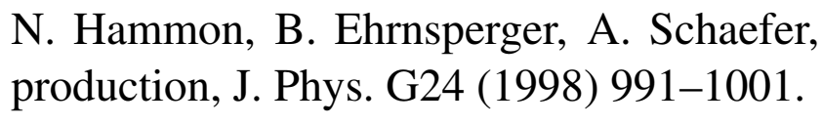
Expected asymmetries in prompt photon production

Slide 28
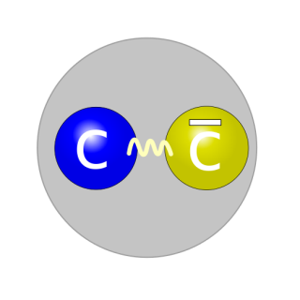

Charmonium (J/ψ) production
Applicability of the method is limited due the lack of understanding J/ψ production mechanism.
J/Ψ
Proton-proton collisions at SPD provide ideal opportunity for verification of theoretical approaches to J/ψ production.
Quark annihilation
NRQCD
Gluon fusion
Studying of J/Ψ production gives us access to the gluon PDFs.

Slide 29



Asymmetries in high p_{T} hadron production
Diquark properties;
Confinement laws;
Nature of the huge spin effects;
Deuteron spin structure;
Properties of the bare NΛ- and NK-interactions;
Nature and properties of the cold super dense baryonic matter (CsDBM) (pA and AA);
Dilepton production puzzle in np-interaction.
Notes:
29
29

Slide 30


Exclusive DY

Slide 31



GPD through vector meson exclusive production
p+p → p+p+VM

Slide 32


Slide 33
Minimum biased events
PYTHIA 6, √s_{pp} = 26 GeV; 4 MHz event rate
Average charged particle multiplicity ≈ 7.8
Average neutral particle multiplicity ≈ 6.5
√s
from A. Guskov

Slide 34


Requirements for the SPD
close to 4π geometrical acceptance;
high-precision (~50 µm) and fast vertex detector;
high-precision (~100 µm) and fast tracker,
good particle ID capabilities;
efficient muon range system,
good electromagnetic calorimeter,
low material budget over the track paths,
trigger and DAQ system able to cope with event rates at luminosity of 10³² (cm.s)⁻¹,
modularity and easy access to the detector elements, that makes possible further reconfiguration and upgrade of the facility.

Slide 35

General view
Length: 9.2 m;
Diameter: 6.8 m;
Mass: 1800 t;
Consists of three modules;
Easy way to rearrange.

Slide 36

Dimensions

Slide 37

Hybrid magnetic system
stainless steel tube
insulation epoxy
layer, 0.3 mm
copper shield
multilayer thermal shield
outer cover,
1mm stailess steel

Slide 38


Vertex detector (Inner tracker)
Charged particle creates electron/hole pairs, which migrates to electrodes creating signal in the nearest strips
Silicon vertex detector around the beam pipe;
Several layers of double ­sided silicon strips and MAPS;
Optimized number of layers w.r.t. material budget;
Goal: few tens of µm resolution for the vertex reconstruction.

Slide 39



Six particles from the vertex
Vertex detector with 5 layers

Slide 40


Central tracker
Minimum material on the particle tracks (X₀ ~ 0.1);
Time (~ 100 ns) and spatial resolution (~100 μm);
Expected particle rates (DAQ rates) ~ MHz;
Technology developed also in JINR, production workshops available

Slide 41




Momentum resolution
Hybrid magnetic system
Vertex Det.: 5 silicon layers
of 300 μm thickness each;
Barrel TS: 8 straw-tube
layers, two planes of
1 cm thickness in each
Pseudo-solenoidal
or 3↔3

Slide 42



Electromagnetic calorimeter
Photon energy range 0.1 - 10 GeV;
Due to space limitations the total length of the ECAL module should be less than 50 cm;
Required energy resolution <10.0%/√E (GeV) and energy threshold below 100 MeV;
Design ("shashlik") similar of that for KOPIO ECal
About 6500 modules
Shashlik

Slide 43





Range system
It should provide good (>95%) muon identification for momenta above 1 GeV.
Combination of responses from the ECal and RS could give additional lever for rejecting of pions and protons in a wide energy range.
The RS also provides additional coordinate measurement.
Our design will follow closely the design of the PANDA experiment range system (at FAIR, GSI) being developed now at the DLNP of JINR
Notes:
43
43
43

Slide 44
DAQ
The SPD DAQ may be developed a la upgraded DAQ of the COMPASS experiment;
Event rate 3.0 MHz (at L=10³² cm⁻²s⁻¹, √s=27 GeV);
Rough preliminary estimation of the total data flux from the detectors (Si tracker + straw tracker + PID + ECal + Range system): 10-20 GBytes/s (no detailed simulation results available yet);
Triggered or trigger-less DAQ: to be decided.

Slide 45

Software and computing

Slide 46
SPD advantages:
measurements with pp, pd and dd beams,
possibility to perform energy scan with small steps,
measurements via muon
and electron-positron pairs,
operations with
non-polarized,
transverse and
longitudinally
polarized beams
and their combinations,
possibility to extract all
first order PDFs in one
experiment.
HOME INSTITUTE, EXPERIMENT | RHIC, STAR | RHIC, fsPHENIX | NICA, SPD
Beams | pp, pA, pHe³ | pp pA, pHe³ | pp,pd, dd, pHe³, dHe³
Polarization | 0.6 | 0.6 | 0.6-0.8
Luminosity, cm⁻¹ s⁻¹ | 5∙10³² | (0.8-6)∙10³² | 10³²
√s , GeV | 160,200, 500 | 160,200, 500 | 10-26
X₁, range | 0.3-1.0 | 0.3-1.0 | 0.1-0.8
Q _{T}, GeV | 1-10 | 1-10 | 0.5-6
Lepton pairs | µ+µ- | µ+µ- | µ+µ-, e+e-
Start of data taking | >2020 | >2021 | 2025
Measurements
Transversity | yes | yes | yes
Boer-Mulders | yes | yes | yes
Sivers | yes | yes | yes
Predzelosity | no | yes | yes
Worm-Gear | yes | no | yes
Flavour separation | yes | yes | yes
Exclusive DY | yes | no | yes
Deuteron quadrupole structure | no | no | yes

Slide 47
Collaborating institutions – 25 so far
  National Science Laboratory, Armenia
  Institute of Applied Physics of the Belarus Academy of Sciences;
  Gomel State Technical University, Belarus;
  Institute for Nuclear Problems of BSU – Minsk;
  Chilean cluster of universities, Chile
  Tsinghua University, Tsinghua, China
  Instituto Superior de Tecnologías y Ciencias Aplicadas (INsTEC), Havana University;
  Charles University, Prague;
  Technical University, Prague
  INFN section of Turin and University of Turin;
  CEA, Saclay, France;
  Warsaw University of Technology;
  Tomsk State University;
  Tomsk Polytechnic University;
  Lebedev Physics Institute of the RAS, Moscow;
  Institute for High Energy Physics, Protvino;
  Institute of Nuclear Physics of the Moscow State University;
  Institute for Nuclear Research of the RAS, Troitsk;
  Institute for Theoretical and Experimental Physics, Moscow;
  St. Petersburg Nuclear Physics Institute, Gatchina;
  St. Petersburg State University;
  St. Petersburg Polytechnic University;
  Samara National Research University;
  Belgorod National Research University;
  Kharkov National University, Kiev, Ukraine
Protocols for joint research within the SPD project signed.
EoI letters received
Bilateral agreements on NICA exist.

Slide 48
Start of the SPD project
Letter of Intent presented at the JINR PAC in summer 2014, where:
  the physics program of the experiment was developed;
  requirements to NICA polarized beams were formulated;
  desired detector characteristics and sketch of the facility were given;
A few presentation at international conferences about the physics potential and program of the SPD were given;
Several workshops on spin physics at NICA were organized:
  NICA-SPIN-2013, Дубна, 17-19.03.2013
  SPIN-Praha-2013, 7-13.07.2013
  NICA-SPIN-2014, Praha, 11-16.02.2014
  SPIN-Praha-2015, 26-31.07.2015
  DSPIN2013, DSPIN2015, DSPIN2017
arXiv: 1408.3959
In 2017 a new stage of the project started:
From LoI to CDR (Conceptual Design Report)

Slide 49
Roadmap
JINR project for the SPD design (Jan. 2019);
Conceptual and technical design of the Spin Physics Detector (SPD) at the NICA collider
Setting up of the collaboration, MoU (2020);
Preparation of the Conceptual Design Report (2019);
Preparation of the Technical Design Report, including prototyping (2020-2022).
Construction of the detector would take at least three years (2022-2025) and first measurements could be expected as early as close to the end of 2025…

Slide 50


SPD/NICA will provide a unique opportunity
not available at other facilities
to study all of the PDFs in one experiment
and obtain comprehensive information
on the nucleon spin structure
at high statistical level
with minimal systematic uncertainties
You are welcome
to join the SPD/NICA project!
Web site: spd.jinr.ru.
Contact person: Roumen Tsenov (tsenov@jinr.ru)

Slide 51
Back-up

Slide 52
NICA
baryonic density ρ / ρ₀
0 1 ρ₀ = 0,16 fm⁻³

Slide 53







Spin and magnetic moment
nuclear magneton:
for the electron:
μ_{d} = 0.86μ_{N}

Slide 54


Nucleon spin structure
Before 1988
quarks
The quark model says:
the nucleon spin is carried only by quarks.

Slide 55
quarks
PROBLEM: According to the experimental data, only 30% of the nucleon spin is carried by quarks. Where does the rest of the spin come from?

Slide 56




Spin and 3D structure of hadrons
Spin puzzle: small contribution of quarks (may be fractional because of density matrix rather than wave function description) to the proton spin
The deficit may be due to:
1.Gluon average spin ΔG, and
2.Orbital motion L related to transverse (completing to 3D) structure of proton
All ingredients can be explored at SPD!
Main instrument: transverse spin asymmetries
The simplest transverse asymmetry : left-right; more involved: azimuthal modulations

Slide 57


Prompt photon asymmetries: accuracy
Statistics: 3×10⁷ prompt photons with p_{T}>4 GeV/c for one year of data taking (10⁷ s). It could keep statistical uncertainty of AN and ALL asymmetries measurement below 0.001 level.
Main contribution to systematics comes from MC-dependent subtraction of background from decay photons, charged particles etc. The expected total error does not exceed (1-2)×10⁻².
Signal and different sources of background for prompt photon production
Similar accuracy is expected for ALL while the expected asymmetry is between ±0.05
SPD data for AN and ALL at √s∼20 GeV will be complementary to the expected results from RHIC (√s∼200 GeV) and corresponds to the region of typically larger values of ΔG/G
SPD expectations, previous measurement at similar kinematic range and theory predictions for AN

Slide 58

O. Teryaev, SPD meeting
29 April 2019

Slide 59

Year 2014

Slide 60


Reconfigurable design

Slide 61
JINR participation:
112 authors, 37.7 FTE
Laboratory of High-Energy Physics
  authors: 74
  FTE: 24.4
Laboratory of Nuclear Problems
  authors: 30
  FTE: 11.3
Laboratory of Theoretical Physics
  authors: 6
  FTE: 2
Directorate (1), Laboratory of Information Technologies (1)

Slide 62

COMPASS data, pion beam

Slide 63
Systems that have not been thought out yet…
System for particle ID (multigap glass RPCs, Micromegas, Aerogel Cherenkov?);
"Zero degree" system (fine grained hadron calorimeter?)
Front-end electronics of the different subsystems;
Notes:
63

Slide 64


Beam test facility

