Slide 1
Study of polarization phenomena in pp- and dd-interactions at energy in c.m.s. up to 27 GeV/nucleon with SPD at NICA collider
Roumen Tsenov (LHEP),
SPD project coordinator in JINR

Slide 2
NICA (Nuclotron based Ion Colider fAcility)
is the flagship project in high energy physics
of the Joint Institute for Nuclear Research
Main targets of the NICA project:
- study of hot and dense baryonic matter
- investigation of nucleon spin structure,
polarization phenomena
Ring circumference, m | 503.04
heavy ions
energy range for Au⁷⁹⁺: √S_{NN}, GeV | 4 - 11
r.m.s. Δp/p, 10⁻³ | 1.6
Luminosity for Au⁷⁹⁺, cm⁻² s⁻¹ | 1x10²⁷
polarized particles
max. √S for polarized p, Gev | 27
Luminosity for p, cm⁻² s⁻¹ | 1x10³²

Slide 3
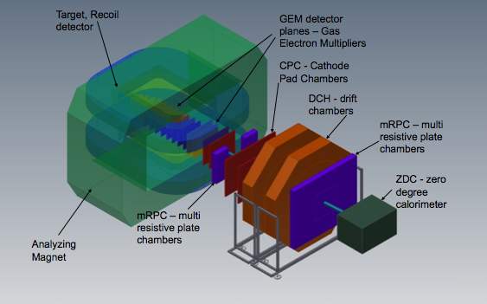
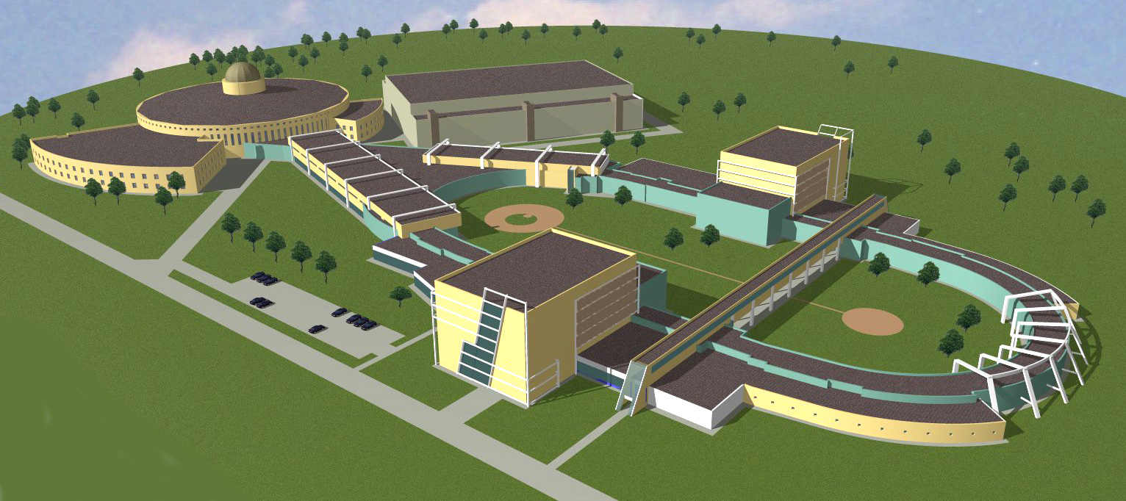
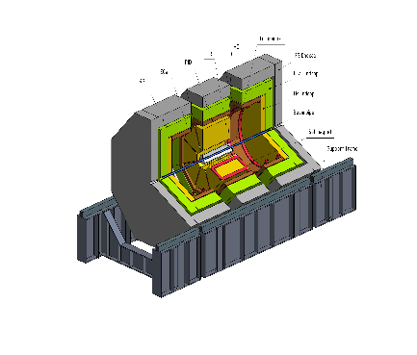
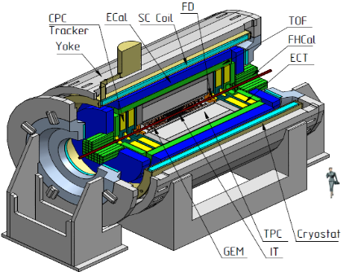
The NICA complex
existing facilities
to be constructed
KRION-6T+ HILac (3MeV/u)
BM@N
SPD
PS & LU-20 (5MeV/u)
hall for fixed target
experiments
Booster
(600 MeV/u)
SPD hall
MPD hall
NUCLOTRON 0.6-4.5 GeV/u
MPD
Collider

Slide 4

Civil Construction, bld.17
June 2018
Collider
Western semiring
MPD Hall
SPD Hall

Slide 5
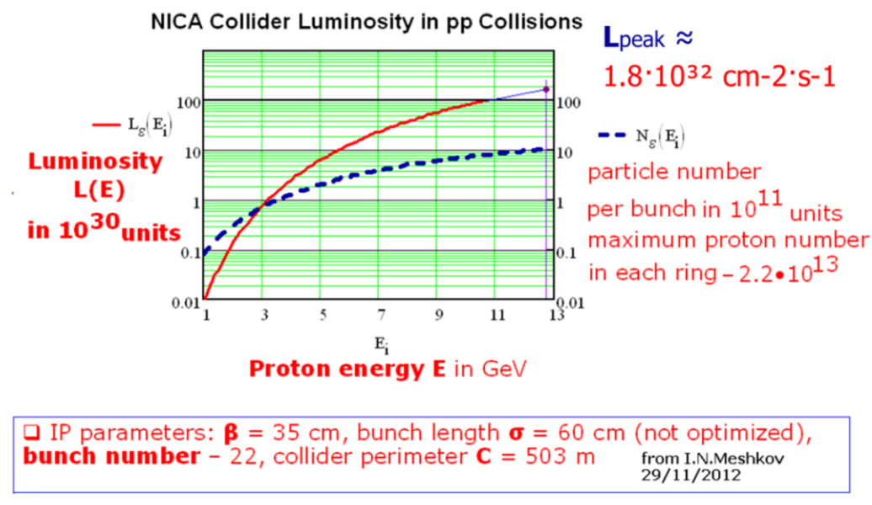
Polarized beams
Bunch crossing each 80 ns;
crossing rate 12.5 MHz .
Polarized beams
p↑p↑ at √s_{pp} = 12 - 27 GeV, L_{av} ≈ 10³² cm⁻²s⁻¹
d↑d↑ at √s_{NN} = 4 - 13 GeV
longitudinal and transverse polarization at SPD and MPD

Slide 6
Start of the SPD project
Letter of Intent presented at the JINR PAC in summer 2014, where:
  the physics program of the experiment was developed;
  requirements to NICA polarized beams were formulated;
  desired detector characteristics and sketch of the facility were given;
A few presentation at international conferences about the physics potential and program of the SPD were given;
Several workshops on spin physics at NICA were organized:
  NICA-SPIN-2013, Дубна, 17-19.03.2013
  SPIN-Praha-2013, 7-13.07.2013
  NICA-SPIN-2014, Praha, 11-16.02.2014
  SPIN-Praha-2015, 26-31.07.2015
  DSPIN2013, DSPIN2015, DSPIN2017
arXiv: 1408.3959
In 2017 a new stage of the project started:
From LoI to CDR (Conceptual Design Report)

Slide 7
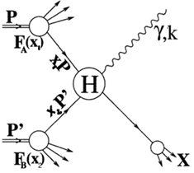
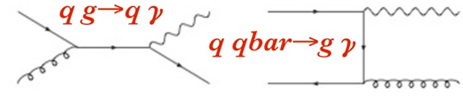
Physics tasks
Nucleon spin structure studies
  Drell-Yan pair production;
  Direct photons;
  Nucleon PDFs by J/ψ production;
Spin-dependent effects in elastic pp, pd and dd scattering;
Spin effects in exclusive hadron production;
Spin effects in production of hadrons with high p_{T} ;
etc….
Notes:
7
7
7
7

Slide 8
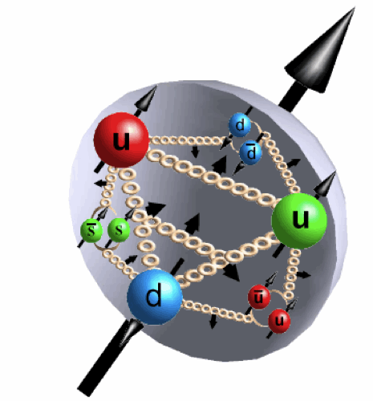
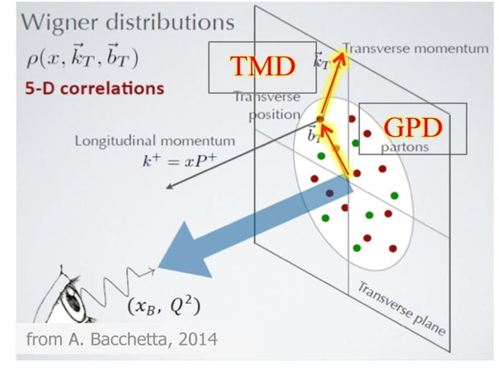

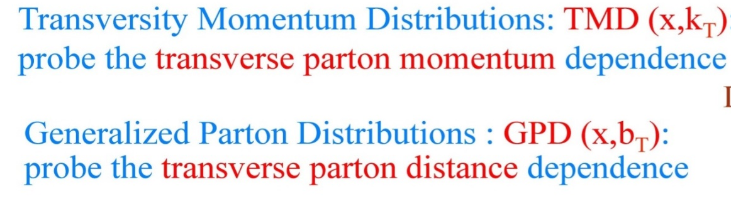
Spin dependent PDFs

Slide 9
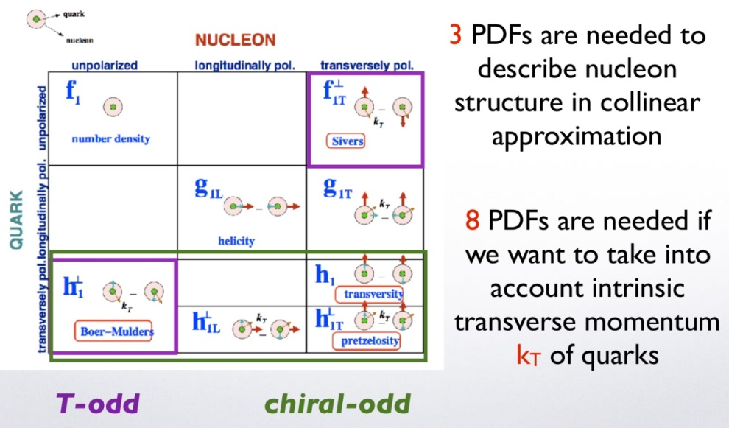
TMD and GPD
Notes:
9
9
1. Transversity: A_{UT} sin(f+fS), correlation between the transverse polarization of nucleon;
2. Sivers: Asin(f-fS)UT , correlation the transverse momentum of non-polarized quark;
3. Pretzelosity: AUT sin(3f-fS), distribution of the transverse momentum of quarks in the transversely
79 polarized nucleon;
4. Boer-Mulders: Acos(2fh)UU , distribution of the quark transverse momentum in the non-polarized nucleon;
5. Worm-Gears: Acos(2fh)UL , correlation between the longitudinal polarization of the nucleon (longitudinal spin) and the transverse momentum of quarks.

Slide 10
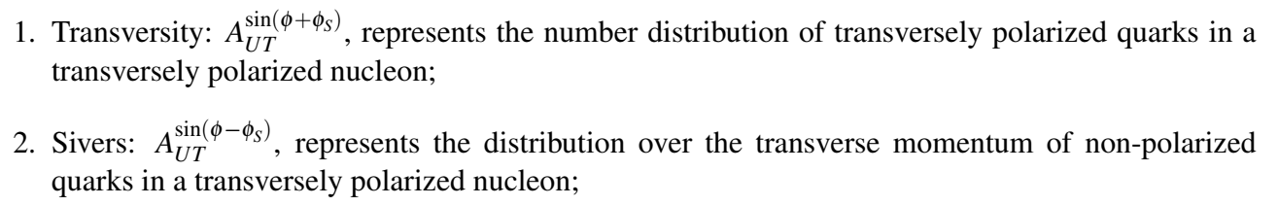
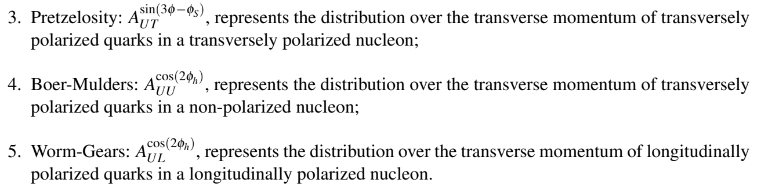
Structure functions

Slide 11
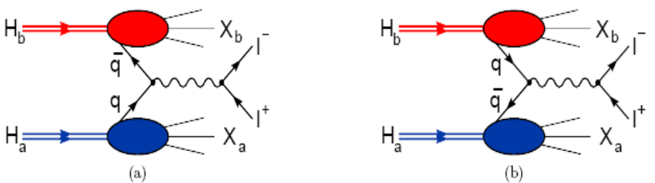
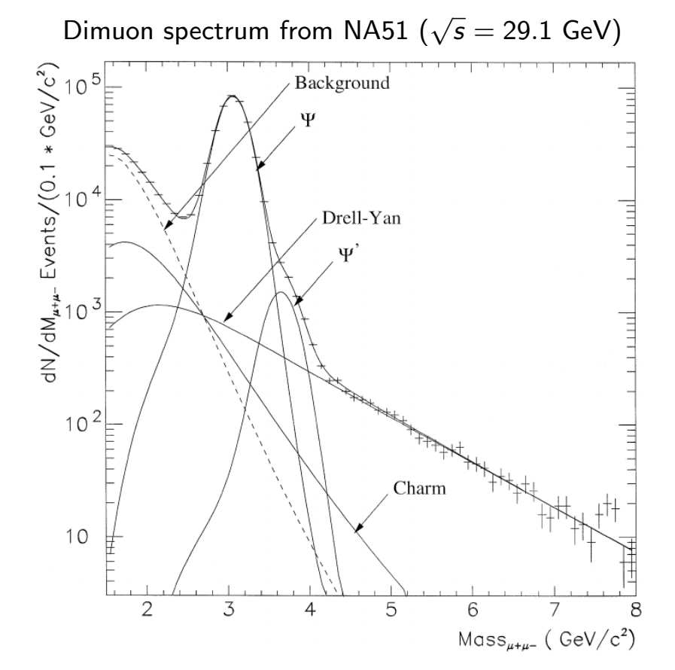
Drell-Yan pairs
σ_{tot} ~ 9 nb
Notes:
10/24/17
A.P.Nagaytsev, SPIN-2010, October 1, Juelich
11
10/24/17
A.P.Nagaytsev, SPIN-2010, October 1, Juelich
11
10/24/17
A.P.Nagaytsev, SPIN-2010, October 1, Juelich
11
10/24/17
A.P.Nagaytsev, SPIN-2010, October 1, Juelich
11
10/24/17
A.P.Nagaytsev, SPIN-2010, October 1, Juelich
11
10/24/17
A.P.Nagaytsev, SPIN-2010, October 1, Juelich
11
10/24/17
A.P.Nagaytsev, SPIN-2010, October 1, Juelich
11
11
A.P.Nagaytsev, SPIN-2010, October 1, Juelich
11
11

Slide 12
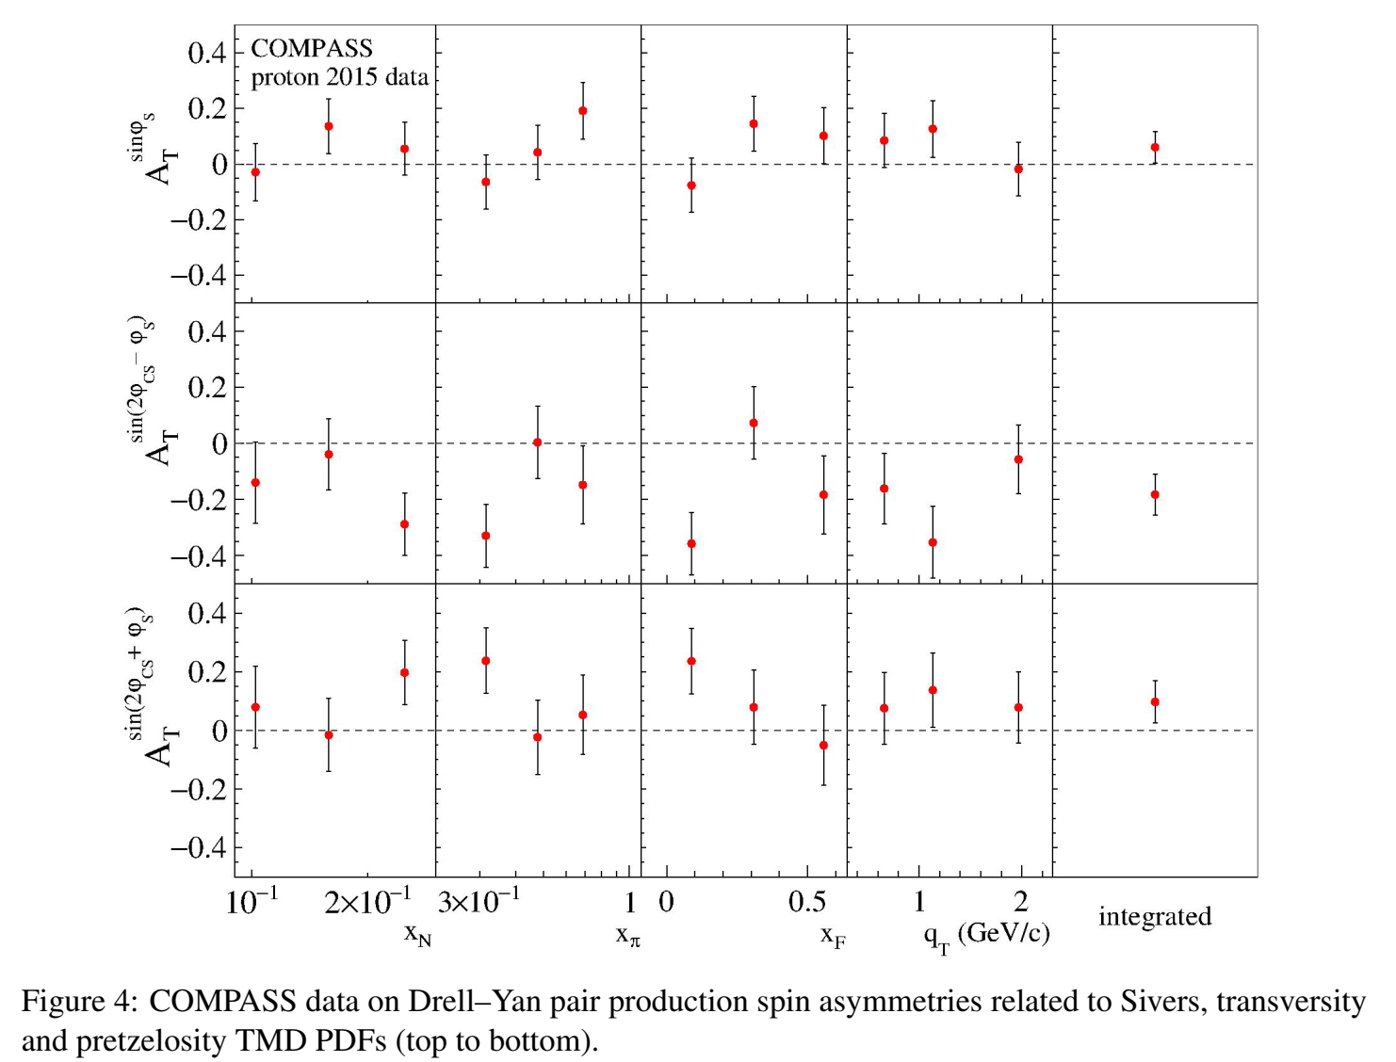
COMPASS data, pion beam

Slide 13

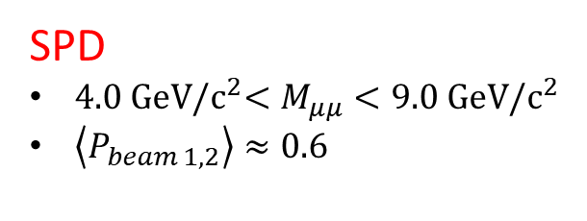

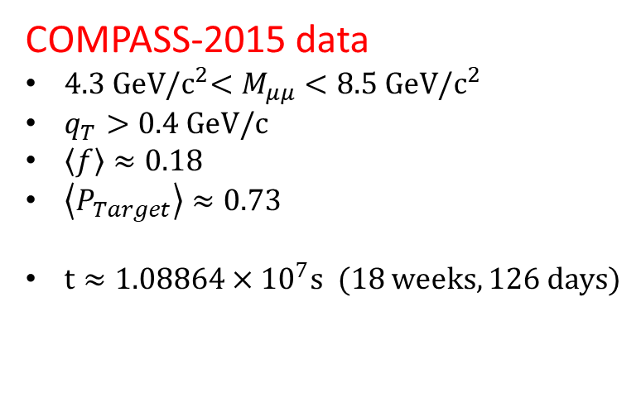

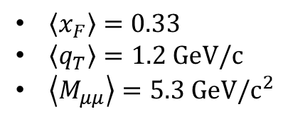

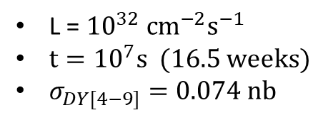
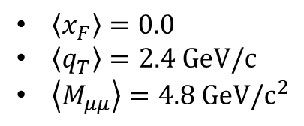
Kinematical ranges and statistics
COMPASS-2015 data
$4.3 GeV{/c}^{2}<M_{μμ}<8.5 GeV/c^{2}$
$q_{T}>0.4 GeV/c$
$\left\langle f\right\rangle ≈0.18$
$\left\langle P_{Target}\right\rangle ≈0.73$
${t≈1.08864×10}^{7}s$ (18 weeks, 126 days)
PRL 119 (2017) 112002
$\left\langle x_{F}\right\rangle =0.33$
$\left\langle q_{T}\right\rangle =1.2 GeV/c$
$\left\langle M_{μμ}\right\rangle =5.3$ $GeV/c^{2}$
$N_{DY}$= 35 $×$ ${10}^{3}$
SPD
$4.0 GeV{/c}^{2}<M_{μμ}<9.0 GeV/c^{2}$
$\left\langle P_{beam 1,2}\right\rangle ≈0.6$
$\left\langle x_{F}\right\rangle =0.0$
$\left\langle q_{T}\right\rangle =2.4 GeV/c$
$\left\langle M_{μμ}\right\rangle =4.8$ $GeV/c^{2}$
L = ${10}^{32} {cm}^{−2}s^{−1}$
${t=10}^{7}s$ (16.5 weeks)
$σ_{DY[4−9]}=0.074 nb$
$N_{DY}$ = $σ_{DY}×L×t$
$N_{DY}$= 88.8 $×$ ${10}^{3}$
$$dA=\frac{1}{P_{b1}P_{b2}}×\frac{1}{\sqrt{N}}$$

Slide 14
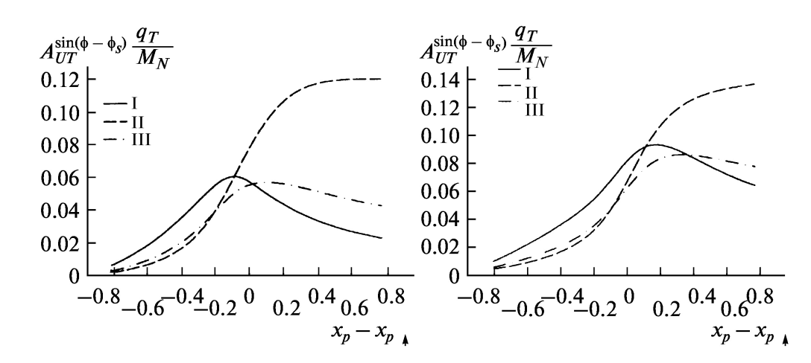
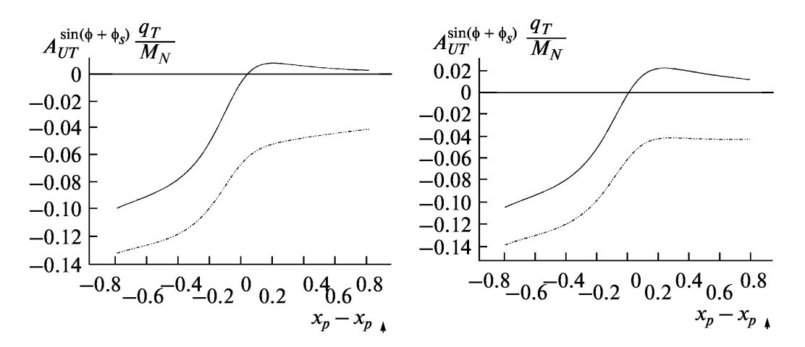
Asymmetries in DY pair production
Q² = 4 GeV²
Q² = 15 GeV²
Sivers
J.C.Collins et al., PRD73
(2006)014021
Boer-Mulders
s= 400 GeV²

Slide 15
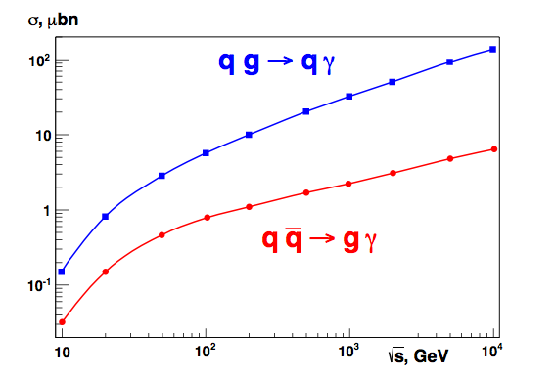
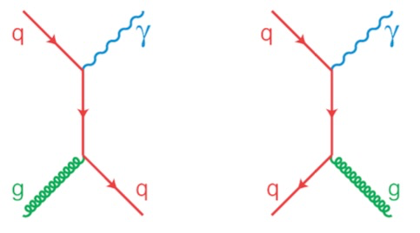
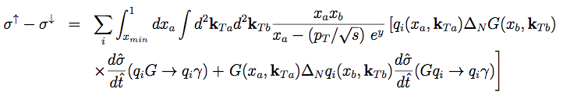
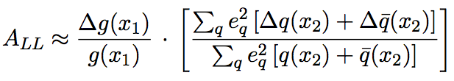

Prompt photons
The gluon Compton scattering gives access to the gluon content of proton:
NICA
RHIC
Transverse beam polarization: access to the Sivers function for gluons
Longitudinal beam polarization: access to gluon polarization ∆g/g
Longitudinal beam polarization: access to gluon polarization ∆g/g

Slide 16
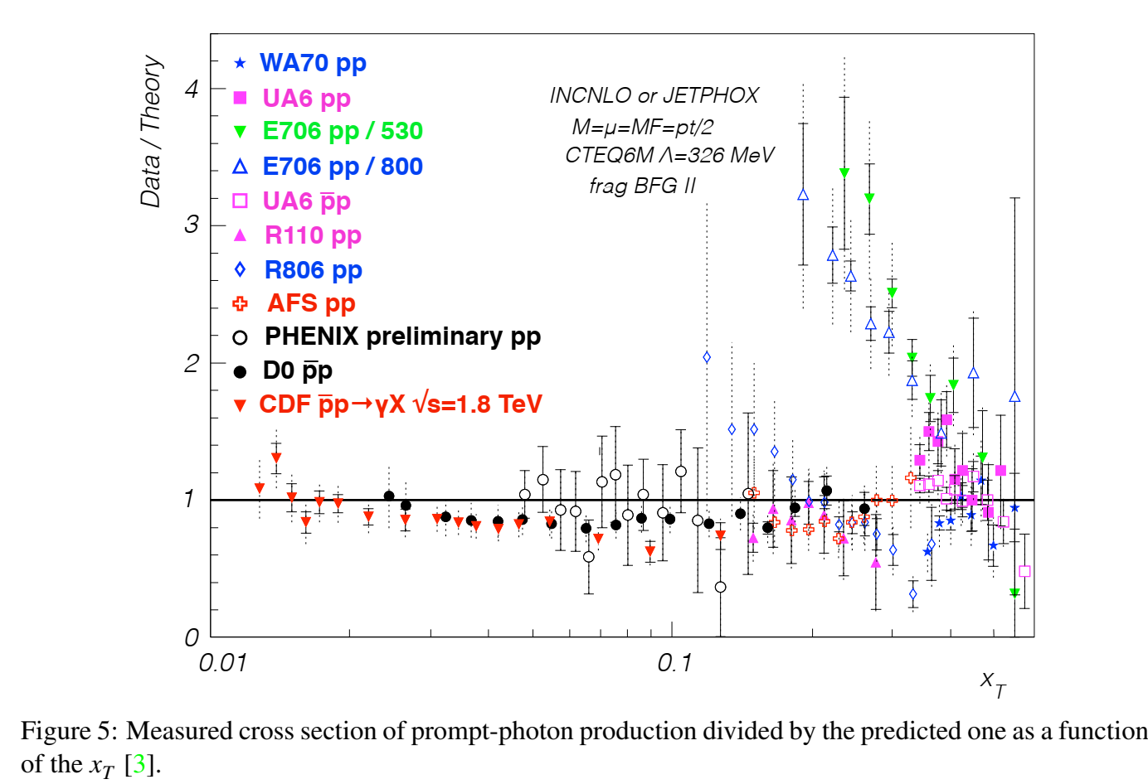
Prompt photon production cross section

Slide 17
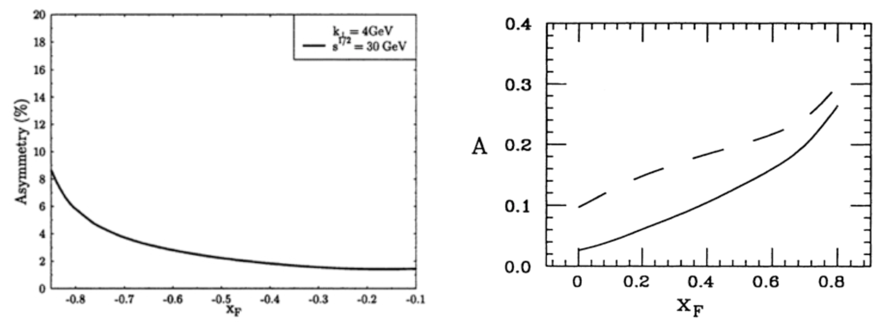
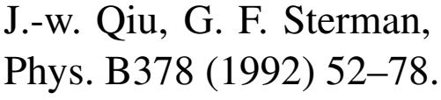
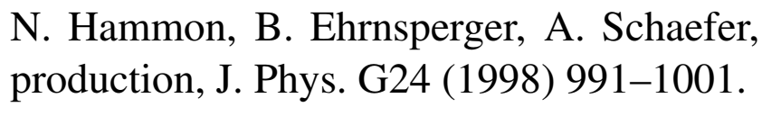
Expected asymmetries

Slide 18
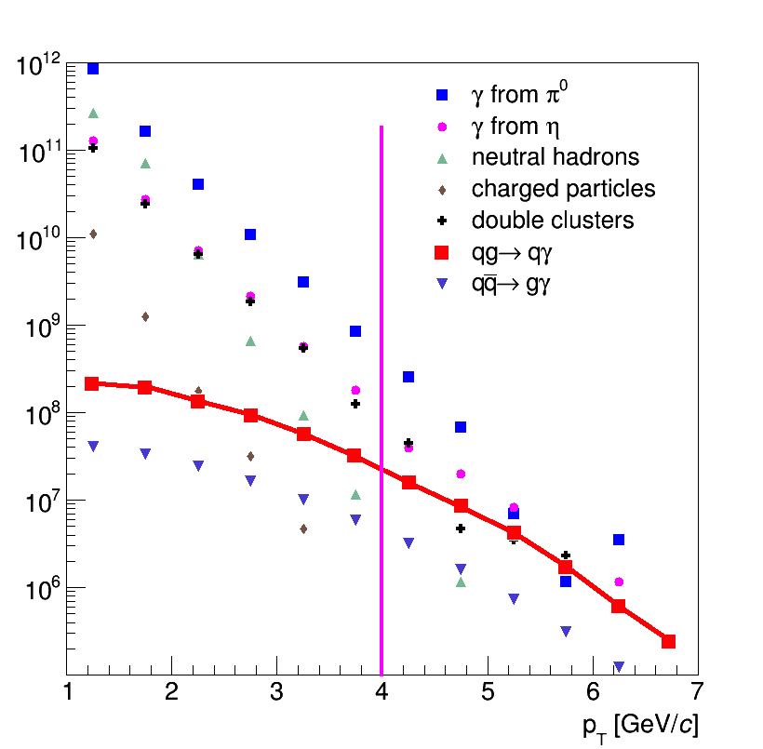
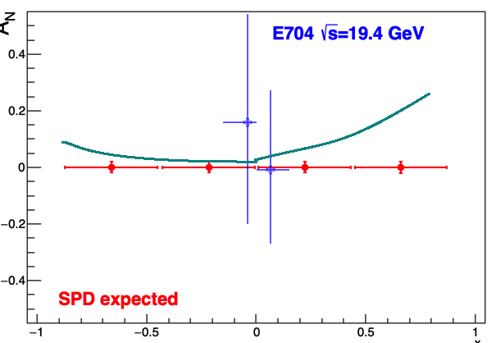
Prompt photon asymmetries: accuracy
Statistics: 3×10⁷ prompt photons with p_{T}>4 GeV/c for one year of data taking (10⁷ s). It could keep statistical uncertainty of AN and ALL asymmetries measurement below 0.001 level.
Main contribution to systematics comes from MC-dependent subtraction of background from decay photons, charged particles etc. The expected total error does not exceed (1-2)×10⁻².
Signal and different sources of background for prompt photon production
Similar accuracy is expected for ALL while the expected asymmetry is between ±0.05
SPD data for AN and ALL at √s∼20 GeV will be complementary to the expected results from RHIC (√s∼200 GeV) and corresponds to the region of typically larger values of ΔG/G
SPD expectations, previous measurement at similar kinematic range and theory predictions for AN

Slide 19
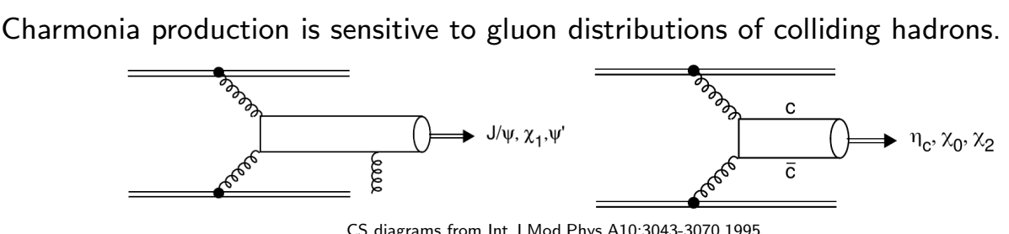
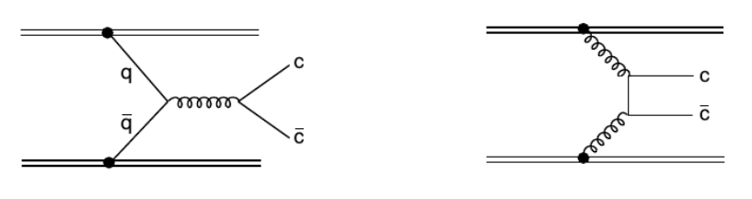
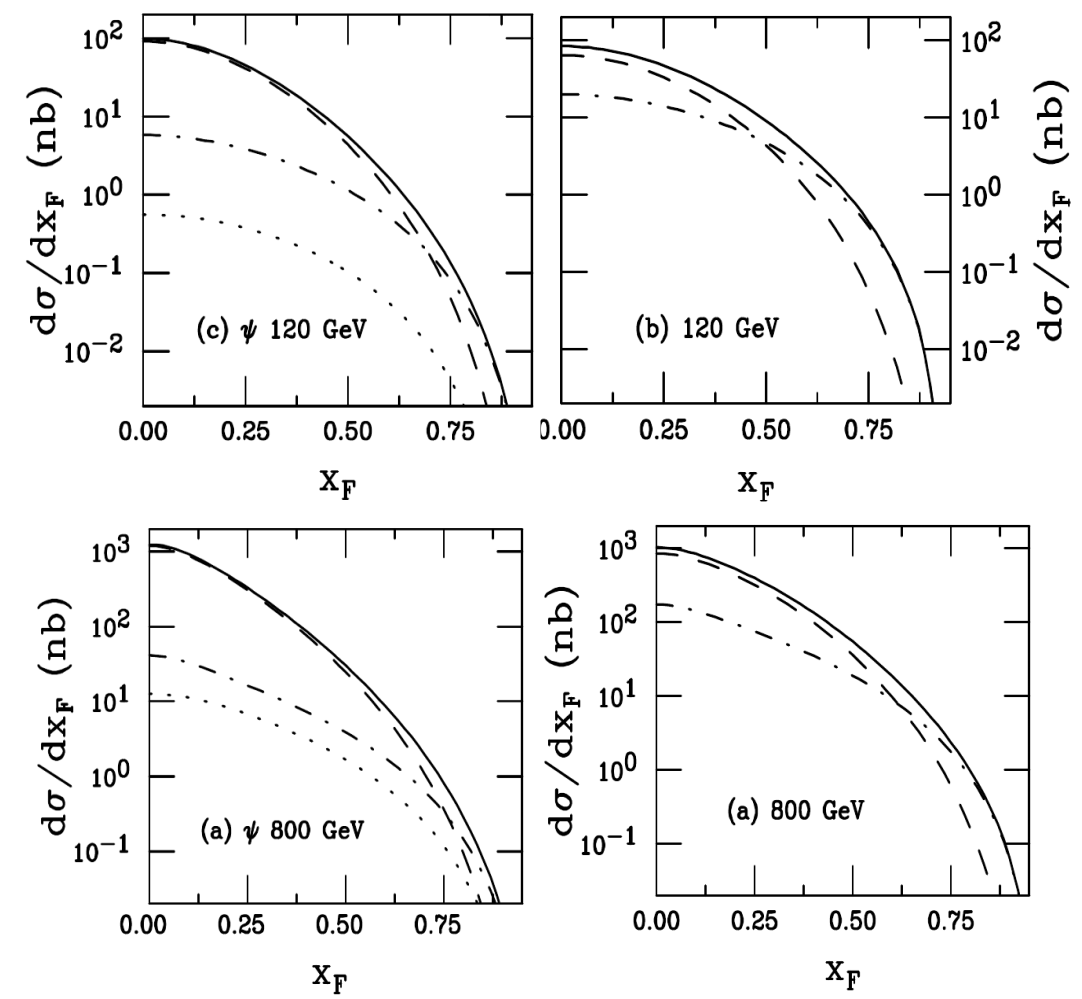
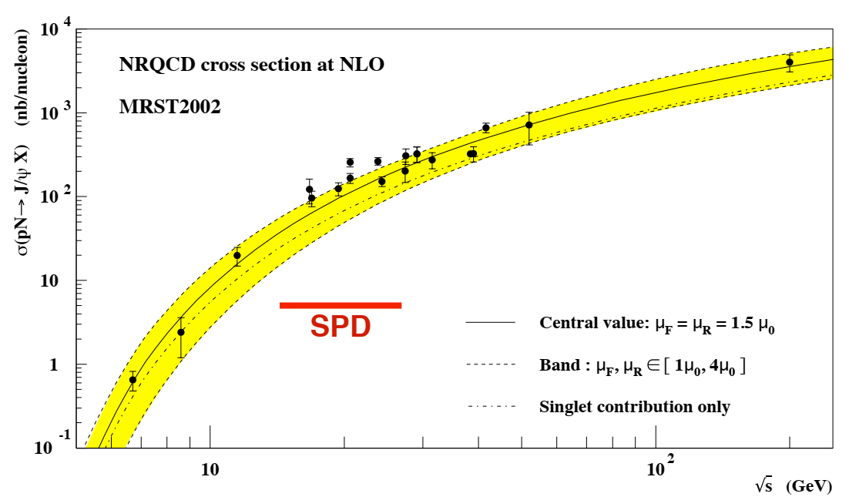
Charmonium production
Gluon fusion
Quark annihilation
NRQCD CEM

Slide 20
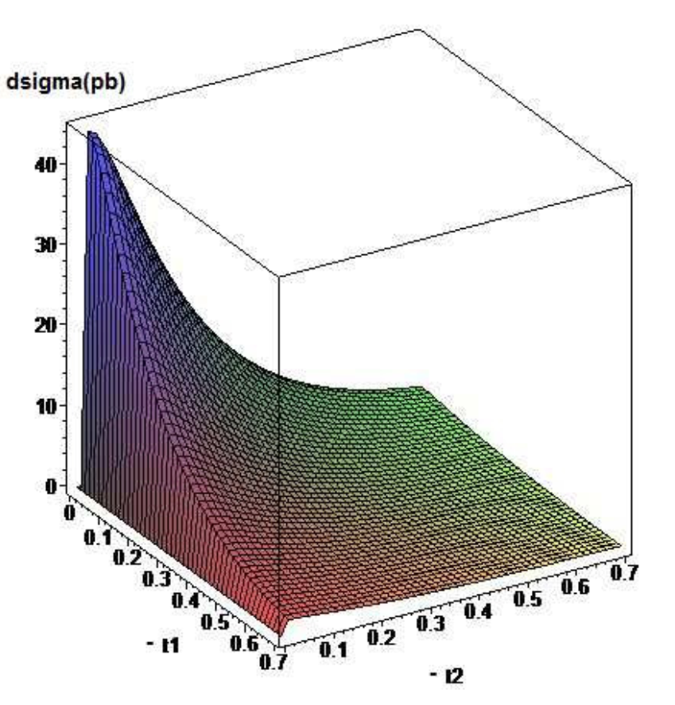
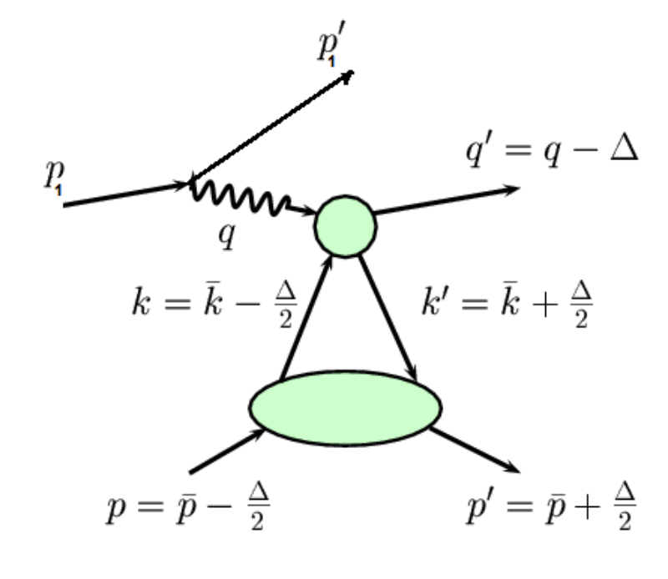

GPD through vector meson exclusive production
Exclusive DY
p+p → p+p+VM

Slide 21
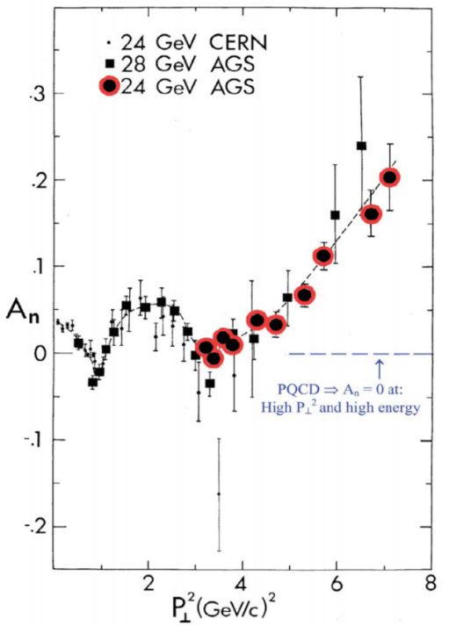
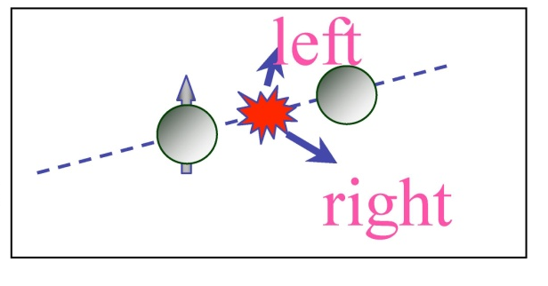
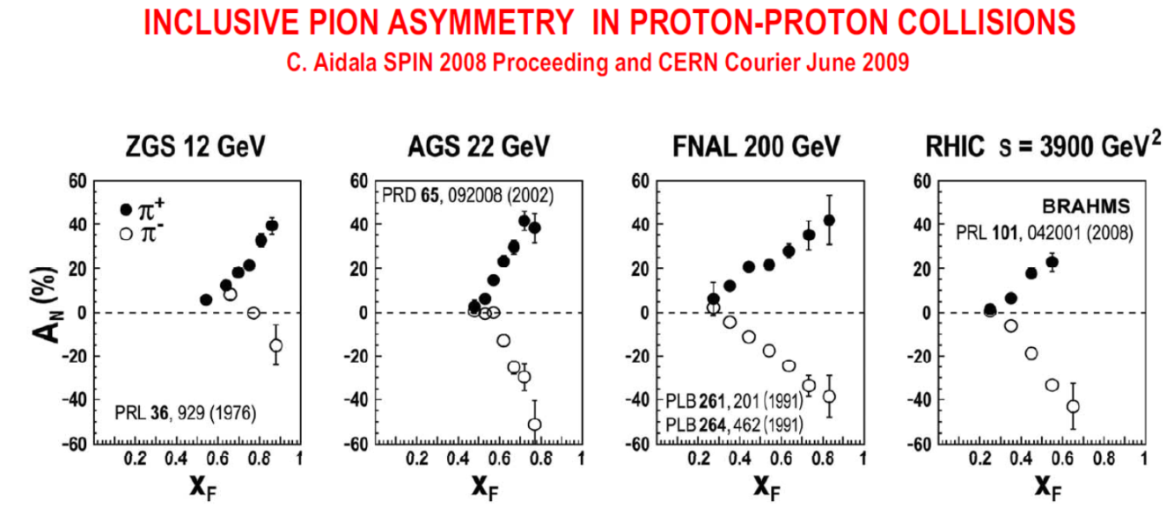
Asymmetries in high p_{T} hadron production
Diquark properties;
Confinement laws;
Nature of the huge spin effects;
Deuteron spin structure;
Properties of the bare NΛ- and NK-interactions;
Nature and properties of the cold super dense baryonic matter (CsDBM) (pA and AA);
Dilepton production puzzle in np-interaction.
Notes:
21
21

Slide 22
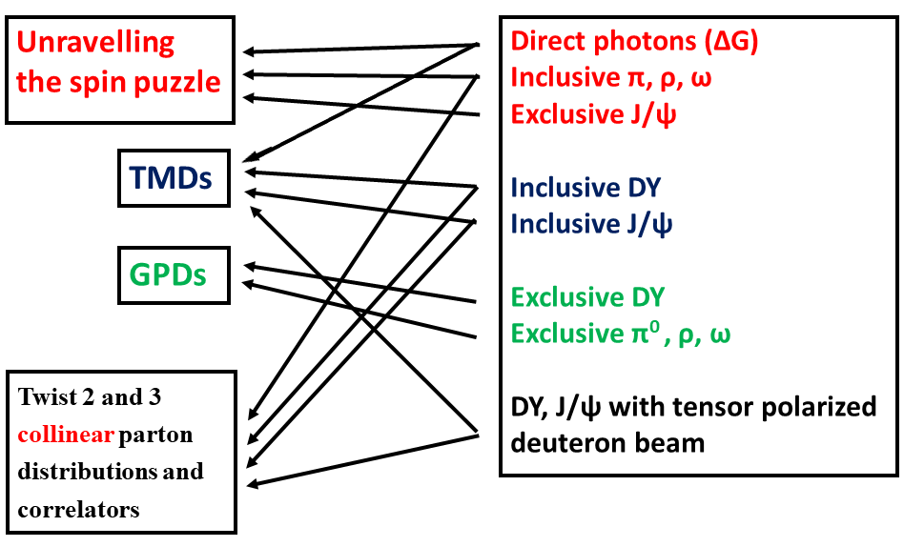

Slide 23
SPD advantages:
measurements with pp, pd and dd beams,
possibility to perform energy scan with small steps,
measurements via muon
and electron-positron pairs,
operations with
non-polarized,
transverse and
longitudinally
polarized beams
and their combinations,
possibility to extract all
first order PDFs in one
experiment.
HOME INSTITUTE, EXPERIMENT | RHIC, STAR | RHIC, fsPHENIX | NICA, SPD
Beams | pp, pA, pHe³ | pp pA, pHe³ | pp,pd, dd, pHe³, dHe³
Polarization | 0.6 | 0.6 | 0.6-0.8
Luminosity, cm⁻¹ s⁻¹ | 5∙10³² | (0.8-6)∙10³² | 10³²
√s , GeV | 160,200, 500 | 160,200, 500 | 10-26
X₁, range | 0.3-1.0 | 0.3-1.0 | 0.1-0.8
Q _{T}, GeV | 1-10 | 1-10 | 0.5-6
Lepton pairs | µ+µ- | µ+µ- | µ+µ-, e+e-
Start of data taking | >2020 | >2021 | 2025
Measurements
Transversity | yes | yes | yes
Boer-Mulders | yes | yes | yes
Sivers | yes | yes | yes
Predzelosity | no | yes | yes
Worm-Gear | yes | no | yes
Flavour separation | yes | yes | yes
Exclusive DY | yes | no | yes
Deuteron quadrupole structure | no | no | yes

Slide 24
Minimum biased events
PYTHIA 6, √s_{pp} = 26 GeV; 4 MHz event rate
Average charged particle multiplicity ≈ 7.8
Average neutral particle multiplicity ≈ 6.5
√s
from A. Guskov

Slide 25
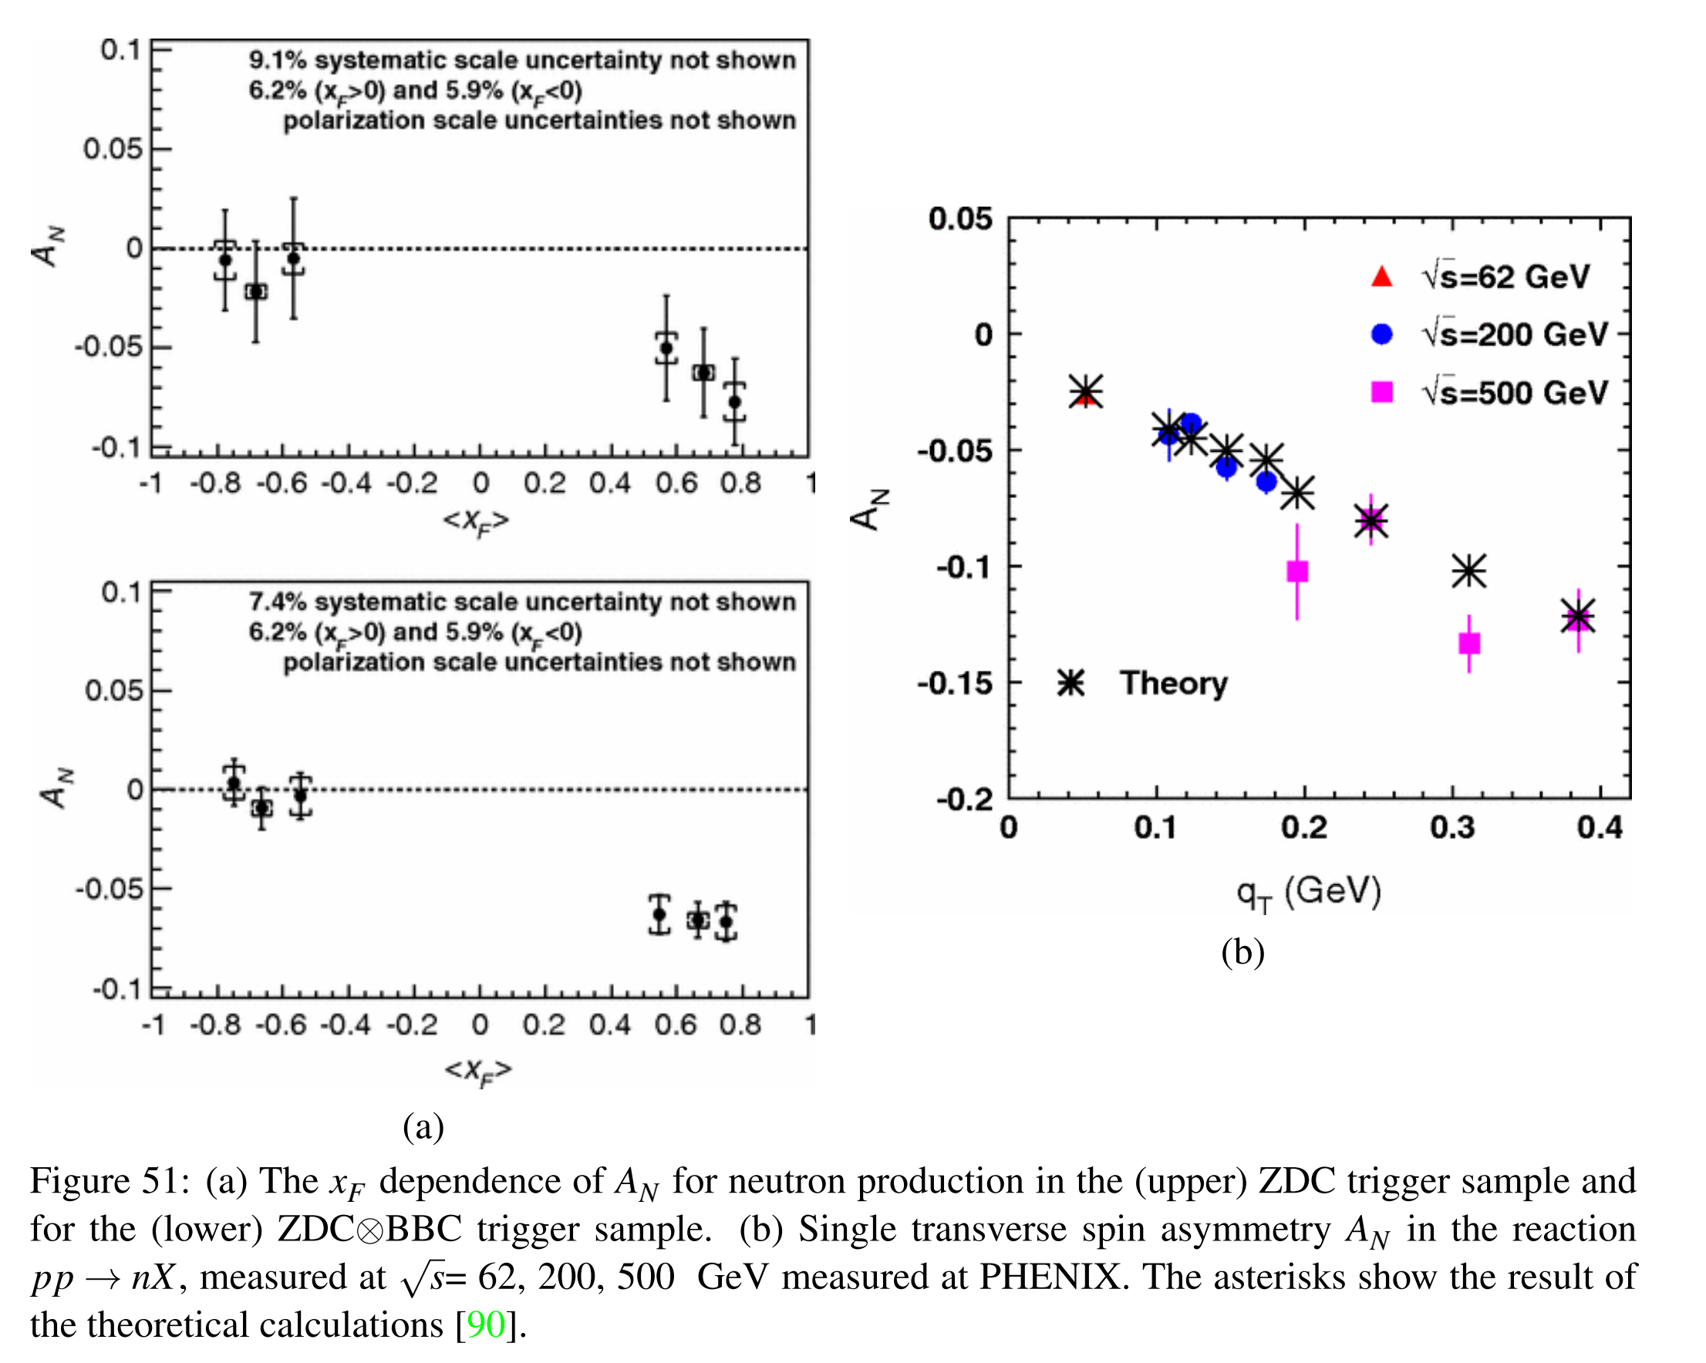

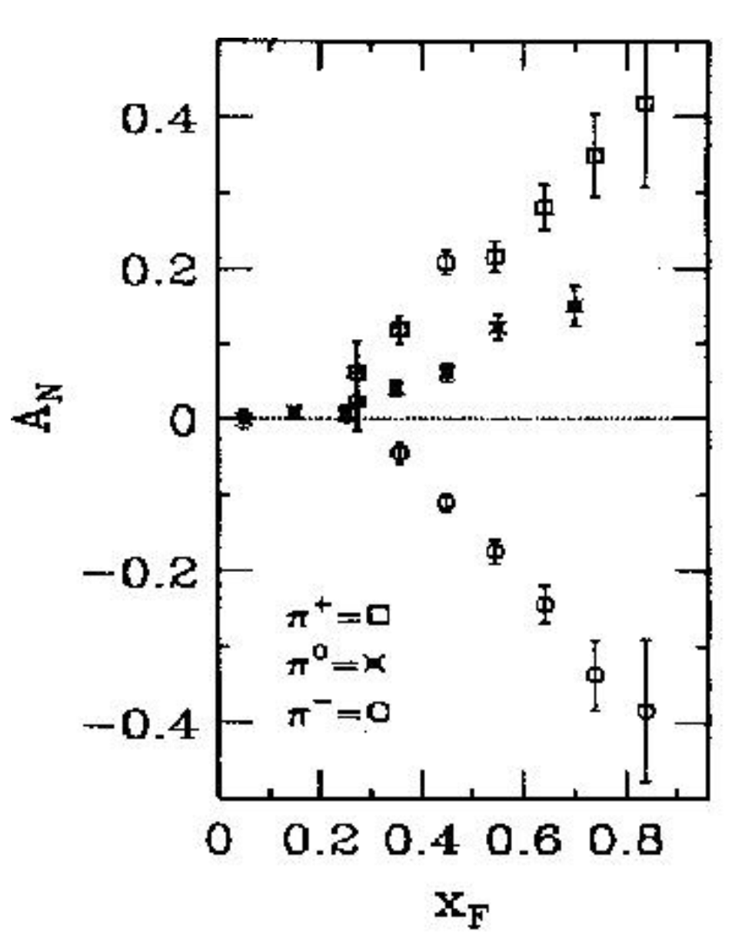
Local polarimetry

Slide 26
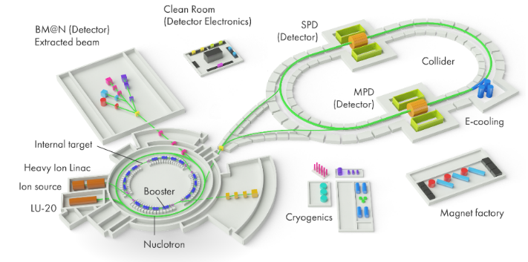
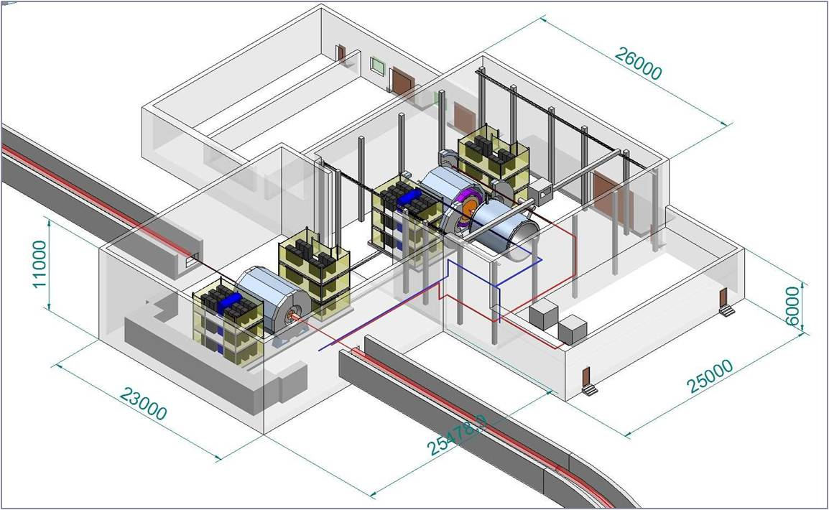
Requirements for the SPD
close to 4π geometrical acceptance;
high-precision (~50 µm) and fast vertex detector;
high-precision (~100 µm) and fast tracker,
good particle ID capabilities;
efficient muon range system,
good electromagnetic calorimeter,
low material budget over the track paths,
trigger and DAQ system able to cope with event rates at luminosity of 10³² (cm.s)⁻¹,
modularity and easy access to the detector elements, that makes possible further reconfiguration and upgrade of the facility.

Slide 27
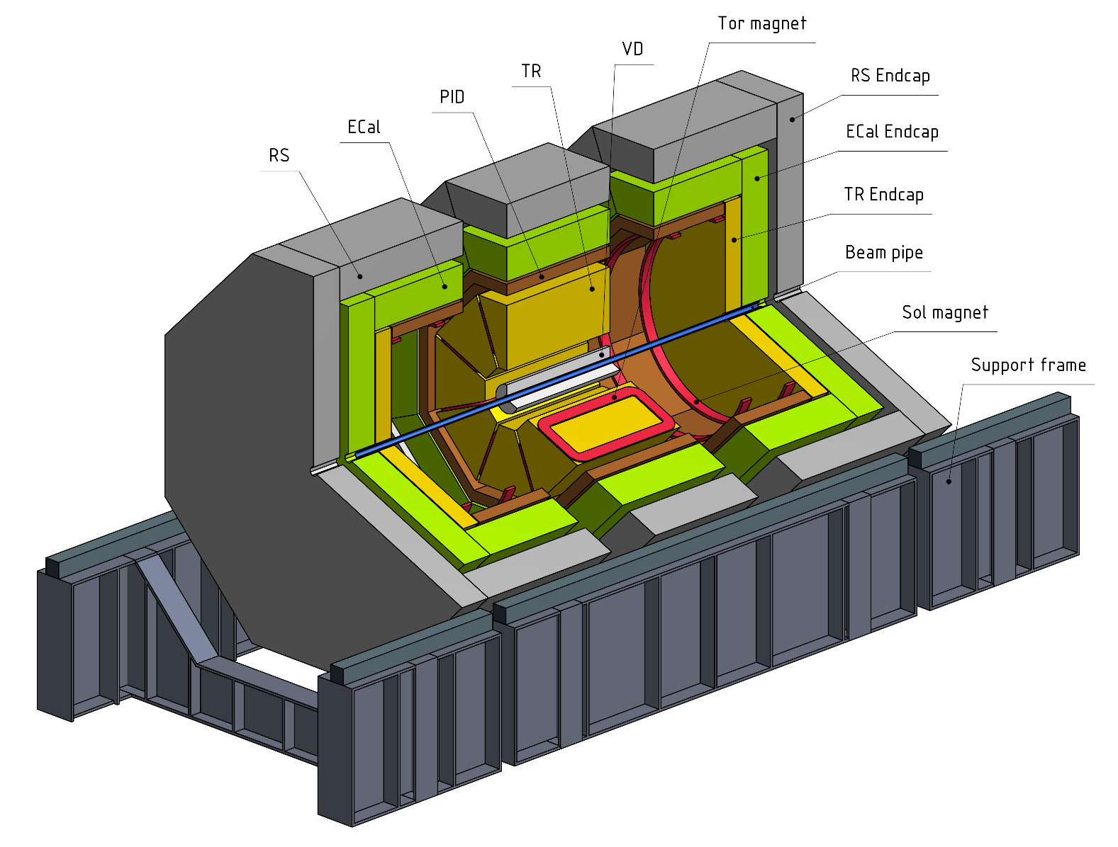
General view

Slide 28
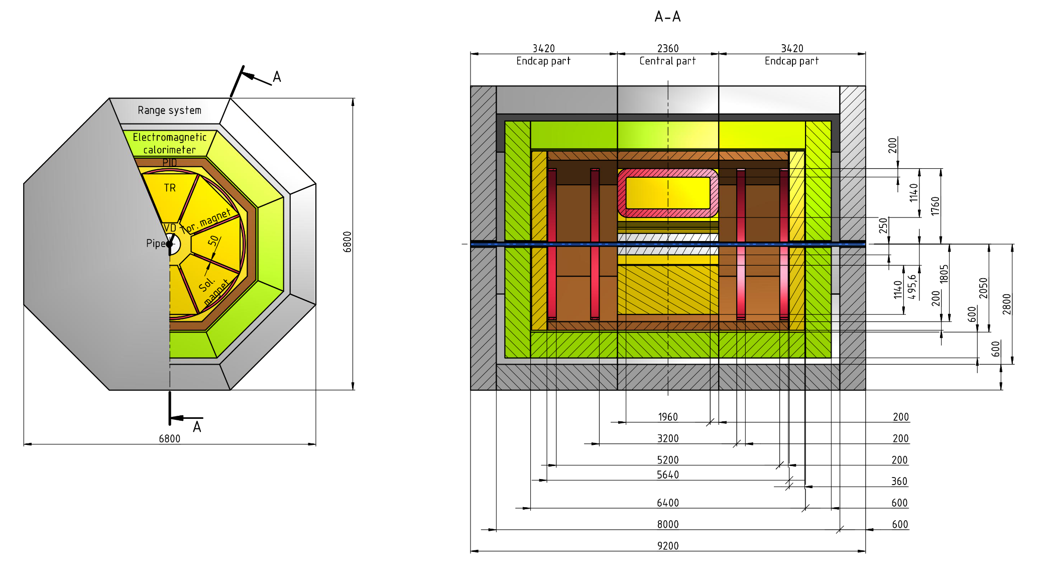
Dimensions

Slide 29
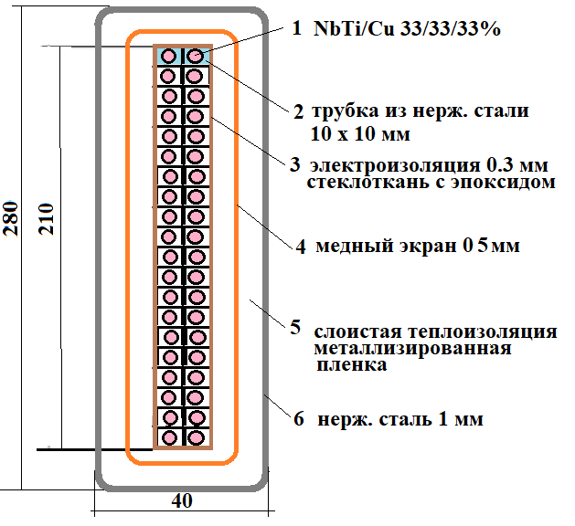
Hybrid magnetic system
stainless steel tube
insulation epoxy
layer, 0.3 mm
copper shield
multilayer thermal shield
outer cover,
1mm stailess steel

Slide 30


Reconfigurable design

Slide 31


Beam-beam interaction and t0 counters

Slide 32


Vertex detector / Inner tracker
Silicon Vertex Detector
Silicon vertex detector around the beam pipe;
Several layers of double ­sided silicon strips and MAPS;
Optimized number of layers w.r.t. material budget;
Goal: few tens of µm resolution for the vertex reconstruction → detection of particles with open charm and rejection of (π) decay muons.
From A. Zinchenko, MPD ITS with MAPS → open charm registration
mm
DSSD: 19.5 m²
MAPS: 3.5 m²
Notes:
32

Slide 33


Central tracker: straw tubes
Minimum material on the particle tracks (X₀ ~ 0.1);
Time (~ 100 ns) and spatial resolution (~100 μm);
Expected particle rates (DAQ rates) ~ MHz;
Technology developed also in JINR, production workshops available
Notes:
33
A.P.Nagaytsev, SPIN-2010, October 1, Juelich
33
33

Slide 34



Electromagnetic calorimeter
~6500 modules
Photon energy range 0.1 - 10 GeV;
Due to space limitations the total length of the ECAL module should be less than 50 cm;
Required energy resolution <10.0%/√E (GeV) and energy threshold below 100 MeV.
Design ("shashlik") similar of that for KOPIO
calorimeter,
Crystal variant is being considered, too.
Notes:
34
34
34

Slide 35



Range system
It should provide good (>95%) muon identification for momenta above 1 GeV.
Combination of responses from the ECal and RS could give additional lever for regecting of pions and protons in a wide energy range.
The RS also provides additional coordinate measurement.
Our design will follow closely the design of the PANDA experiment range system (at FAIR, GSI) being developed now at the DLNP of JINR
Notes:
35
35
35

Slide 36


Slide 37
DAQ
The SPD DAQ may be developed a la upgraded DAQ of the COMPASS experiment;
Event rate ~3.0 MHz (at L=10³² cm⁻²s⁻¹, √s=27 GeV);
Rough preliminary estimation of the total data flux from the detectors (Si tracker + straw tracker + PID + ECal + range system): 10-20 GBytes/s (no detailed simulation results available yet);
Triggered or trigger-less DAQ: to be decided.

Slide 38

Software and computing

Slide 39
Systems that have not been thought out yet…
System for particle ID (multigap glass RPCs, Micromegas, Aerogel Cherenkov?);
"Zero degree" system (fine grained hadron calorimeter?)
Front-end electronics of the different subsystems;
Notes:
39

Slide 40


Beam test facility

Slide 41
Collaborating institutions – 18 so far
  INFN section of Turin and University of Turin;
  Charles University, Prague;
  Technical University, Prague
  Tomsk State University;
  Tomsk Polytechnic University;
  Institute of Applied Physics of the Belarus Academy of Sciences;
  Gomel State Technical University, Belarus;
  Institute for High Energy Physics, Protvino;
  Institute of Nuclear Physics of the Moscow State University;
  Institute for Nuclear Research of the RAS, Troitsk;
  Lebedev Physics Institute of the RAS, Moscow;
  Institute for Theoretical and Experimental Physics, Moscow;
  St. Petersburg Nuclear Physics Institute, Gatchina;
  St. Petersburg State University;
  St. Petersburg Polytechnic University;
  Instituto Superior de Tecnologías y Ciencias Aplicadas (INsTEC), Havana University;
  Warsaw University of Technology;
  Samara National Research University
Protocols for joint research within the SPD project signed.
EoI letters received
Bilateral agreements on NICA exist.

Slide 42
Roadmap
JINR project for the SPD design (Jan. 2019);
Setting up of the collaboration, MoU (2019);
Preparation of the Conceptual Design Report (2019);
Preparation of the Technical Design Report, including prototyping (2020-2022).
Construction of the detector would take at least three years (2022-2025) and first measurements could be expected as early as close to the end of 2025…

Slide 43



http://SPIN-Praha-2018
You are welcome
to join the SPD/NICA project!
Web site: spd.jinr.ru.
Contact person: Roumen Tsenov (tsenov@jinr.ru)
http://indico.jinr.ru/event/SPD-NICA-2019
Notes:
43
43

Slide 44


SPD/NICA will provide a unique opportunity
not available at other facilities
to study all of the PDFs in one experiment
and obtain comprehensive information
on the nucleon spin structure
at high statistical level
with minimal systematic uncertainties

Slide 45
Back-ups

Slide 46

Year 2014

Slide 47




Spin and 3D structure of hadrons
Spin puzzle: small contribution of quarks (may be fractional because of density matrix rather than wave function description) to the proton spin
The deficit may be due to:
1.Gluon average spin ΔG, and
2.Orbital motion L related to transverse (completing to 3D) structure of proton
All ingredients can be explored at SPD!
Main instrument: transverse spin asymmetries
The simplest transverse asymmetry : left-right; more involved: azimuthal modulations

Slide 48



Kinematics
COMPASS
SPD

Slide 49


Unpolarised Drell-Yan
Boer-Mulder
Boer-Mulder
“Naïve” Drell-Yan model
Collinear ($k_{T}$= 0) LO pQCD no rad. processes
Intrinsic transverse motion + QCD effects
Experimentally observed large ν
and violation of the LT-relation

Slide 50





DY UA: NA10 vs SPD
In 6 bins
SPD dA $≈$ 0.02
with $\left\langle P_{beam 1,2}\right\rangle =1.0$ SPD dA $≈$ 0.008

Slide 51
Resources
Форма 29
NN пп | Наименование статей затрат | Полная стоимость | 2019 | 2020 | 2021
1. | Ускоритель, часы | 2100 | - | 700 | 1400
2. | Конструкт. бюро, нормо-часы, | 12250 | 4000 | 4000 | 4250
3. | Опытное пр-во, нормо-часы | 12700 | 4700 | 4000 | 4000
4. | Материалы, тыс. долл. | 850 | 445 | 205 | 200
5. | Оборудование, тыс. долл. | 920 | 465 | 235 | 220
6. | Оплата НИР, тыс. долл. | 280 | 105 | 105 | 70
7. 8. | Команд. расходы, тыс. долл., в т. ч. а) в страны не рублёвой зоны б) в страны рублевой зоны По протоколам о сотрудничестве | 285 225 60 120 | 95 75 20 30 | 95 75 20 40 | 95 75 20 50
 | Итого по прямым расходам, тыс. долл. | 2455 | 1140 | 680 | 635

Slide 52
Ресурсы по подсистемам
 | Ускоритель,часы | КБ, часы | ОП, часы | Материалы, k$ | Оборуд., k$ | НИР, k$ | Итого, k$
Калориметр |  | 800 | 800 | 25 | 25 | 20 | 70
Мюонная система |  | 1000 | 1000 | 135 | 135 | 10 | 280
Идентификация частиц |  | 1000 | 1000 | 15 | 15 | 40 | 70
Магнит |  | 2000 | 2000 | 15 | 15 | 100 | 130
Трекер |  | 1000 | 500 | 135 | 135 | 20 | 290
Вершинный детектор |  | 1500 | 1500 | 250 | 250 |  | 500
Система сбора данных |  |  |  |  | 70 |  | 70
Компьютинг |  |  |  |  | 30 |  | 30
Тестовая зона | 1800 | 3500 | 4000 | 250 | 250 |  | 500
Локальная поляриметрия | 300 | 1100 | 1100 | 105 | 105 | 50 | 260
Станция мечения |  | 350 | 800 | 20 | 20 | 40 | 80
2100 ч. 12250ч. 12700ч. 850 k$ 920 k$ 280 k$ 2050 k$
ИТОГО из бюджета лаборатории: 2050 k$ + 285 k$ (МНТС) = 2335 k$

Slide 53
JINR participation:
112 authors, 37.7 FTE
Laboratory of High-Energy Physics
  authors: 74
  FTE: 24.4
Laboratory of Nuclear Problems
  authors: 30
  FTE: 11.3
Laboratory of Theoretical Physics
  authors: 6
  FTE: 2
Directorate (1), Laboratory of Information Technologies (1)

