Slide 1
Measurement and control of absolute luminosity at the NICA
A.G.Litvinenko^{1,3,*}
*alitvin@jinr.ru
A.B.Kurepin², E.I.Litvinenko¹, V.F.Peresedov¹, M.Cruceru⁴, Z.Igamkulov¹
¹JINR,Dubna, Russia
²INR RAS, Moscow, Russia
³Dubna State University, Dubna, Russia
⁴ IFIN-HH, Bucharest, Romania

Slide 2
Definition
Absolute Luminosity $\left(L\right)$
$$\frac{dR}{dt}=L σ$$
number of events
per second
$$\dim\left(L\right)={cm}^{−2}s^{−1}$$
cross section

Slide 3
Definition
Relative Luminosity ($L_{r}$)
$$\frac{dR}{dt}=k L_{r} σ$$
number of events
per second
$$\dim\left(L_{r}\right)={cm}^{−2}s^{−1}$$
cross section
$$\dim\left(k\right)=1;k −unknown const$$

Slide 4
Knowledge of absolute luminosity is necessary for the following tasks:
When planning the measurements - to calculate the counting rate.
When planning the experiment - to calculate the overlay of signals from different events (pile-up events).
To calculate the absolute value of cross section from experimental data.
To make differential measurements.
…………

Slide 5
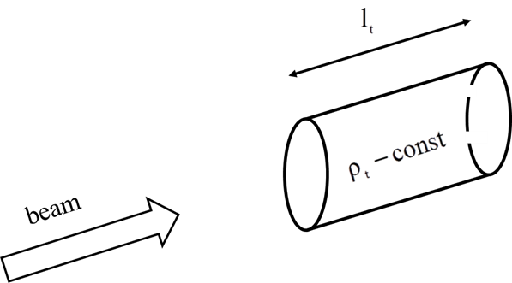
Fixed target luminosity
$$\frac{dR}{dt}=\left[N_{bm}\left(N_{A}\frac{ρ\left(g∙{cm}^{−3}\right)l_{t}\left(cm\right)}{A_{t}}\right)D\right]σ({cm}^{2})$$
${dR}/{dt}$ - counting rate
$N_{bm} −$numbers of particles per burst
$N_{A} −$Avogadro number
$ρ\left(…\right)$- the target density
$l_{t}\left(…\right)$ - the target length for the beam
$A_{t}$ - the target atomic mass
$D$ - duty cycle

Slide 6
Fixed target luminosity
$L=N_{bm}N_{A}\frac{{ρ\left(g/{{cm}^{3}}\right)l}_{t}\left(см\right)}{A_{t}}D$
Example
Nuclotron $D=0.1$ 1/s
$A_{t}=208$ (Pb)
$l_{t}$ = 0.1 cm
$N_{bm}$= ${10}^{10}$
$$L=3.3∙{10}^{30} {cm}^{−2}s^{−1}$$

Slide 7
Colliding beams luminosity
Z

Slide 8
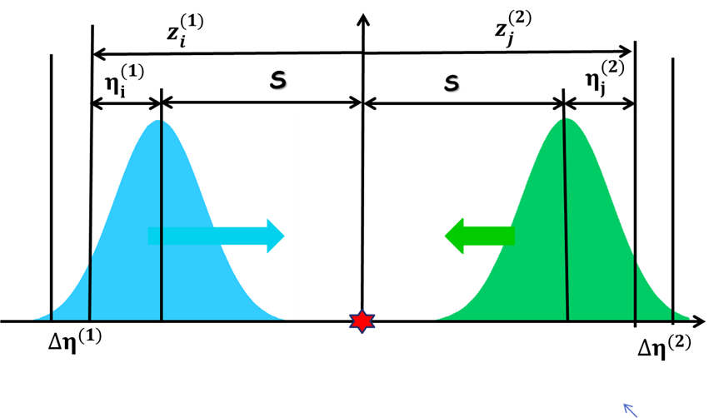
Colliding of two bunch.
$$\begin{aligned}z_{i}^{(1)}=s−η_{i}^{(1)} \\ z_{j}^{(2)}=−s+η_{j}^{(2)}\end{aligned}$$
$$z_{i,j}={\left(η_{i}^{(1)}−η_{j}^{(2)}\right)}/2$$
$z_{i}^{(1)}=z_{j}^{(2)}$
$$s_{i,j}={\left(η_{i}^{(1)}+η_{j}^{(2)}\right)}/2$$
$$p_{1,2}\left(x,y,z\right) ; \iiint{p_{1,2}\left(x,y,z\right)}dxdydz=1$$

Slide 9
Colliding of two bunches.
$$\begin{aligned}z_{i}^{(1)}=s−η_{i}^{(1)} \\ z_{j}^{(2)}=−s+η_{j}^{(2)}\end{aligned}$$
$z_{i}^{(1)}=z_{j}^{(2)}$
$$z_{i,j}={\left(η_{i}^{(1)}−η_{j}^{(2)}\right)}/2$$
$$s_{i,j}={\left(η_{i}^{(1)}+η_{j}^{(2)}\right)}/2$$
$$N_{1,2}^{coll}\left(σ\right) {=σ∙N}_{1}N_{2}\iint{dxdy\sum_{i}{\sum_{j}{p_{1}\left(x,y,η_{j}^{(1)};s\right){{∆η}_{i}^{\left(1\right) }p}_{2}\left(x,y,η_{i}^{(2)};s\right){∆η}_{j}^{\left(2\right) }}}}$$
convenient variables
$\left\{\begin{aligned}η^{(1)}=ξ+u \\ η^{(2)}=ξ−u\end{aligned}\right.$
$$\left\{\begin{aligned}ξ ={\left(η^{(1)}+η^{(2)}\right)}/2 \\ u={\left(η^{(1)}−η^{(2)}\right)}/2\end{aligned}\right.$$
$$\left|\frac{∂\left(η^{(1)}η^{(2)}\right)}{∂\left(u,ξ\right)}\right|=2$$
$$N_{1,2}^{coll}\left(σ\right)={2∙σ∙N}_{1}N_{2}\iint{dxdy}\iint{dudξp_{1}\left(x,y,u−ξ\right)p_{2}\left(x,y,u+ξ\right)}$$

Slide 10
Colliding of two bunches. Luminosity.
. $L_{1,2}={2∙N}_{1}N_{2}f\iint{dxdy}\iint{dudξp_{1}\left(x,y,u−ξ\right)p_{2}\left(x,y,u+ξ\right)}$
$$S_{eff}=1/{\left(2\int_{−∞}^{+∞}{dx\int_{−∞}^{+∞}{dy\int_{−∞}^{+∞}{du\int_{−∞}^{+∞}{dξ}}}}p_{1}\left(x,y,u−ξ\right)p_{2}\left(x,y,u+ξ\right)\right)}$$
$$L_{1,2}= {\left(N_{1}N_{2}f\right)}/{S_{eff}}$$
f$≅0.587 MHZ$ — revolution frequency

Slide 11
Normal (Gauss) distribution
$$p_{(1,2)}\left(x,y,η^{(1,2)};z^{(1,2)}\right)={ p}_{x,(1,2)}(x)∙ p_{y,\left(1,2\right)}(y)∙p_{z,\left(1,2\right)}(η^{(1,2)})$$
$$\left\{\begin{aligned}p_{x,\left(1,2\right)}\left(x\right)=\left(1/{(\sqrt{2π}σ_{x,\left(1,2\right)})}\right)exp⁡(−{x^{2}}/{(2σ_{x,\left(1,2\right)}^{2})} \\ p_{y,\left(1,2\right)}\left(y\right)=\left(1/{(\sqrt{2π}σ_{y,\left(1,2\right)})}\right)exp⁡(−{y^{2}}/{(2σ_{y,\left(1,2\right)}^{2})} \\ p_{z,\left(1,2\right)}\left(η^{(1,2)}−z^{(1,2)}\right)=\left(1/{(\sqrt{2π}σ_{z,\left(1,2\right)})}\right)exp⁡(−{{(η^{(1,2)})}^{2}}/{(2σ_{z,\left(1,2\right)}^{2})}\end{aligned}\right.$$
$${ L}_{1,2}= {\left(N_{1}N_{2}f\right)}/{\left(2π\sqrt{σ_{x,1}^{2}+σ_{x,2}^{2}}\sqrt{σ_{y,1}^{2}+σ_{y,2}^{2}}\right)}$$
$$S_{eff}= 2π\sqrt{σ_{x,1}^{2}+σ_{x,2}^{2}}\sqrt{σ_{y,1}^{2}+σ_{y,2}^{2}}=4πσ_{x}σ_{y}$$

Slide 12
Relative Luminosity ($L_{r}$)
Counting rate for reaction with unknown cross section
or/and unknown detector efficiency
$${dR}/{dt}=ε_{D }∙\tilde{σ}∙L=σ_{c}L_{r};$$
$$L_{r}=k∙L;k={\left(ε_{D }\tilde{σ}\right)}/{σ_{c}}$$
Knowledge of relative luminosity is often enough to calculate physical quantities from measured experimental data. For example, when measuring polarization observables, for a given reaction, it is sufficient to know the relative luminosity.
BUT … SEE NEXT SLIDE

Slide 13
relative and absolute luminosity
Without knowledge of absolute luminosity, it is impossible to make ’difference’ measurements. For example, studying the analyzing power
$A_{y }\left(n↑+d=π+X\right)$
for neutron scattering from measurements on beams of polarized deuterons and protons
A.G. Litvinenko, «The possibility of studying polarization observables in reactions of the production of pions by polarized beams of protons and deuterons at the JINR LHEP»,
EPJ Web of Conferences 204, 05004 (2019)

Slide 14
Approaches to luminosity determination
I.
From the experimental data for the counting rate of some reaction
$$\frac{dR}{dt}=L \left(σε\right) →{L= \frac{dR}{dt} }/{\left(σε\right)}$$
II.
From theoretical calculations based on the distribution of particles in bunches
$$L_{1,2}={2∙N}_{1}N_{2}f\iint{dxdy}\iint{dudξp_{1}\left(x,y,u−ξ\right)p_{2}\left(x,y,u+ξ\right)}$$
III.
Combined method (van der Meer scan (Vernier scan)):
a) measurement of the counting rate in some special conditions;
b) calculations involving the equation for calculating luminosity using particle distribution.

Slide 15
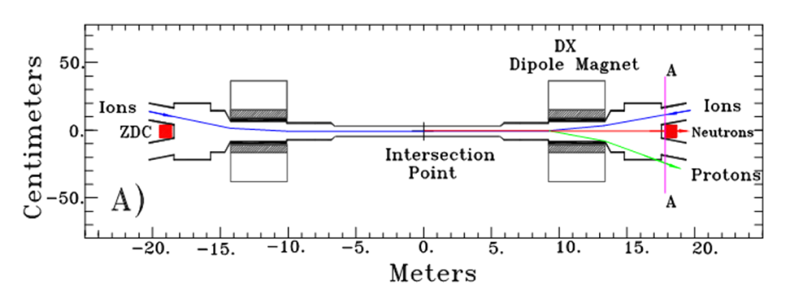
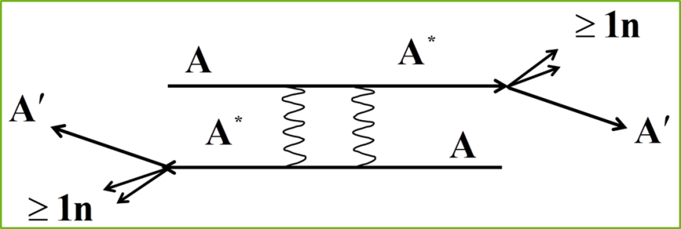
I. From the data for the counting rate
Requirements:
Well known scattering cross section;
Detector with well-known efficiency.
Question:
"Are there any cases of using this method on hadron colliders?"
Answer:
"Yes. RHIC for Au + Au for the mutual electromagnetic dissociation of Au and ZDC."

Slide 16
I. From the data for the counting rate
NICA features:
large energy range $\sqrt{S_{NN}}=4 GeV ÷$11 GeV;
wide range of accelerated nuclei (p -- Au)
In such conditions it is difficult (impossible) to find
reaction (reactions) with a well-known cross section and it’s not easy to create a detector with well-known efficiency

Slide 17
II. From theoretical calculations based on the distribution of particles in bunches
$$L_{1,2}={2∙N}_{1}N_{2}f\iint{dxdy}\iint{dudξp_{1}\left(x,y,u−ξ\right)p_{2}\left(x,y,u+ξ\right)}$$
A precise beam diagnostics system is required.
I am not ready to discuss this opportunity.
But an alternate source of information about the absolute luminosity is needed

Slide 18
III. absolute luminosity
S. van der Meer, CERN-ISR-PO-68-31, 1968
van der Meer scan
at RHIC and LHC the van der Meer scan is commonly accepted procedure for calibration

Slide 19
III. absolute luminosity
van der Meer scan
algorithm
Selection of the reaction and the corresponding detector.
Measurements for different distances between bunches in the transverse plane (van der Meer scan)
Scan data processing. Get constants to calculate absolute luminosity

Slide 20
III. absolute luminosity
van der Meer scan
Suppose that a reaction is chosen, a detector is created, and measurements for a van der Meer scan are performed.
convenient to use normalized counting rate
$\frac{dr_{1,2}\left(δX,δY\right)}{dt}= {\left(\frac{dR_{1,2}\left(δX,δY\right)}{dt}\right)}/{\left(N_{1}N_{2}f\right)}$
$$\frac{dR_{1,2}\left(δX,δY\right)}{dt}=\left(σε\right){2∙N}_{1}N_{2}f\iint{dxdy}\iint{dudξp_{1}\left(x,y,u−ξ\right)p_{2}\left(x+δX,y+δY,u+ξ\right)}$$
$$\frac{dr_{1,2}\left(δX,δY\right)}{dt}=\left(σε\right)2\iint{dxdy}\iint{dudξp_{1}\left(x,y,u−ξ\right)p_{2}\left(x+δX,y+δY,u+ξ\right)}$$
$$\iint{\frac{dr_{1,2}\left(δX,δY\right)}{dt}dδXdδY=\left(σε\right)2\iint{dδXdδY\left(\iint{dxdy}\iint{dudξp_{1}\left(x,y,u−ξ\right)p_{2}\left(x+δX,y+δY,u+ξ\right)}\right)}}$$

Slide 21
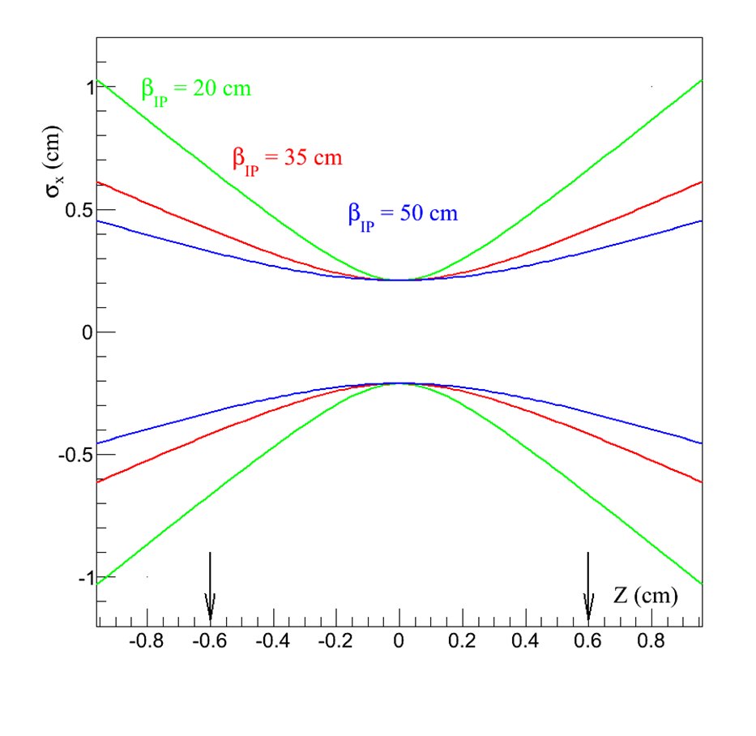
Focusing when crossing beams. Hourglass effect.
$$\left\{\begin{aligned}p_{x}\left(x\right)=\left(1/{(\sqrt{2π}σ_{x}\left(z\right))}\right)exp⁡(−{x^{2}}/{(2σ_{x}^{2}(z))} \\ p_{y}\left(y\right)=\left(1/{(\sqrt{2π}σ_{y}\left(z\right))}\right)exp⁡(−{y^{2}}/{(2σ_{y}^{2}(z))} \\ p_{z}\left(z\right)=\left(1/{(\sqrt{2π}σ_{z})}\right)exp⁡(−{z^{2}}/{\left(2σ_{z}^{2}\right)})\end{aligned}\right.$$
$$σ_{x}(z)= σ_{x}(0)\sqrt{\left(1+{\left(z/{β_{IP}}\right)}^{2}\right)}$$

Slide 22
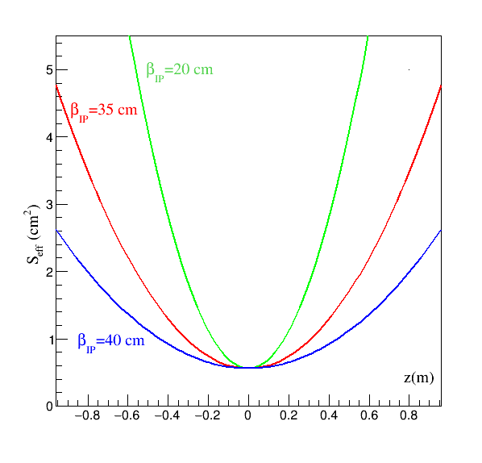
Focusing when crossing beams. Hourglass effect.
most common distribution
$$\left\{\begin{aligned}p\left(x,y,z\right)=p_{x,y}(x,y;z)∙p_{z}\left(z\right) \\ \iint{{dxdyp}_{x,y}(x,y;z)}=1 \\ \int{dz∙p_{z}\left(z\right)}=1\end{aligned}\right.$$
$$S_{eff,(⊥)}\left(z\right)=1/{\iint{dxdyp_{x,y}(x,y;z)}}p_{x,y}(x,y;z)$$

Slide 23
III. absolute luminosity
van der Meer scan
Scan data processing.
$$\begin{matrix}\iint{\iint{dxdydδXdδYp_{x,y}\left(x,y;z\right)∙p_{x,y}\left(x+δX,y+δY;z\right)=}} \\ \iint{\iint{dxdyd\tilde{x}d\tilde{y}p_{x,y}\left(x,y;z\right)∙p_{x,y}\left(\tilde{x},\tilde{y};z\right)=}} \\ \left(\iint{dxdy}p_{x,y}\left(x,y;z\right)\right)∙\left(\iint{d\tilde{x}d\tilde{y}}p_{x,y}\left(\tilde{x},\tilde{y};z\right)\right)=1\end{matrix}$$
$$2\iint{\left(dudξ\left(\iint{\iint{dxdydδXdδYp_{x,y}\left(x,y;z\right)∙p_{x,y}\left(x+δX,y+δY;z\right)}}\right)p_{z}\left(u+ξ\right)p_{z}\left(u−ξ\right)\right)=1}$$
$$\iint{\frac{dr_{1,2}\left(δX,δY\right)}{dt}dδXdδY=\left(σε\right)}$$
$\frac{dR_{1,2}\left(0,0\right)}{dt}={\left(\iint{\frac{dr_{1,2}\left(δX,δY\right)}{dt}dδXdδY}\right)}_{vdM}L$

Slide 24
III. absolute luminosity
$$L=\frac{\frac{dR_{1,2}\left(0,0\right)}{dt}}{{\left(\iint{\frac{dr_{1,2}\left(δX,δY\right)}{dt}dδXdδY}\right)}_{vdM}}$$

Slide 25
DETECTOR
scintillation detector
Ring№ | Distance to IP (L) | Overlapping area | Square | Thickness
1 | 300 cm | $$R_{1}=7 cm≤r≤R_{2}=11cm$$ | $$S_{1}=226.2 {cm}^{2}$$ | 0.5 cm
2 | 300 cm | $$R_{3}=11.3 cm≤r≤R_{4}=15.3cm$$ | $$S_{2}=343.3 {cm}^{2}$$ | 0.5 cm
3 | 300 cm | $$R_{5}=15.6 cm≤r≤R_{6}=19,6cm$$ | $$S_{3}=442.3 {cm}^{2}$$ | 0.5 cm
4. | 300 cm | $$R_{7}=19.9 cm≤r≤R_{8}=24 cm$$ | $$S_{4}=565.4 {cm}^{2}$$ | 0.5 cm

Slide 26
REACTIONS
pp elastic scattering
Ring № | $${dR}/{dt (s^{−1})};L={10}^{30}{cm}^{−2}s^{−2}$$
$$\sqrt{S_{pp}}=8 GeV$$
1 | $$1∙{10}^{3}$$
2 | $$1.3∙{10}^{3}$$
3 | $$1.4∙{10}^{3}$$
4 | $$1.3∙{10}^{3}$$
$$\sqrt{S_{pp}}=22 GeV$$
1 | $$3.2∙{10}^{3}$$
2 | $$1.4∙{10}^{3}$$
3 | $$320$$
4 | $$46$$

Slide 27
REACTIONS
AuAu spectators protons
$$σ\left(AuAu;2 fm ≤b≤12 fm\right)=σ\left(AuAu\right){\left(\frac{12}{14}\right)}^{2}\left(1.−{\left(\frac{2}{12}\right)}^{2}\right)∙=4.4 b$$
M. B. Golubeva et.al. ,// Physics of Atomic Nuclei, 2013, 76, No. 1, p. 1,(2013)
$$\begin{matrix}L={10}^{27}{cm}^{−2}s^{−2} \\ {\left({dR}/{dt(2 fm ≤b≤12 fm)}\right)}_{AuAu}≥4400\frac{1}{s} \end{matrix}$$

Slide 28
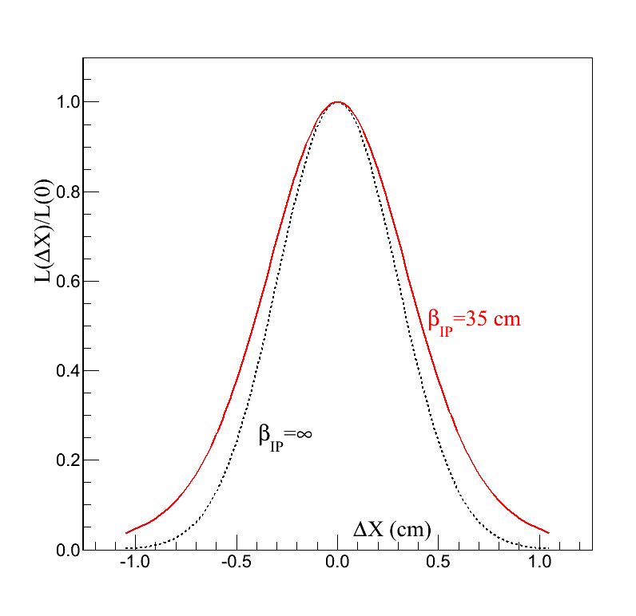
van der Meer scan
Luminosity vs transverse beam separation

Slide 29
Background coming from interaction with residual gas and elements of the collider is absent because of the kinematic restrictions.
$$p_{b}$$
$$p_{t}=0$$
$$p_{b}$$
$$p_{b}$$
X
+
+
+
$$\sqrt{S_{NN}}=11 GeV →\sqrt{{\tilde{S}}_{NN}}= \sqrt{2∙m_{N}\left(E_{b}+B\right)}\text{=3.5 }\text{GeV}$$
$$M_{pp}\left(pp\right)=11 GeV$$
$$X_{c}≥20$$
$${background}/{signal ≤}{10}^{−60}$$

Slide 30
The conclusions
A detector and algorithm for measuring the absolute luminosity is proposed.
It is shown that the counting rate of the detector makes it possible to detect more than 10000 events per minute for proton-proton and gold-gold collisions.
The detector is compact, lightweight and can operate both independently and as part of a large detector.

Slide 31
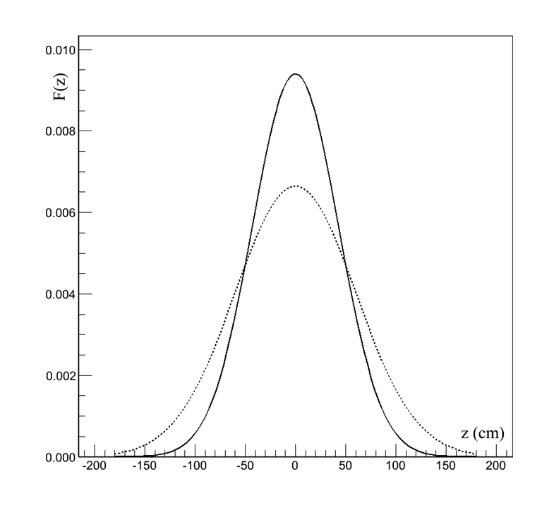
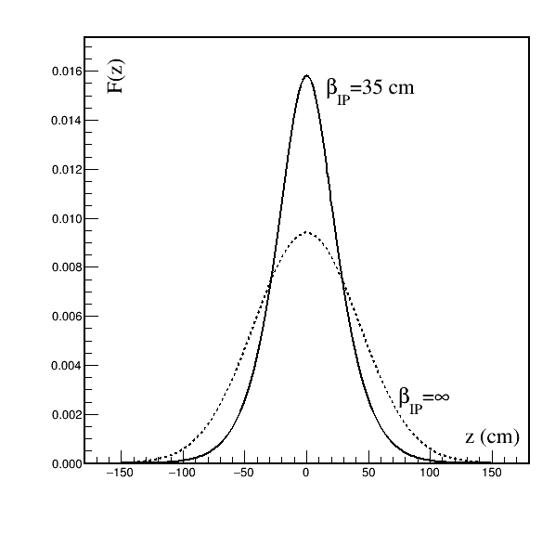
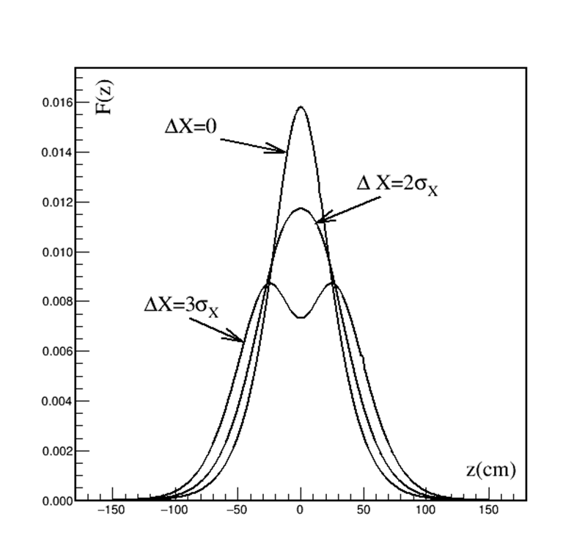
Can van der Meer scan be used with other detectors?
Yes. Not only can but should.
Additional detectors, additional observables.
For example, the distribution of vertices.
Solid line -distribution of vertices
without focusing ${ σ}_{z,V}=42.3 cm$
dotted line - distribution of particles
without focusing ${ σ}_{z,V}=60 cm$
Solid line -distribution of vertices
with focusing ${ σ}_{z,V}=28.9 cm$
dotted line -distribution of vertices
with focusing ${ σ}_{z,V}=42.3 cm$

Slide 32
many bunches luminosity
L$={2∙N}_{1}N_{2}f\left(N_{b}\right)\iint{dxdy}\iint{dudξp_{1}\left(x,y,u−ξ\right)p_{2}\left(x,y,u+ξ\right)}$
$N_{b}$ - number of bunches in one ring

Slide 34
Backup slides

Slide 35
$$S=∆x∙∆y$$
$$P=\frac{σ}{S}N_{1}N_{2}$$
$$S$$
$$∆y$$
$$∆η_{}^{1}$$
$$∆x$$
$$∆y$$
$$N_{1/2}=n_{1/2}∆x∙∆y∙∆{η }^{1/2}$$
$$∆x$$
$$∆η_{}^{2}$$

Slide 36
DETECTOR
Оne shoulder detector:
dimensions $R_{max}=24 cm; ∆Z≤3 cm$;
volume scintillator $V_{sc}≤0.9∗3=2.7 {cm}^{3}$;
scintillator weight $P_{sc}$ $≤0.9∗3=2.7$ kg;
total thickness ${∆Z}_{tot}≤5 cm$
total weight $P_{tot}$ $≤4$ kg;
$∆Z≤0.05 λ_{int}$
price 3 -4 K$
total price (3-4)х6=(18-24) K$

Slide 37
elastic scattering cross section
И.М.Дрёмин, «Упругое рассеяние адронов», УФН, 183, No.1, (2013)
V.A.Okorokov, arXiv :0811.0895v2 [hep-ph], (2008)
$$\frac{dσ}{dT}=σ_{el}∙B∙exp⁡(B∙T)$$
$$σ_{el}≅10 mb$$
$$T={(P_{b}−P^{′})}^{2}=−2p_{b}^{2}\left(1−cos\left(θ\right)\right)≅−p_{b}^{2} θ^{2}$$

Slide 38
van der Meer scan. Vertex distribution

Slide 39
Background coming from interaction with residual gas and elements of the collider is absent because of the kinematic restrictions.
$$p_{b}$$
$$p_{t}=0$$
$$p_{b}$$
$$p_{b}$$
X
+
+
+
$$\sqrt{S_{NN}}=11 GeV →\sqrt{{\tilde{S}}_{NN}}= \sqrt{2∙m_{N}\left(E_{b}+B\right)}\text{=3.5 }\text{GeV}$$
$$M_{pp}\left(pp\right)=11 GeV$$
$$X_{c}≥20$$
$${background}/{signal ≤}{10}^{−60}$$

Slide 40
Background coming from pile-up.
X
{
n
+
+
X
n
+
+

Slide 41
Background coming from interaction with residual gas and elements of the collider is absent because of the kinematic restrictions.
X
n
n
+
+
+

Slide 42
Colliding beams luminosity
Z
Some factors affecting the luminosity
Bunch structure
Hourglass effect
…

Slide 43
vertex distribution
$$V\left(z\right)={2\int_{−∞}^{+∞}{dx\int_{−∞}^{+∞}{dy\int_{−∞}^{∞}{dξp_{1}\left(x,y,z−ξ\right)p_{2}\left(x,y,z+ξ\right)}}}}/{S_{eff}}$$
$$σ_{z}=60 cm$$
$$σ_{V}={σ_{z}}/{\sqrt{2}=}42.3 cm$$

Slide 44
Focusing when crossing beams. Hourglass effect.
$$\left\{\begin{aligned}p_{x}\left(x\right)=\left(1/{(\sqrt{2π}σ_{x}\left(z\right))}\right)exp⁡(−{x^{2}}/{(2σ_{x}^{2}(z))} \\ p_{y}\left(y\right)=\left(1/{(\sqrt{2π}σ_{y}\left(z\right))}\right)exp⁡(−{y^{2}}/{(2σ_{y}^{2}(z))} \\ p_{z}\left(z\right)=\left(1/{(\sqrt{2π}σ_{z})}\right)exp⁡(−{z^{2}}/{\left(2σ_{z}^{2}\right)})\end{aligned}\right.$$
$$σ_{x}(z)= σ_{x}(0)\sqrt{\left(1+{\left(z/{β_{IP}}\right)}^{2}\right)}$$

Slide 45
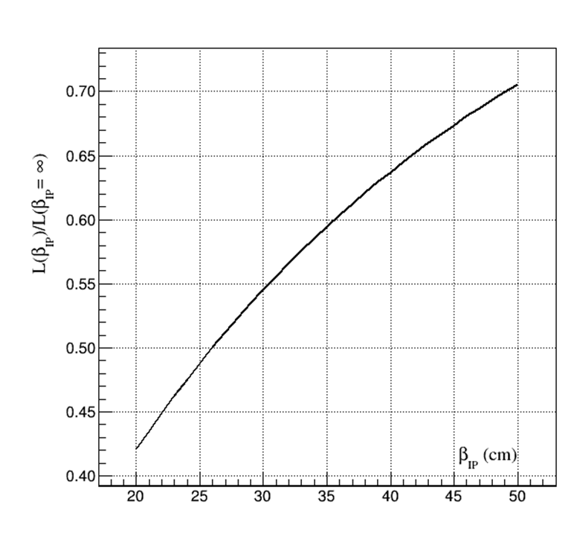
Focusing when crossing beams. Hourglass effect.

Slide 46
Hourglass effect. Vertex distribution
$$σ_{z}=60 cm$$
$$σ_{V}=42.3 cm$$
$${\tilde{σ}}_{V}=28.9 cm$$

Slide 47
Colliding of two bunch.
$N_{1,2}^{coll}\left(σ\right) {=σ∙N}_{1}N_{2}\int{\int{\int{\int{dxdydη^{(1)}dη^{(2)}}}}}p_{1}\left(x,y,η^{(1)};s\right)p_{2}\left(x,y,η^{(2)};s\right)$ .
$$N_{1,2}^{coll}\left(σ\right)={2∙σ∙N}_{1}N_{2}\iint{dxdy}\iint{dudξp_{1}\left(x,y,u−ξ\right)p_{2}\left(x,y,u+ξ\right)}$$

Slide 48
Background coming from pile-up.
X
{
n
+
+
X
n
+
+

Slide 49
Оценки для NICA: Длина кольца 503,4 м
Отсюда время для скорости света
Скорость для p=4.5 GeV/c β=0.9779
Частота обращения f=0.583 MHz
Отсюда находим площадь пересечения
Если же учесть изменение светимости за счёт бета функции, то исходная
светимость должна быть в 1/0.37 = 2.7 больше, что даёт:

Slide 50
Оценки для NICA: Длина кольца 503,4 м
Отсюда время для скорости света
Скорость для p=4.5 GeV/c β=0.9779
Частота обращения f=0.583 MHz
Отсюда находим площадь пересечения
Если же учесть изменение светимости за счёт бета функции, то исходная
светимость должна быть в 1/0.39 = 2.56 больше, что даёт:

Slide 51
Оценку поперечных размеров можно получить
опираясь на известный акксептанс и бета функцию.
Для параметров NICA:
Это даёт:

Slide 52
Fixed target luminosity
t
T=1/f
number of events per second

Slide 53
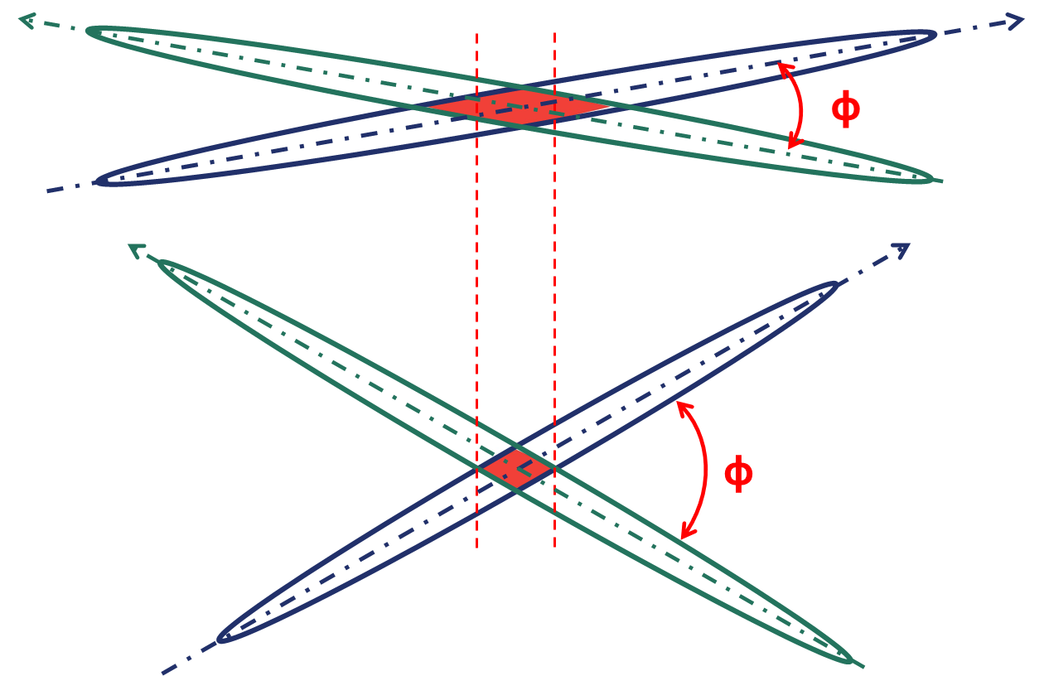
Colliding beams luminosity
non zero crossing angle
collision at non-zero angle is used to reduce the size of the interaction region
But non-zero angle of collision leads to a reduction of energy

Slide 54
Colliding beams luminosity
non zero crossing angle
Luminosity for Gaussian beam
C. Moller, K. Danske Vidensk. Selsk., Mat.-Fys. Medd., 23, 1 ,(1945)
or
M. A. Furmany, LBNL-53553, CBP Note-543, (2003)
LHC

Slide 55
$$δX$$

